Slide 1
War of 1812 DBQ
The War of 1812 has been seen as a forgotten war in American History. Do you believe this to be true, false, or somewhere in between? Utilize the following Documents to support of refute your stance.

Slide 2
Document 1
The United States declared War on Great Britain on June 12, 1812. The war was declared as a result of long simmering disputes with Great Britain. The central disagreement surrounded the impressment of American soldiers by the British. The British had previously attacked the USS Chesapeake and nearly caused a war two year earlier. In addition, disputes continued with Great Britain over the Northwest Territories and the border with Canada. Native American groups were being armed by the British to fight American settlers in these areas. Finally, the attempts of Great Britain to impose a blockade on France during the Napoleonic Wars was a constant source of conflict with the United States.
We behold our seafaring citizens still the daily victims of lawless violence, committed on the great common and highway of nations, even within sight of the country which owes them protection. We behold our vessels, freighted with the products of our soil and industry, or returning with the honest proceeds of them, wrested from their lawful destinations, confiscated by prize courts no longer the organs of public law but the instruments of arbitrary edicts, and their unfortunate crews dispersed and lost, or forced or inveigled in British ports into British fleets,
President James Madison’s War Message to Congress, June 1, 1812.

Slide 3
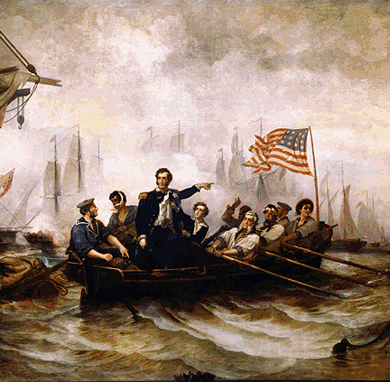
Document 2
Commodore Oliver Hazard Perry commanded the American fleet on the Great Lakes. He helped America win 9 battles in the area.
Capturing Fort George
Destroying the British ammunitions at Fort Erie
Rescuing five vessels from Black Rock
Building of the fleet at Erie
Getting the ships over the sandbar
Blocking British supplies on Lake Erie for a month prior to battle
Planning the Thames invasion with General Harrison
Winning the Battle of Lake Erie
Winning the Battle of Thames
The victory at the Battle of Thames brought an end to the British threat in the Northwest. Native American leader Tecumseh lost his life during the battle, disabling native resistance. He and his people had been fighting on the side of the British.

Slide 4
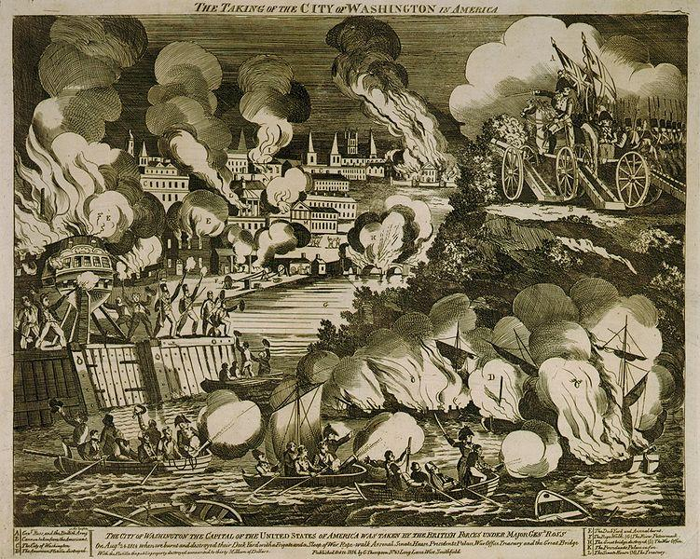
Document 3
The British Army occupied Washington, D.C. and set fire to many public buildings following the American defeat at the Battle of Bladensburg. The facilities of the U.S. government, including the White House and U.S. Capitol, were largely destroyed. This has been the only time since the Revolutionary War that a foreign power has captured and occupied the United States capitol.

Slide 5
Document 4
There shall be a firm and universal peace between His Britannic Majesty and the United States, and between their respective countries, territories, cities, towns, and people, of every degree, without exception of places or persons. All hostilities, both by sea and land, shall cease as soon as this treaty shall have been ratified by both parties, as hereinafter mentioned. All territory, places, and possessions whatsoever, taken by either party from the other during the war, or which may be taken after the signing of this treaty, excepting only the islands hereinafter mentioned, shall be restored without delay, and without causing any destruction or carrying away any of the artillery or other public property originally captured in the said forts or places, and which shall remain therein upon the exchange of the ratifications of this treaty, or any slaves or other private property.
Treaty of Ghent – ended the War of 1812.

Slide 6
Document 5
Effects of War
Increased Patriotism
Weakened
Native American Resistance
Growth of US Manufacturing

