Slide 1
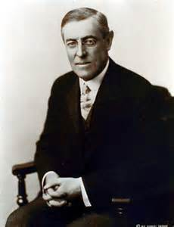
The Wilson Years
Progressive Era

Slide 2
Objectives
Describe Wilson’s economic and social reforms
Evaluate the legacy of the Progressive movement.

Slide 3
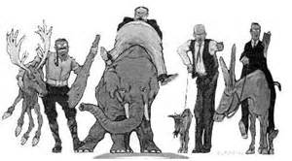
Woodrow Wilson
I. Election of 1912
A. Republican Party Divides
1. Taft = (R)
2. Roosevelt = (P)
B. Democratic Party
1. Wilson
a. Governor of NJ
C. Socialist Party
1. Eugene V. Debbs

Slide 4
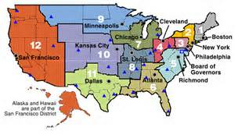
Wilson as President
II. Wilson as President
A. Reforming Tariffs
1. Underwood Tariff
a. cut tariffs by ½
b. income tax
-16th Amendment
B. Reforming Banks
1. Federal Reserve Act
a. Safeguard Economy by:
-control $ supply
-set interest rates

