Slide 1
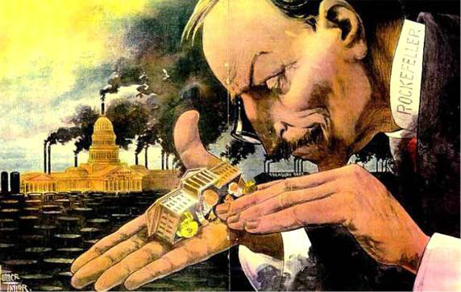
The Rise of Big Business
Chapter 6.2

Slide 2
Objectives
Analyze how large corporations came to dominate American business.
Evaluate how Andrew Carnegie’s innovations transformed the steel industry.

Slide 3
A New Capitalist Spirit
I. Capitalism
-economic system whereby private businesses run most industries, and competition drives costs and wages.
A. Economic Factors:
1. laissez-faire
a. supply/demand
2. entrepreneurs
3. investing
a. stock
B. Government Policy
1. Protective tariffs
2. Federal subsidies

Slide 4
Supporters of laissez-faire generally oppose federal subsidies and support..
Tariffs
High prices
Free trade
monopolies
:10

Slide 5
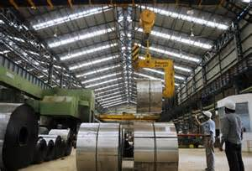
The Corporation
II. Corporations
A. Economies of Scale
-Corporations make goods more cheaply because they produce so much so quickly using large manufacturing.
B. Costs of a Business/Corporation
1. Fixed Costs
-Cost that is constant
2. Operating Costs
-Cost that is variable

Slide 6
What is an organization owned by many people but treated by law as though it were a single person?
a. a corporation
b. an organized pool
c. a holding company
d. a trust
:10

Slide 7
Loans, mortgages, and taxes are examples of a company’s
10
a. stock.
b. pools.
c. fixed costs.
d. operating costs.

Slide 8
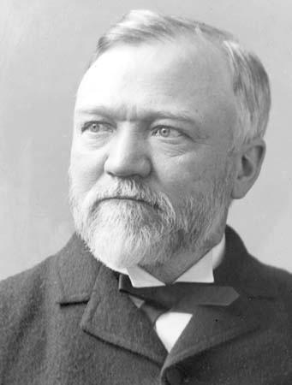
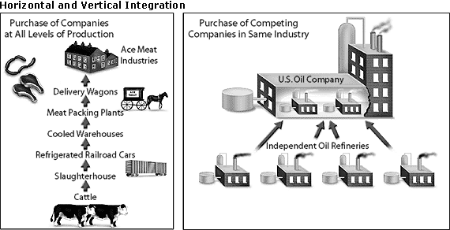
Big Business Entrepreneurs
III. Andrew Carnegie
A. Background
1. Immigrant Family (Scottish)
2. Investor – bridges, railroads, telegraph, oil
B. Steel Industry
1. Bessemer process
a. vertical integration
b. horizontal integration

Slide 9
Combining many firms engaged in the same type of business into one corporation is called
a. vertical integration.
b. a holding company.
c. horizontal integration.
d. a monopoly.
:10

Slide 10
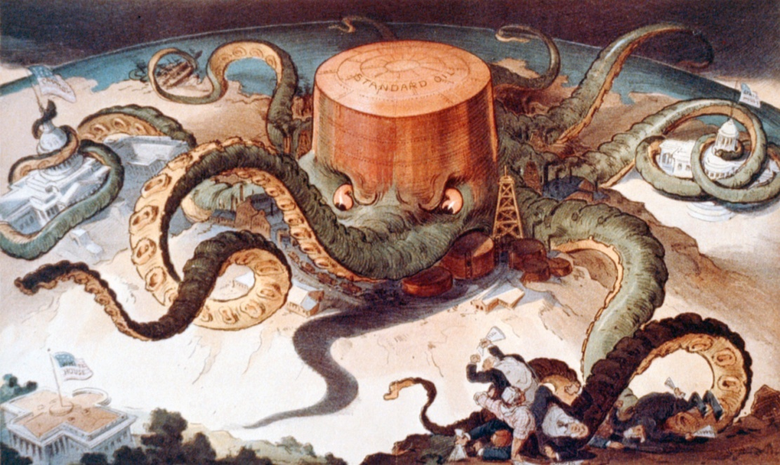
Big Business Entrepreneurs
IV. John D. Rockefeller
A. Standard Oil
1. horizontal integration
a. monopoly–single
company achieves
control of an entire
market

Slide 11
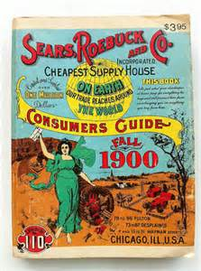
Mass Marketing
V. Marketing Products
A. Names & Packaging
B. Advertising
C. Mail Order Catalogs
D. Department Stores

Slide 12
Which Department store began as a mail order catalog?
10
Woolworths
Sears
Macy’s
J.C. Penny

Slide 13
Homework
Complete the “Crash Course Industrialization” video and questions

