Slide 1
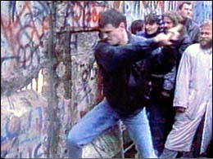
The End of the Cold War
Ch. 28.4

Slide 2
Objectives
Identify the events that brought an end to the Cold War
Explain the domestic challenges facing the Bush administration

Slide 3
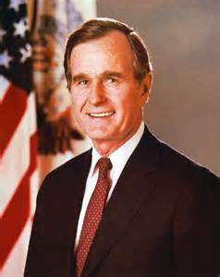
George Bush
I. George Bush
A. Background:
-WWII Veteran
-CIA Director
-Diplomat to China
-Reagan’s VP
II. The Cold War Ends
A. Gorbachev’s reforms
1. perestroika ”restructuring”
2. glasnost “openness”

Slide 4
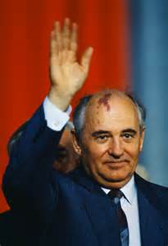
Revolution in E. Europe
B. Revolution in E. Europe
1. Fall of Communist regimes
-Poland, Hungary, Czechoslovakia, Romania, Bulgaria
2. Berlin Wall Falls
a. Nov. 9th, 1989
C. Soviet Union Collapses
1. Coup on Gorbachev (1991)
a. Boris Yeltsin
-outlaws Communist party

Slide 5
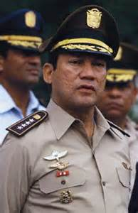
New World Order
IV. New World Order
A. Tiananmen Square
1. Chinese Students Protest
a. met with military opposition
B. Panama
1. General Manuel Noriega
-supported drug trafficking
*U.S. aids overthrow & elections

Slide 6
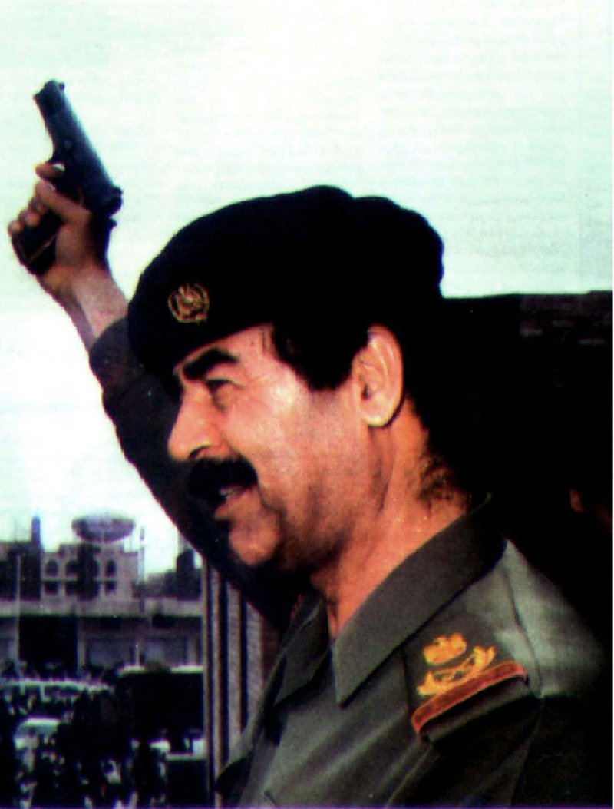
The Persian Gulf
C. Persian Gulf War
1. Saddam Hussein
a. Invades Kuwait
i. Bush organizes UN force
-attacks on Jan. 16, 1991
*Operation Desert Storm

Slide 7
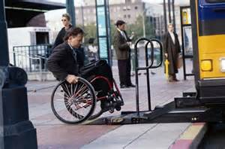
Domestic Challenges
V. Domestic Challenges
A. Slowing Economy
1. downsizing
B. Extending Rights
1. Americans with Disabilities Act

