Slide 1
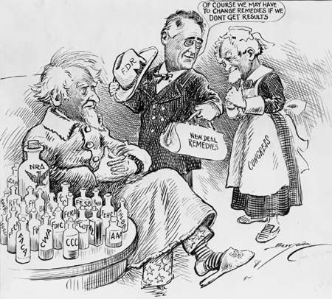
Second New Deal & Coalition

Slide 2
Second New Deal

Slide 3
Second New Deal
Second New Deal
A. Criticism
1. American Liberty League
2. Huey Long
3. Father Coughlin
4. Townsend Plan
B. Programs
1. WPA
*Congress resentment
C. Rise of Industrial Unions
1. NLRB
2. CIO
sit-down strikes
D. Social Security Act

Slide 4
Eleanor Roosevelt

Slide 5
Escaping the Dust Bowl

Slide 6
New Deal Coalition
II. New Deal Coalition
A. Roosevelt’s Second Term
1. Court-Packing Plan
a. “9 old men” – FDR
* number of Justices
B. Roosevelt Recession
1. Balance the Budget (1937)
a. $2billion for Soc. Security
b. Keynesianism
- deficit spending
C. Last New Deal Reforms
1. Nat’l Housing Act
2. Farm Security Administration
3. Fair Labor Standards Act

Slide 7
Legacy of the New Deal
D. Legacy of the New Deal
1. Broker State
a. increase of federal power in economy
-settle disputes through arbitration
2. Governments New Role
a. Gov. = Safety Net for Society
Homework = Crash Course “New Deal” Video and Questions

