Slide 1
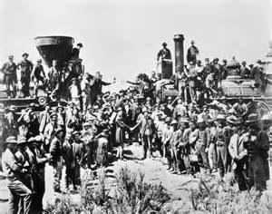
Railroads

Slide 2
Objectives
Discuss ways in which the railroads spurred industrial growth
Analyze how the railroads were financed and how they grew

Slide 3
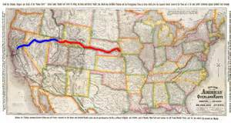
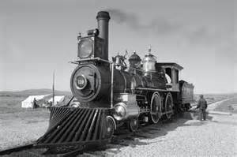
The Transcontinental Railroad
I. Linking the Nation
A. Pacific Railway Act
1. Transcontinental Railroad
a. Union Pacific
i. Omaha, Nebraska land grants
b. Central Pacific
i. Sacramento, California

Slide 4
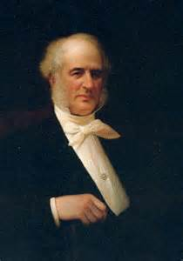
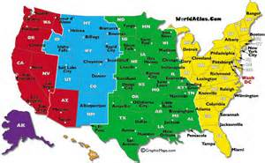
Struggle to Organize
II. Linking Lines
A. Problem→ 400 rail lines
Solution→ Consolidation
1. Cornelius Vanderbilt
a. New York Central
-Grand Central Station
B. Problems in Scheduling
1. Differing Local Times
a. Time Zones
*Formed a more homogenous society

Slide 5
Homework
Read Pages
209-215

