Slide 1
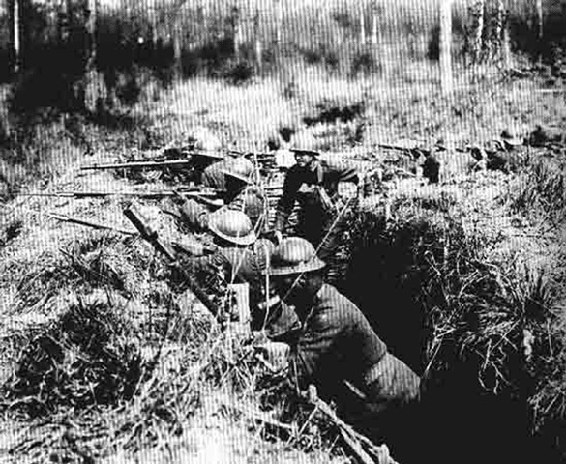
OGT – WWI & Onset of WWII
Getting down to crunch time!

Slide 2
Causes for the War
Imperialism – nations raised tariffs against one another during industrialization and decreased economic dependences
Nationalism – European nations began to focus on self-determination based on shared cultural distinctions
Militarism – Nations began building large scale modern militaries
Alliances – Nations began joining militarily with similar political/cultural nations

Slide 3
OGT Short Answer Question
Historians often cite the harshness of the Treaty of Versailles on Germany as a primary cause of the eventual outbreak of World War II. Summarize two provisions of the Versailles Treaty relating to Germany and discuss how each helped lead to World War II. Write your answer in the Answer Document. (4 points)

Slide 4
The League of Nations was created after World War I as a forum for resolving international conflicts. However, the League was unable to resolve tensions that led to World War II. One factor that contributed to the ineffectiveness of the League was the
:15
breakup of colonial empires in Africa and Asia.
decision of the United States not to join the League.
opposition of League members to the Treaty of Versailles.
rise of the Cold War between the United States and the Soviet Union.

Slide 5
After World War I, the League of Nations was created to help resolve international conflicts before they led to war. What did Japan’s successful invasion of Manchuria in 1931 indicate about the ability of the League of Nations to prevent World War II?
:15
The League had little power to stop acts of aggression.
The League was concerned only with disputes in Europe.
The League’s army was unprepared for modern warfare.
The League was led by countries with the weakest military forces.

Slide 6
Britain and France suffered heavy casualties during World War I. Because of this, when faced with Axis expansion before World War II, these countries were
:15
Unwilling to take actions that might start another war.
prepared to use military intervention wherever necessary.
dependent on the United States to intervene in an international crisis.
reluctant to call upon the League of Nations to settle disputes.

Slide 7
The Weimar Republic was established in Germany following World War I. An important factor leading to the collapse of the Weimar Republic and the rise of Nazi dictatorship that took Germany into World War II was
:15
Germany’s resentment of U.S. involvement in European affairs.
the rise of independence movements in Germany’s overseas colonies.
Germany’s failure to rebuild its armed forces following World War I.
the economic burden of war reparations (payments) to Germany’s former enemies.

Slide 8
During World War I, two revolutions took place in Russia while Russia was at war with Germany. Vladimir Lenin, leader of the Bolshevik Revolution, said: There can be no doubt that our army is absolutely in no condition... to beat back a German offensive successfully. ... Source: V. I. Lenin, Collected Works, 4th English Edition, Progress Publishers, Moscow, 1964, p. 447. The excerpt above could be used to support the thesis that
:15
Lenin had few skills as a military leader
Russia shared in the responsibility for World War I.
Lenin believed that Russia should withdraw from World War I.
The Bolshevik Revolution had the support of the Russian army.

Slide 9
After the Treaty of Versailles
I. Rise of Militarism& totalitarian States
A. Dictatorial Nations:
1. Japan – Hirohito (militaristic society)
2. Italy – Mussolini (Fascism)
3. Germany – Hitler (Fascism)
B. Expansion
1. Japan – Pacific Islands, China, Korea
2. Italy – Ethiopia
3. Germany – Sudetenland & Austria
Appeasement

