Slide 1
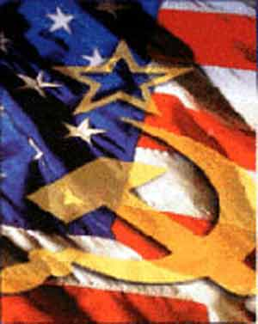
AIR TEST – The Cold War

Slide 2
In 1923, Adolf Hitler, the future leader of Nazi Germany, declared: The day must come when a German government shall summon up the courage to declare to the foreign powers: “The Treaty of Versailles is founded on a monstrous lie.” We fulfill nothing more. Do what you will! If you want battle, look for it! Source: Adolf Hitler, Speech of August 1, 1923, reprinted at www.nizkor.org This excerpt would help support which thesis?
:20
Hitler believed the League of Nations would help Germany.
Hitler believed Germany was responsible for starting World War I.
Hitler used German resentment toward the Treaty of Versailles to gain power.
Hitler wanted the World War I Allies to live up to what they promised in the Treaty of Versailles.

Slide 3
In 1942, President Roosevelt issued a series of executive orders that authorized the military to remove persons of Japanese ancestry from the West Coast and relocate them to internment camps. In 1982, a commission established by Congress to review the reasons for the relocation and internment found that the decisions were not justified by military necessity. Instead, the commission found that the decision to relocate and intern Japanese- Americans was the result of “race prejudice, war hysteria, and a failure of political leadership.” The commission findings reflect a change in views on what subject?
:20
the balance of power between Congress and the judiciary
the balance between individual rights and national security
the balance of power between the states and the federal government
the balance between freedom of the press and compelling government interest

Slide 4
As a result of the Versailles Treaty, Germany lost its overseas colonies in Africa. How did the loss of these colonies contribute to the outbreak of World War II?
:30
Without Germany as a competitor for colonies, Britain and France put little effort into rebuilding their navies
The Nazis exploited German resentment of their colonial losses by engaging in territorial expansion in Europe.
Rivalries between Britain and France for territory in Africa prevented these countries from taking action to stop aggression in Europe.
The United States ignored Germany’s military build-up because Germany was not likely to become powerful without raw materials from its former African colonies.

Slide 5
The Cold War
I. Major Differences:
A. Political→ U.S. = Democracy
USSR = Communist
B. Economic→ U.S. = Capitalistic/Market
USSR = Command
Following WWII, the Soviet Union was mainly concerned with national protection. They wanted to build a buffer area between Moscow and the rest of Europe. In opposition, the U.S. was concerned with spreading their way of life into other areas of the world. (Yalta Conference)

Slide 6
Which was a common factor in the United States that caused the Red Scare following World War I and McCarthyism following World War II?
:15
racial tension in major cities
signs of economic downturn
fear of communist expansion
the counterculture movement

Slide 7
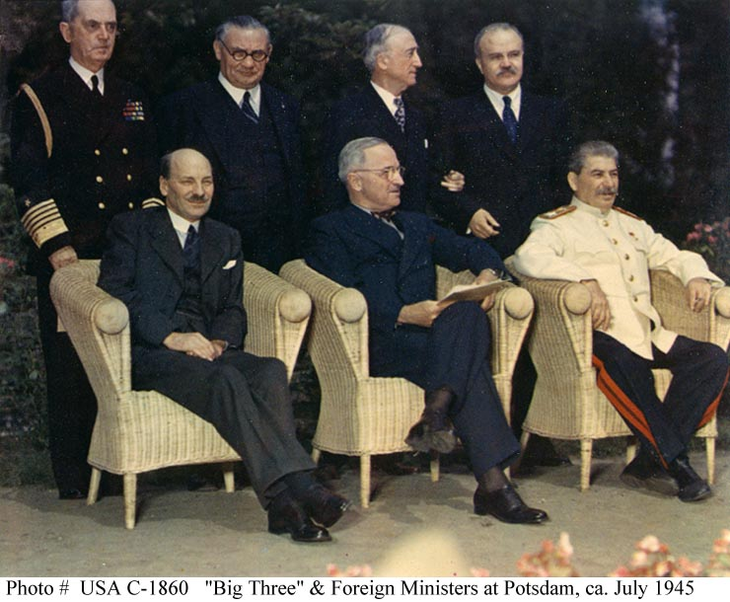
The Cold War
II. Tensions between the powers
A. Potsdam Conference
1. Disagreed upon:
-reparations
-borders for Germany
B. An Iron Curtain Descends
1. Poland, Romania, Bulgaria, Hungary, Czechoslovakia fall to Communist governments

Slide 8
In the years following World War II, the countries of communist Eastern Europe were often referred to as being “behind the iron curtain.” These countries were perceived as a single region based on
:15
a common cultural heritage.
unique physical features.
economic and political characteristics.
widespread immigration from other regions.

Slide 9
The Cold War
III. Organizations
A. United Nations
B. North Atlantic Treaty Organization (NATO) 1949
-mutual defense organization
C. Warsaw Pact 1955
D. Southeast Asia Treaty Organization 1955
E. Central Treaty Organization 1959
-Middle Eastern Nations

Slide 10
In the United Nations Charter, member nations pledge to “unite our strength to maintain international peace and security.” Since ratification of its charter following World War II, the primary goal of the United Nations has been to
:15
restore world trade disrupted by World War II.
encourage industrial growth begun during World War II.
establish policies to help nations pay World War II debts.
intervene in world conflicts to prevent another war such as World War II.

Slide 11
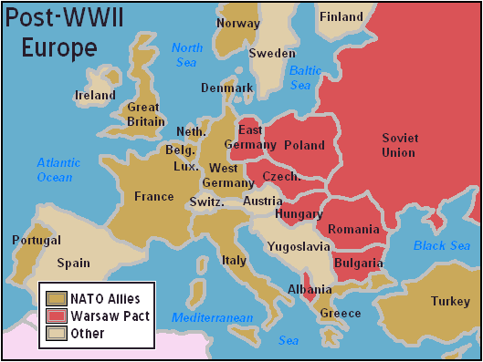
The Cold War
IV. Stopping the Red Threat
A. Policy of Containment
1. Truman Doctrine
2. Marshall Plan
3. Eisenhower Doctrine
- “Domino Theory”
**Soviets also had a containment policy….The Berlin Wall (Stop E. German people from escaping to democratic W. Germany)

Slide 12
OGT Short Answer
During the years between 1945 and 1950, the period directly following World War II, the Soviet Union expanded its influence in Central and Eastern Europe. • Describe two concerns the United States had about this expansion. • For each concern, identify a related action taken by the United States to counter Soviet activities in Europe during this time period. Write your answer in the Answer Document. (4 points)

Slide 13
At the end of World War II, Soviet armies liberated the countries of Eastern Europe from Nazi Germany. The occupation of these countries by the Soviet Union contributed to the development of the Cold War by
:15
contributing to conflict in the Middle East.
bringing about the reunification of Germany.
strengthening the authority of the United Nations.
dividing Europe into communist and non-communist spheres.

Slide 14
On March 12, 1947, President Truman addressed a joint session of Congress to recommend that the United States provide economic assistance to Greece and Turkey. His reasons were as follows: The seeds of totalitarian regimes are nurtured by misery and want. They spread and grow in the evil soil of poverty and strife. … The free peoples of the world look to us for support in maintaining their freedoms. If we falter in our leadership, we may endanger the peace of the world—and we shall surely endanger the welfare of our own Nation. President Harry S. Truman, address to Congress, March 12, 1947 This statement would be helpful in supporting the thesis that, in 1947, President Truman believed the United States
:15
Had little to gain from membership in the United Nations.
was more interested in foreign policy than in domestic issues.
should help maintain democratic governments in other countries.
should conserve its resources to maintain its own economic strength.

Slide 15
The Cold War
V. Conflicts
A. China
1. Mao Zedong
- supported by Soviet Union
-defeats Chinese Nationalists
B. Korea
1. divided after WWII @ 38th parallel
a. NK = Communist (Soviet supported)
b. SK = non-Communist (UN support)

Slide 16
During World War II, Japanese troops occupied much of China. This weakened the Chinese government, and in 1949, communist forces overthrew the government and established a communist state. What effect did the Chinese Communist Revolution have on the development of the Cold War?
:20
It decreased tensions, because it led to the formation of the Warsaw Pact.
It increased tensions, because it strengthened the independence movement in India.
It increased tensions, because it increased Western fears of communist expansion.
It decreased tensions, because it led to the collapse of communism in the Soviet Union.

Slide 17
The Cold War
C. Vietnam
1. former French colony taken by Japan during WWII
a. Ho Chi Minh (Comm) resist French control
-division @ 17th parallel
*U.S. support S. Vietnam
-stalemate

Slide 18
Following World War II, France attempted to re-establish control over its colony, Indochina, which included Vietnam. Leaders of the Vietminh, a communist-supported independence movement in Vietnam, fought against France’s efforts to retake the colony. The United States viewed this conflict as part of the Cold War and aided France. This U.S. action was based on which policy?
:15
a policy of opposing colonialism
a policy of helping Japan rebuild its economy
a policy of containing the spread of communism
a policy of participating in United Nations’ peacekeeping efforts

Slide 19
The Cold War
D. Cuban Missile Crisis
1. Bay of Pigs
a. U.S. support Cuban nationals
- failed mission
2. Soviet/Cuban relations
a. Missile launch sites in Cuba
-Kennedy blockades island
*Soviets withdraw missiles

Slide 20
The use of atomic weapons at the end of World War II fostered fears about their potential use during the Cold War years. These fears were critical in determining the U.S. response to
The Marshall Plan.
the Berlin Blockade.
the Cuban Missile Crisis.
the independence movement in India.
:15

