Slide 1
Because you didn’t remember everything!

Slide 2
The Enlightenment
I. Scientific Method
A. Ptolemy v. Copernicus
-heliocentric theory (sun centered)
B. Galileo
-1st telescope (challenged church)
C. Isaac Newton
-Theory of Gravity

Slide 3
In a Democracy, the source of authority for the government is the
A Head of State
Legislature
Courts
People
10

Slide 4
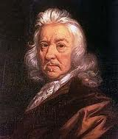
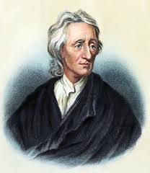
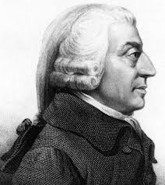
The Enlightenment
II. Philosophes
A. English Philosophers
1. Thomas Hobbes
-social contract theory
II. John Locke
-natural rights & social contract
III. Adam Smith
-laissez-faire economics / free MARKET economics
B. French Philosophers
I. Voltaire
-religious tolerance
II. Montesquieu
-Separation of Powers / Checks & Balances

Slide 5
In exploring the relationship between governments and people, Thomas Hobbes argued that governments resulted from a social contract to maintain an orderly society. John Locke, another philosopher of the Enlightenment, inspired American revolutionaries by arguing that a new social contract could be instituted under what circumstance?
if a government failed to compel obedience
if a government violated people’s natural rights
if a government failed to protect people from economic inequality
if a government entered into alliances with foreign governments
20

Slide 6
Natural law was a fundamental idea of the Enlightenment. Which concept is an application of natural law to the government’s role in the economic lives of its citizens?
free markets based on supply and demand
government control to achieve a favorable balance of trade
agriculture based on tenant farming and serfdom
lower taxes on the most privileged groups in society
20

Slide 7
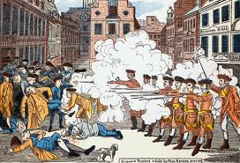
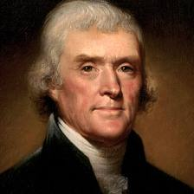
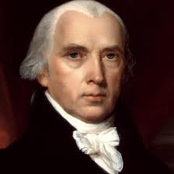
Enlightened Revolutions
III. American Revolution
A. French & Indian War put G.B. in debt
1. Place heavy taxation upon the colonies & controlled trade
a. Colonists argument – “NO TAXATION WITHOUT REPRESENTATION!”
B. Declaration of Independence
I. Thomas Jefferson – Uses enlightenment ideas to show disproval of British policies and describe the reasoning for independence
C. Constitution of the U.S.
I. James Madison – Uses Montesquieu’s ideas to structure new
government

Slide 8
What was one idea that the leaders of the American Revolution shared with Enlightenment thinkers?
20
Colonies exist to provide raw materials and markets for mother countries.
B. The people have the right to overthrow their government if it abuses its powers.
C. Governments may restrict freedom of speech and of the press during times of crisis.
D. Factories and businesses should be owned by the government rather than by individuals.

Slide 9
Enlightenment philosophers such as John Locke and Jean-Jacques Rousseau challenged the idea of the divine right of kings. They wrote about a government’s obligations to uphold people’s rights and how the government should be based on the consent of the governed. These new ideas encouraged people to
remain firm in their support of absolute monarchs.
look for leaders who would exercise dictatorial powers.
engage in revolutions to establish democratic governments.
call for church leaders to create theocracies and replace the monarchies.
20

Slide 10
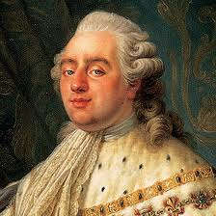
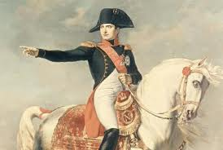
Enlightened Revolutions
IV. French Revolution
A. King Lois XVI versus the French People
1. Class Struggles: Estate 1&2 (2%) vs. 3rd Estate (taxed)
a. Estates-General vs. National Assembly
II. Storming of the Bastille
a. Declaration of the Rights of Man and of the Citizen
-based on enlightenment thought
III. National Convention (Robespierre)
a. overthrew Monarchy (killed King & Queen)
IV. Napoleon Bonaparte
a. declared an emperor

Slide 11
Enlightenment philosophers such as John Locke and Jean Jacques Rousseau wrote that the relationship between citizens and their government was a social contract. Which statement describes the impact of the idea of government as a social contract on the French Revolution in 1789?
The king granted women the right to vote.
French citizens claimed their natural rights.
The king raised taxes to pay off the public debt.
French citizens supported the king against the nobles.

Slide 12
What action by the leaders of the French Revolution demonstrates that they were influenced by Enlightenment ideas?
They called for the fall of the absolute monarchy.
They encouraged the conquests of Napoleon.
They fought to maintain France’s colonial empire.
They supported the combination of church and state.
20

Slide 13
One way absolute monarchies are similar to dictatorships is that citizens under both systems of government typically
can elect new leadership by voting in elections.
have greater freedoms than citizens in democracies.
can amend their constitutions by gathering signatures on petitions.
must engage in revolution in order to achieve governmental change
20

Slide 14
How do absolute monarchs differ from constitutional monarchs in their ability to use power?
The power of absolute monarchs is unlimited.
The power of absolute monarchs is maintained through periodic elections.
The power of absolute monarchs is limited by the fundamental laws of the country.
The power of absolute monarchs depends on continued support from their political party.
20

Slide 15
During the Enlightenment, a number of writers explored the relationship between governments and the people they governed. For example, Rousseau wrote The Social Contract, in which he examined ideas about majority will and the common good. How did these ideas influence the American and French Revolutions?
They encouraged loyalty to established governments.
They supported movements for social and political change.
They encouraged the formation of American and French constitutional monarchies.
They supported the efforts of governments to maintain control over their subjects.
20

Slide 16
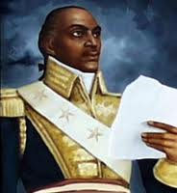
Enlightened Revolutions
V. Latin American Revolutions
A. Haiti
1. French Colony – existed under slavery to fuel French sugar trade
a. Toussaint-L’Ouverture leads slaves against their oppressors
-French sell land W. of Mississippi River to U.S.
(Louisiana Purchase)
B. Mexico
I. Spain defeated by Napoleon in 1808
a. Father Hidalgo wins independence for Mexico

