Slide 1
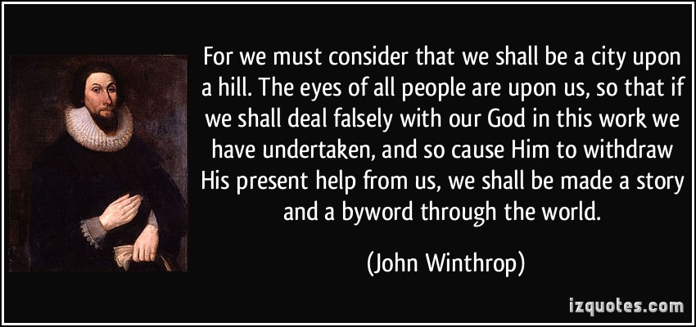
Opening Activity (Journal Response)
To what does John Winthrop (Puritan leader) mean when he desires the Puritans to be a city upon a hill? Why is this important?

Slide 2
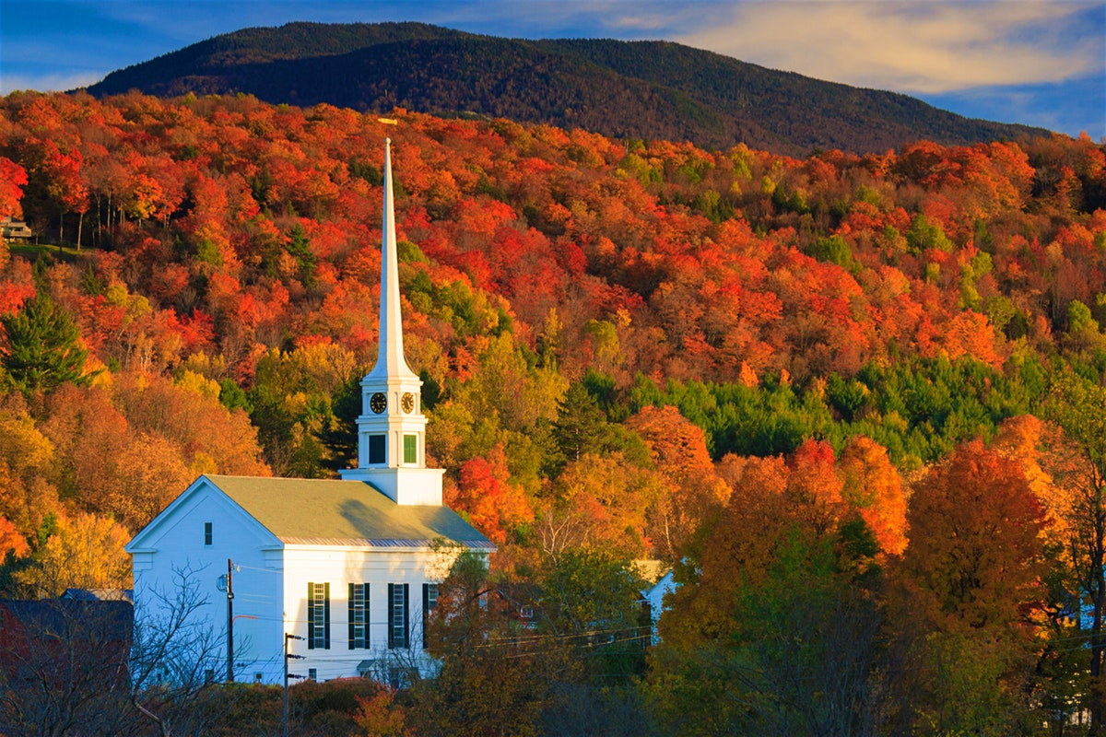
New England Colonies
Mr. Preisse

Slide 3
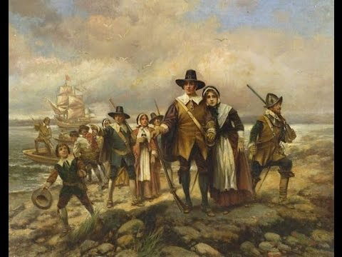
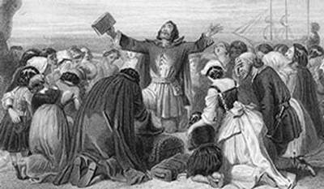
MASSACHUSETTS
I. Massachusetts (1630)
A. Founded by 2 Groups:
1. Pilgrims →
a. Sought Religious Freedom
b. Mayflower Compact
c. founded Plymouth
B. Puritans →
1. Massachusetts Bay Colony
a. Seeking Religious Freedoms as well

Slide 4
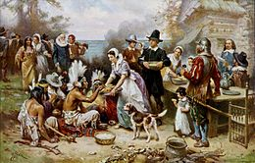
Pilgrims & Puritans
Pilgrims
Puritans
Separatists from the C of E
Start new religion
Aided by Native Americans (Squanto) during first year
THANKSGIVING!
Wanted PURE form of religion
Bible = LAW
Higher social status that Pilgrims in England

Slide 5
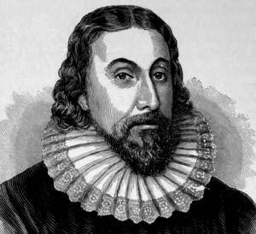
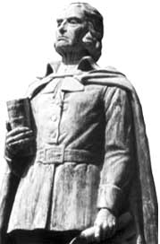
Massachusetts Bay Colony (Cont.)
2. Jon Winthrop = Governor/Minister
-Authoritarian (Only Puritans in Gov.)
-Energetic
II. Connecticut (1636)-petition for charter
A. Thomas Hooker
1. Fundamental Orders of Connecticut
a. All men could vote (land owning)
b. Limited power of Governor

Slide 6
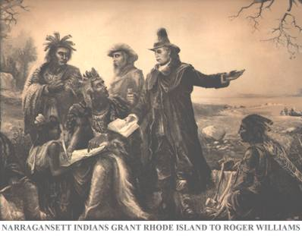
Rhode Island
III. Rhode Island
A. Roger Williams
1. Radical beliefs: (Enlightened Philosophes)
- separate church & state!
- religious toleration

Slide 7
Anne Hutchinson – (Women in America)
https://www.youtube.com/watch?v=KMllFouri0c
What was the covenant of grace?
How did the antonomian trials affect her?
Why did she and her family go to Rhode Island?

