Slide 1
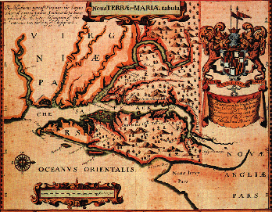
English America –Chesapeake & Southern colonies
1500 - 1740

Slide 3
Attempts at Empire
England did not look to the Americas for colonial expansion until the late 1500s due to:
Protestant Reformation
Elizabethan England (1558 – 1603) emerged energized to create a colonial empire in the New World
Bringing all of Ireland under English control
Encouragement of ‘sea dogs' to seize Spanish ships
Defeat of the Spanish Armada -1588
England emerges as the dominant navy of the N. Atlantic
Monarchy financed early attempts
Newfoundland (Gilbert)
Roanoke Island (Raleigh)

Slide 4
Why England colonized
Huge population explosion in the latter half of the 1500s
Old methods of wealth creation limited too many, so new methods needed to emerge for social stability
Primogeniture (old)
Joint-stock company (new)
Wealthy landowners ‘enclosed' once open land, making farmers tenants or evicting them
Economic depression came to woolen industry in late 1500s
Many Puritans in southern England become itinerant

Slide 5
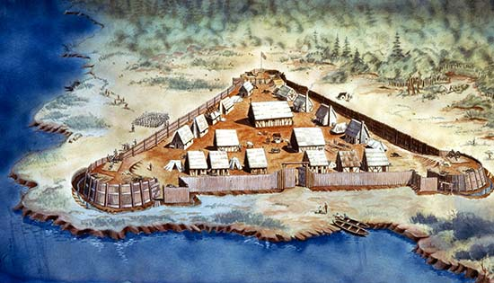
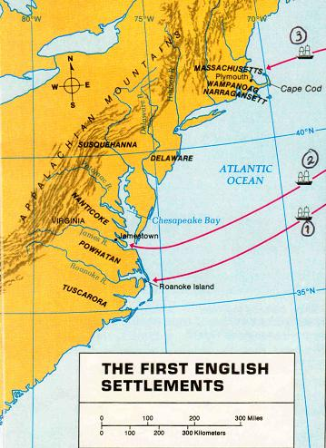
The Chesapeake

Slide 6
AP PARTS:
LOVING AND KIND FATHER AND MOTHER: This is to let you understand that I your child am in a most heavy case by reason of the country…is such that it cause much sickness, [such] as the scurvy and the bloody flux and diverse other diseases, which make the body very poor and weak. And when we are sick there is nothing to comfort us; for since I came out of the ship I never ate anything but peas, and loblollie (that is, water gruel). As for deer or venison I never saw any since I came into this land…do not forget me, but have mercy and pity my miserable case. I know if you did but see me, you would weep to see me

Slide 7
Jamestown (1607)
Virginia Company
Chartered by James 1
Colonists would have same rights as Englishmen
Joint-stock venture set up for short term exploration for gold & passage through the West Indies
Colonist had to be successful or could be abandoned
Chesapeake Bay and James River site
Colonists looked for gold instead of producing food
Too many colonists were gentlemen who would not work led to ‘Starving Time’ (1609-10)
Conflict with Powhatan Indians (Pocahontas intervenes)
Lord De La Warr brings relief in 1610 & military rule
By 1625, there were still only 1200 settlers

Slide 8
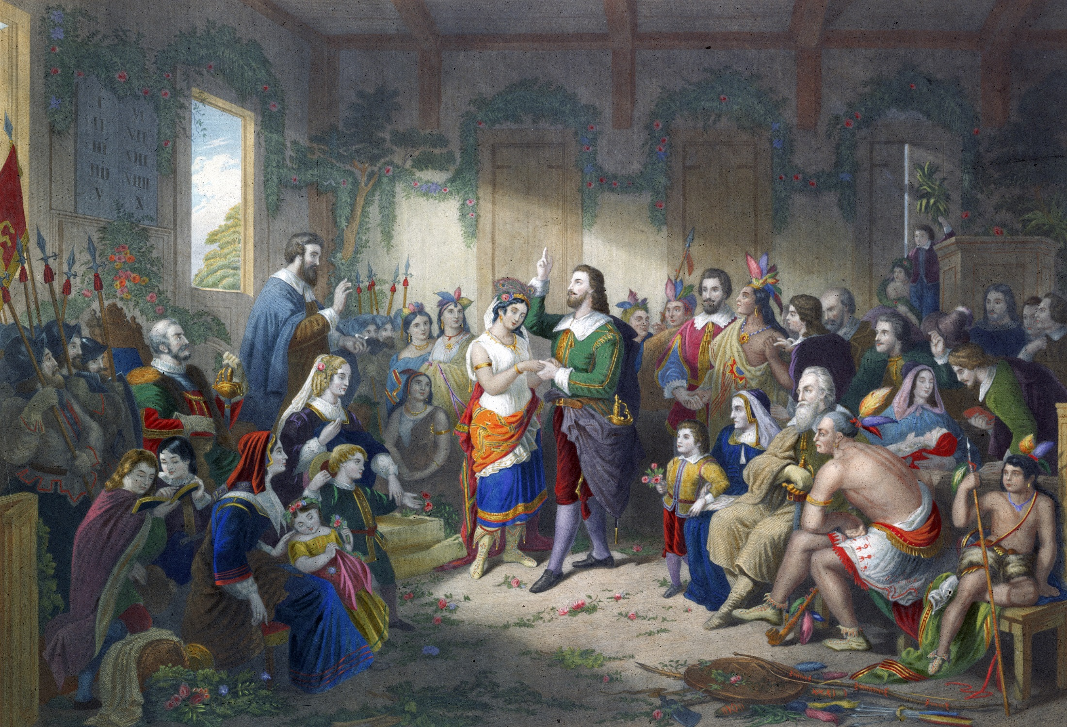
Cultural Clashes
Powhatans vs. the Virginia Company
VA Co. will win due to disease, disorganization & disposability
1st Anglo-Powhatan War (1610)
Ends w/ marriage of Pocahontas to John Rolfe
1622 hostilities resumed, VAC orders “a perpetual war without peace or truce” that would ultimately conclude with the natives “from being any longer a people”
2nd Anglo-Powhatan War (1644),
by 1669 only 10% of the original native population survived
By 1685, English considered the Powhatans extinct

Slide 9
Transformation of Indian Life
Causes
Disease
Horses
Trade
Expanding Atlantic Economy
Effects
Desire for firearms & animal skins incurred greater inter-tribal conflict
Epidemics depleted social hierarchy & knowledge
Eastern seaboard Indians faced greatest hardships, in land tribes planned & adapted
For English wanting to trade farther inland, had to adopt Indian customs

Slide 10
Virginia
Tobacco -‘the bewitching weed’
Cash crops
High profit, but ruined soil & tied fate of colony to one crop
Indentured servitude
Head-right system
slave labor (not until 1619)
1st Parliamentary Body
VA House of Burgesses
By 1624, James I grew to hate the “stinking weed” & the “seminary of sedition”
revoked charter & made VA a royal colony

Slide 11
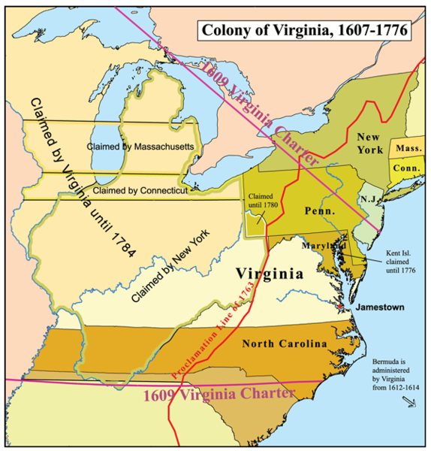

Slide 12
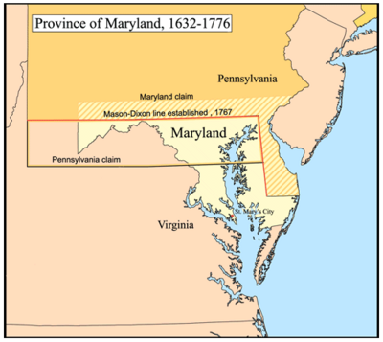
Maryland
Founded in 1634 by Lord Baltimore's family, the Calverts
Refuge for Catholics
Tobacco economy
Operated much like the aristocrat system in England –led to conflicts b/w eastern plantation owners (Catholic) & backcountry farmers (Protestant)
1649 Act of Toleration (for all Christians, not Jews or atheists)
Passed to protect minority population of Catholics

Slide 13
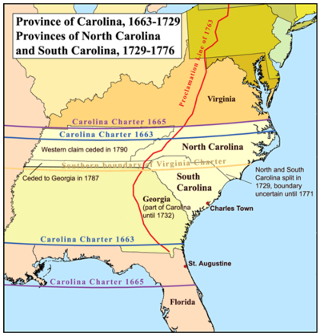
The Carolinas
Founded in 1670, with support of Charles II by 8 Lord Proprietors
Established to produce food stuff to support sugar cane economy of Barbados –Rice
Slave economy (southern part of the colony) brought from start (ability to resist malaria)
Native peoples enslaved and sold to Barbados (population control)

Slide 14
By 1712, colonies divided into two separate royal colonies
South Carolina
North Carolina
Charles Town (Charleston) -major port city
Diverse population of religions emerge due to toleration
Economics more important than faith
Emerges as center of culture, refinement (plantations of owning class)& trade
Emerges as ‘squatter’ culture or poor hardworking Scots-Irish
Little Slavery
Little respect for royal authority
Extremely democratic compared to other colonies

Slide 15
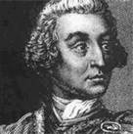
Georgia
Buffer colony b/w English holdings & Spanish Florida
James Oglethorpe –prison reformer & military leader
Haven for debtors to start over
Melting pot community
Early restriction on slavery
Slow growing population due to unhealthy climate

Slide 16
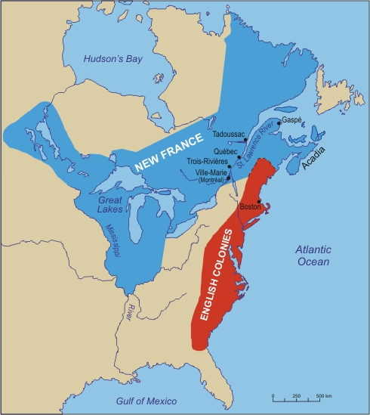

Slide 17
French Interests in North America
Religious conflict during Reformation Period
violence not ending until 1598 w/ Edict of Nantes
1530 Jacques Cartier mapped the St. Lawrence River & claimed it for France
1608, Quebec founded on the St. Lawrence River, by Samuel de Champlain
Developed early relationship w/ Huron against their foes the Iroquois, ultimately confining their territory to north of the Great Lakes
Directly controlled by monarchy
New France grew slowly b/c
religious dissidents (protestant Huguenots) could not leave France
Wealthy Catholics did not need to for economic gain
Gov’t wanted to focus on the West Indies

Slide 18
New France

Slide 19
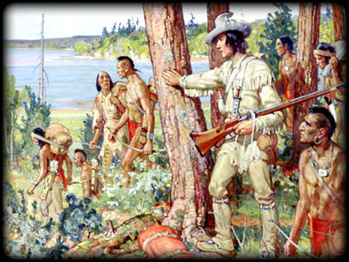
French colonists
Created great wealth, but decimated beaver population, brought disease & alcoholism to Indian population
Voyageurs –moved furs from interior to seaports for sale back to Europe
Coureurs de bois - ‘runners of the woods’
Fur trappers who explored river systems

Slide 20
Conflict for Empire (pre- French & Indian War)
These colonial wars were part of greater conflict b/w European empires on the European continent
King Williams’ War (1689 – 1697)
Indian allies of the French vs. Massachusetts colonists
Decimates native population of CT & MA
Queen Anne’s War (1702 – 1713)
English win Nova Scotia (Acadia) & begin period of salutary neglect
War of Jenkins’s Ear (1739)
Trade dispute b/w GR and Spain
British vs Spanish fought mostly in Georgia & the Caribbean

