Slide 1
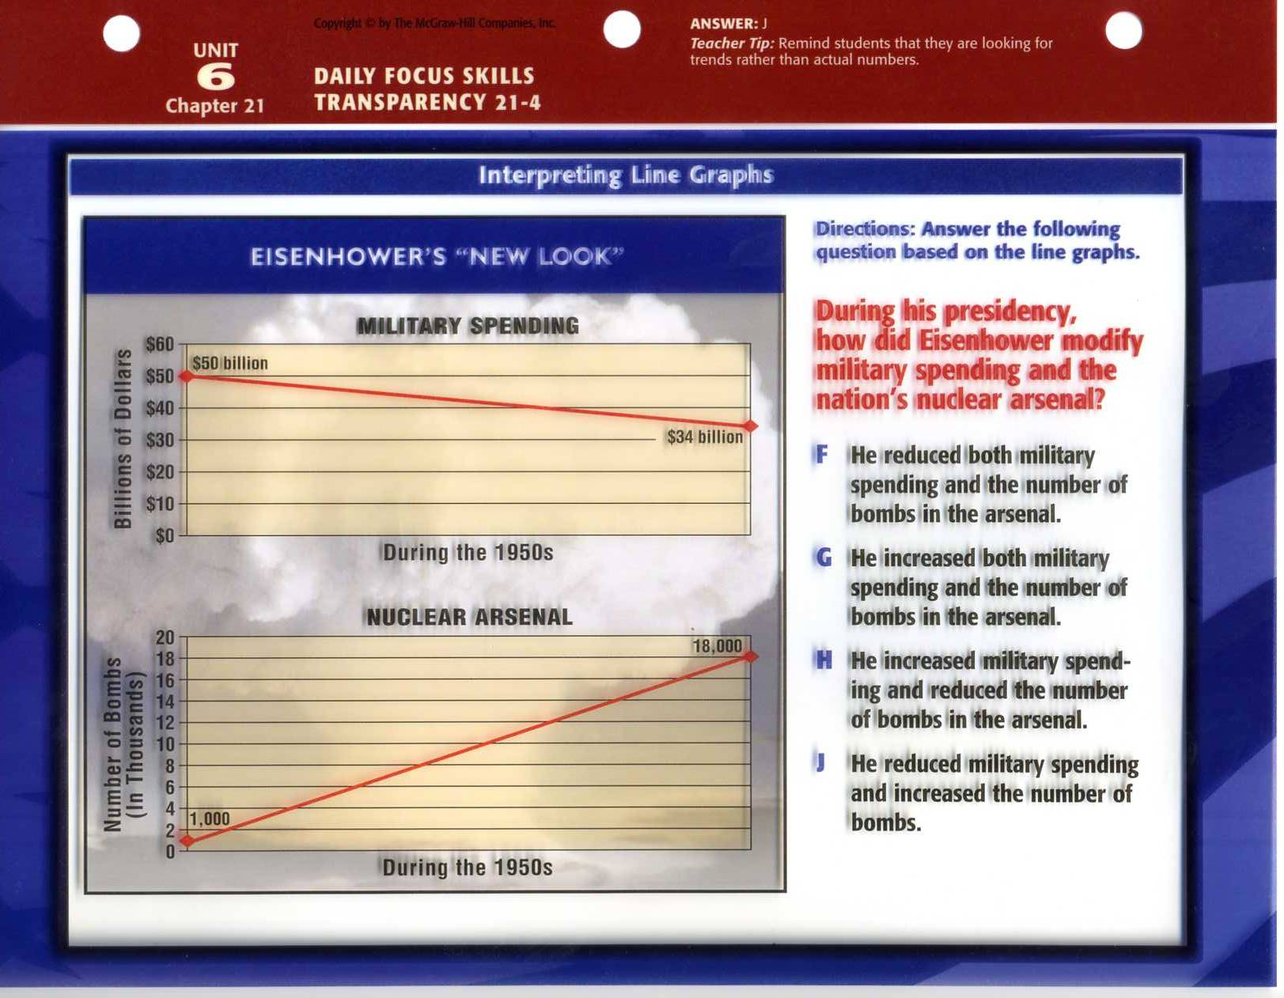

Slide 2
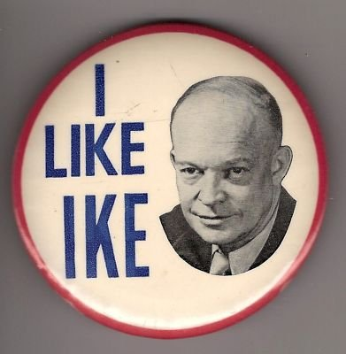
Eisenhower’s Policies
Ch. 21.4

Slide 3
Objectives
Evaluate Eisenhower’s military policy known as the “New Look”
Debate the effectiveness of Eisenhower’s foreign policy

Slide 4

A New Look

Slide 5
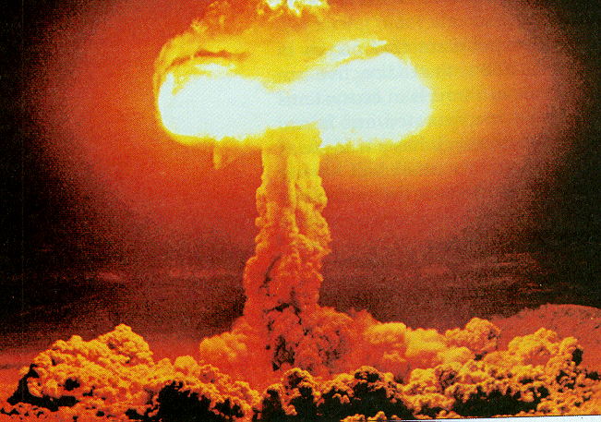
Eisenhower’s New Look
I. Ike’s New Look
A. Public scrutiny of Truman:
1. Soviets gained Atomic Bomb
2. Soviets took E. Europe
3. China fell to Communism
4. U.S. Troops were in Korea
B. 1952 Election
1. Adlai Stevenson v. Dwight D. Eisenhower
a. Landslide Victory for
C. The New Look
1. Building Economy & Decreasing Military

Slide 6
1. What allowed Eisenhower to easily win the Presidency in 1952?
15
A. His role as a Democratic Candidate
B. His ideas of a decreasing military
C. His success as a politician
D. His role in WWII

Slide 7
2. What was Eisenhower’s “New Look”?
15
A. Build Economy & Decrease Military
B. Use Nuclear Force against USSR
C. Sign Armistice with China
D. Rocking fresh kicks and skinny jeans

Slide 8
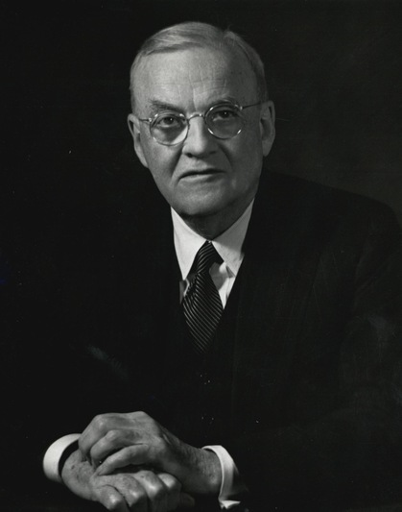
Massive Retaliation
D. Massive Retaliation
1. Prevent Conflicts through threat
a. nuclear force
-cut military & increase
nuclear weapons
E. Sputnik Crisis
1. Intercontinental Ballistic Missiles (ICBM)
a. Soviet satellite (Oct. 1957)
2. NASA & Nat’l Defense Ed. Act

Slide 9
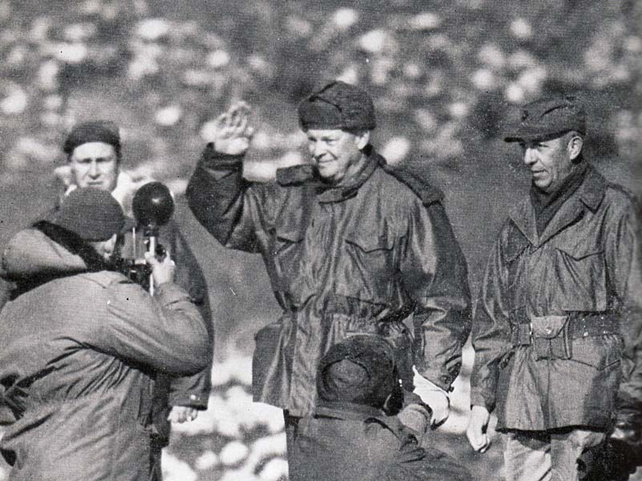
Brinkmanship
II. Brinkmanship
A. John Foster Dulles
1. willingness to go to edge of war
to prevent a war
B. Ending Korean War
1. Eisenhower’s Campaign Promise
a. Nov. 1952 visits battle front
- contacts Chinese (massive retaliation)
*Armistice –July 1953

Slide 10
3. Preventing war through the threat of nuclear force is referred to as…?
15
A. New Look
B. Massive Retaliation
C. NASA
D. Brinkmanship

Slide 11
4. What was the true significance of Sputnik?
10
A. Proved Soviet superiority in space
B. Showed Soviet ability to attack US
C. Provided video surveillance of US
D. Changed American Education

Slide 12
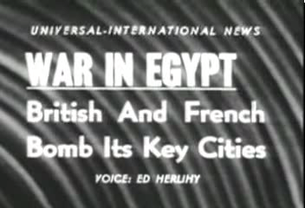
Suez Crisis

Slide 13
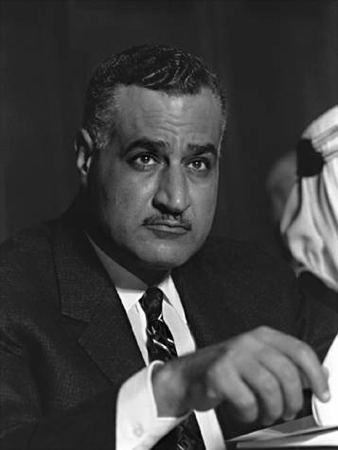
Suez Crisis
C. Suez Crisis
1. Preventing communism in
the Middle East
III. Fighting Communism
A. Central Intelligence Agency
1. Developing Nations
a. overthrow anti-American
leaders

Slide 14
5. What was Brinkmanship?
10
A. Using Nuclear arms against enemy
B. Using covert operations in USSR
C. Threaten War to Prevent War
D. Increasing nuclear arsenal

Slide 15
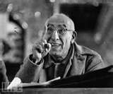
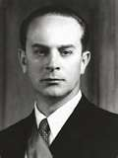
Iran & Guatemala
B. Iran
1. Mohammed Mossadegh (PM)
a. nationalizes oil companies
-moves against Shah
*US organizes rioting
C. Guatemala
1. Jacobo Guzman (Comm. Pres)
a. socializes farms
-armed by communists
*US arms opposition

Slide 16
6. What was the intended purpose of the CIA?
10
A. Arming developing nations
B. Aiding democratic governments
C. Organizing operation treadstone
D. Preventing Communist expansion

Slide 17
Death of Stalin

Slide 18
7. How did the USSR deal with E. German, Polish, and Hungarian revolutions?
10
A. Crush them with military force
B. Allow new democracies to form
C. Negotiate with Revolution leaders
D. Ignore the situation

Slide 19
8. What Soviet leader took control after the death of Stalin?
10
A. Vladimir Lenin
B. Nikita Khrushchev
C. Leon Trotsky
D. Drew Bell

Slide 20
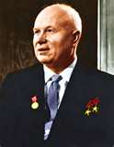
Uprising in Hungary
D. Hungary
1. 1953 – Stalin Dies
a. Nikita Khrushchev
-negative speech toward Stalin
*CIA broadcasts to E. Europe
b. E. European rioting
-Soviets smash riots with force

Slide 21
Gary Powers – U2 incident

Slide 22
9. What was the purpose of the U2?
10
A. Collect weather information
B. Collect spy photos
C. Sing “Bloody Sunday”
D. Drop Nuclear bombs

Slide 23
10. What was the initial US reaction to the downed plane?
10
A. Accuse civilian of flying off course
B. Tell the truth
C. Blame a weather collecting mission
D. Blame G.B. for spy plane

