Slide 1
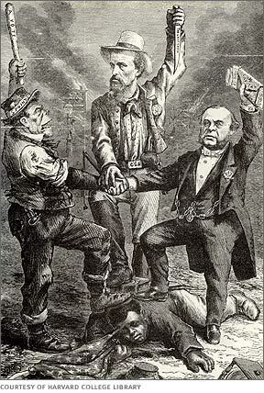
Congressional Reconstruction
Ch. 4.2

Slide 2
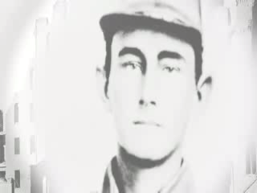
Post Civil War Reconstruction

Slide 3
President Lincoln’s plan for Reconstruction offered a general pardon to Southerners who took an oath of loyalty to the United States and accepted the Union’s proclamation concerning
a. slavery.
b. elections.
c. prisons.
d. food supplies.

Slide 4
Under the provisions of the Wade-Davis Bill, who would not be allowed the right to vote or hold office?
a. former enslaved African Americans
b. plantation owners
c. former Confederate government officials and military officers
d. any men who fought in the Confederate army

Slide 5
Objectives
Discuss life in the South immediately following the Civil War
Describe the major features of Congressional Reconstruction and its political impact.

Slide 6
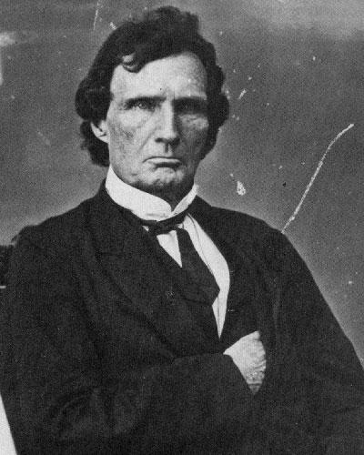
The Republican Congress and Reconstruction
I. Congressional Reconstruction
A. Groups: Moderates & Radicals
1. Radicals:
a. Thaddeus Stevens & Charles Sumner
i. citizenship
-Civil Rights Act 1866
-14th Amendment
ii. voting rights
-15th Amendment
iii. property

Slide 7
Reconstruction Acts / Military Reconstruction

Slide 8
Congressional Reconstruction began with the passage of what act that granted citizenship to all persons born in the United States except Native Americans?
a. Fourteenth Amendment
b. Military Reconstruction Act
c. Thirteenth Amendment
d. Civil Rights Act of 1866

Slide 9
Recognizing the importance of African American suffrage, the Republican-led Congress proposed the
a. Civil Rights Act of 1866.
b. Thirteenth Amendment.
c. Fourteenth Amendment.
d. Fifteenth Amendment.

Slide 10
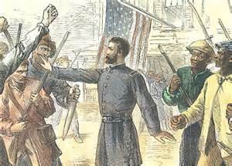
The Republican Congress and Reconstruction
II. Congress vs. Johnson
A. The Freedmen’s Bureau:
-food & clothing
-employment agency
-established hospitals
-EDUCATION
**Johnson vetoes extension bill for Freedmen’s Bureau based on finances.

Slide 11
The agency given the task of feeding and clothing war refugees in the South using surplus army supplies was called the
a. Military Reconstruction Bureau.
b. Radical Republicans.
c. Freedmen’s Bureau.
d. Red Cross.

Slide 12
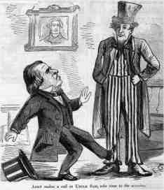
The Republican Congress and Reconstruction
III. Radicals in Power
A. Presidential Impeachment
1. Congress:
-Command of Army Act
-Tenure of Office Act
*Johnson fires Stanton
impeach = high crimes and misdemeanors

Slide 13
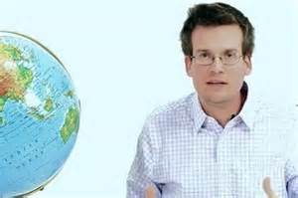
Homework:
Complete the “Crash Course U.S. History Video” & Questions under Module #2

