Slide 1
Ch. 22.2

Slide 2
Spread of Wealth
I. Spread of Wealth
A. Incomes tripled
B. White-Collar Jobs
1. Organization Men
2. franchises
3. multinational corporations

Slide 3
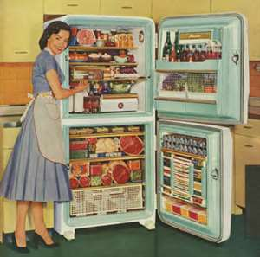
New Consumerism
II. New Consumerism
A. “Keeping up with the Joneses”
1. Buying luxury items
a. Mass advertising
- Appliances
- Second car
- Well kept suburban home
B. Growth of Suburbia
1. Leavittowns

Slide 4
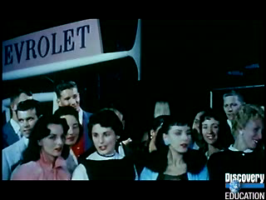
Suburbia

Slide 5
The Baby Boom

Slide 6
Television

