Slide 1
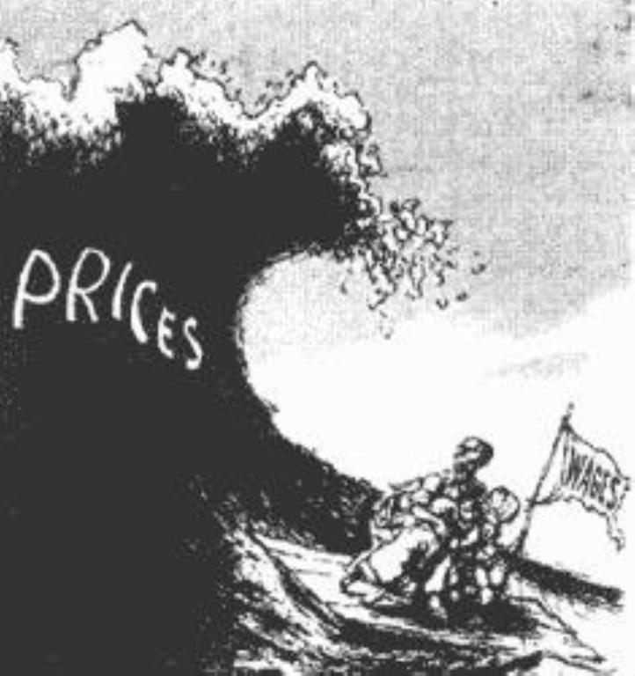
The War’s Impact
Ch. 14.4

Slide 2
Objectives
Describe the effects of postwar recession on the United States.
Discuss the causes of and reaction to the Red Scare.

Slide 3
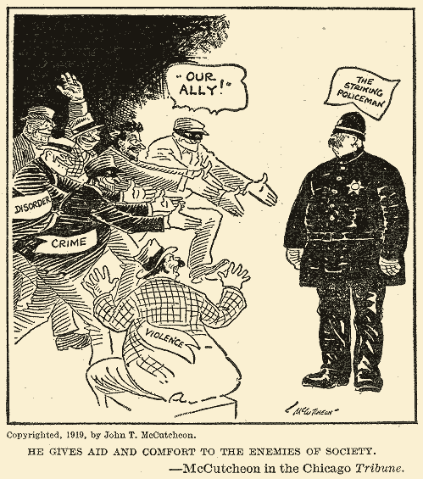
Nation in Turmoil
I. Economy in Turmoil
A. Strikes
1. Seattle General Strike
2. Boston Police Strike
3. Steel Strike
II. Racial Turmoil
A. Chicago Race Riot

Slide 4
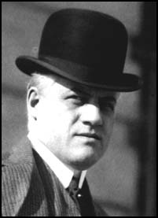
Red Scare
III. The Red Scare
A. Communist International
B. Palmer Raids
-General Intelligence Division

