Slide 1
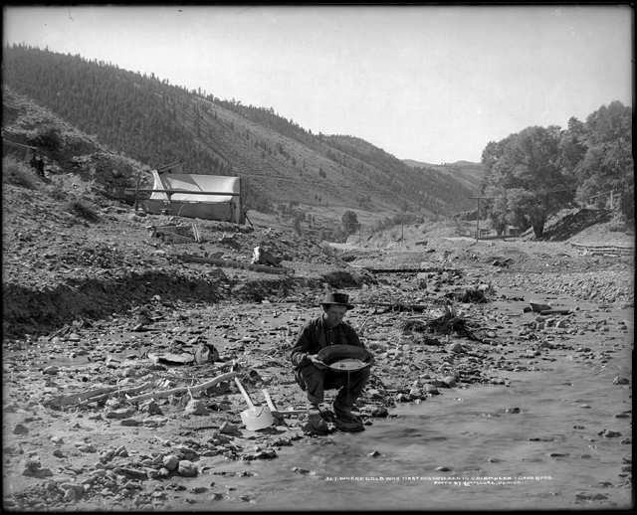
Word List: Gold Mining

Slide 2
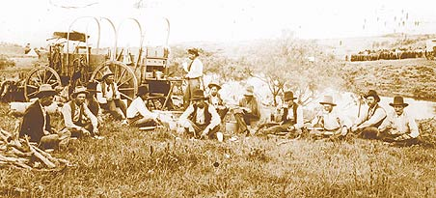
Word List: Cattle Drives

Slide 3
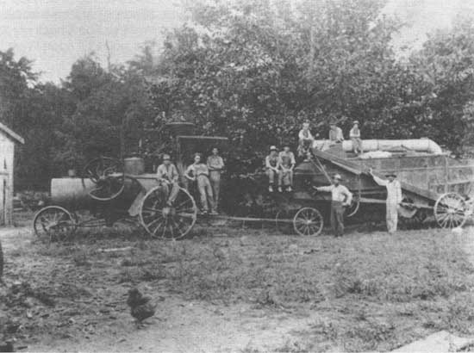
Word List: Mechanical Farming

Slide 4
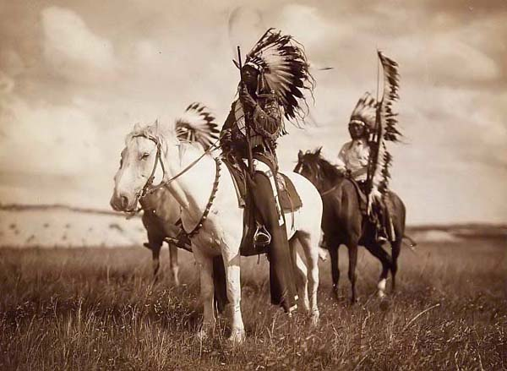
Word List: Plains Indians

Slide 5
Westward Expansion
Ch.8

Slide 6
Objectives
1. Explore the way the mining industry helped settle the west.
2. Describe how technology changed open range ranching and commercial farming.
3. Summarize problems caused by attempts to assimilate

Slide 7
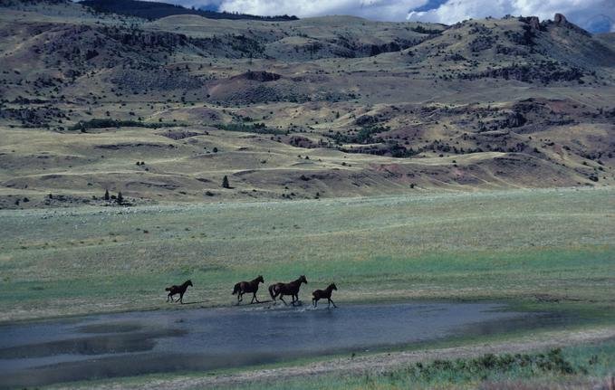
Settlement
I. Settlement
A. Miners
1. Impacts:
- fueled industry
- increased settlers
B. Ranching & Cattle Drives
1. Cattle Drives
a. Open Range
2. Long Drives
a. railroads

Slide 8
What brought the first wave of settlers to the West?
10
Ranching
Fur trading
Farming
Mining

Slide 9
Vast areas of grassland owned by the federal government.
10
Open range
Wagon trail
Vigilance committees
farming

Slide 10
The major route north to Abilene, Kansas for cattle drives.
10
Open range
Chisholm Trail
Wagon train
Long drive

Slide 11
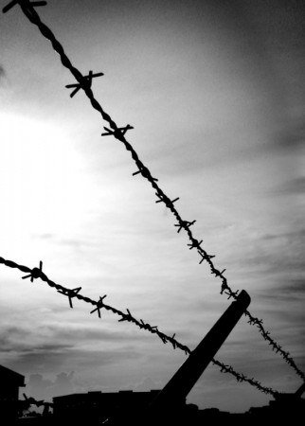
Farming the Plains
3. Ranching
a. barbed wire
-cuts off Range
II. Farming the Plains
A. Migration:
1. Railroads
2. Homestead Act 1862
a. public land available for settlement

Slide 12
Eventually, and after considerable loss of life, the open range was largely fenced off with a new invention called
10
Range barriers
Electric fences
Lariats
Barbed wire

Slide 13
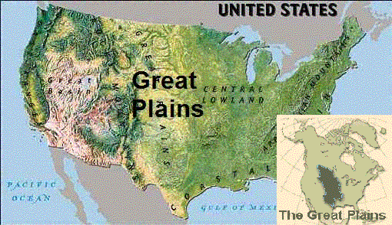
Revolution in Agriculture
B. Revolution in Agriculture
1. Wheat Belt
a. Mechanized &
Commercial Farms
*caused soil erosion

Slide 14
Homework
Ch. 8.1 #’s 1-6

Slide 15
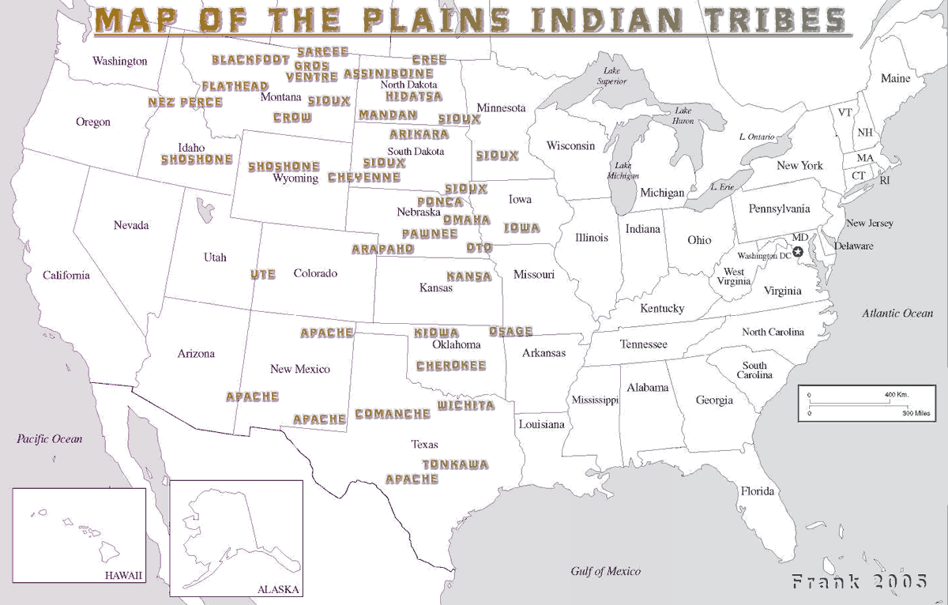
Native American Tribes

Slide 16
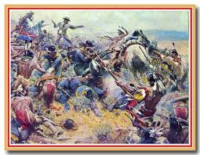
Native Americans

Slide 17
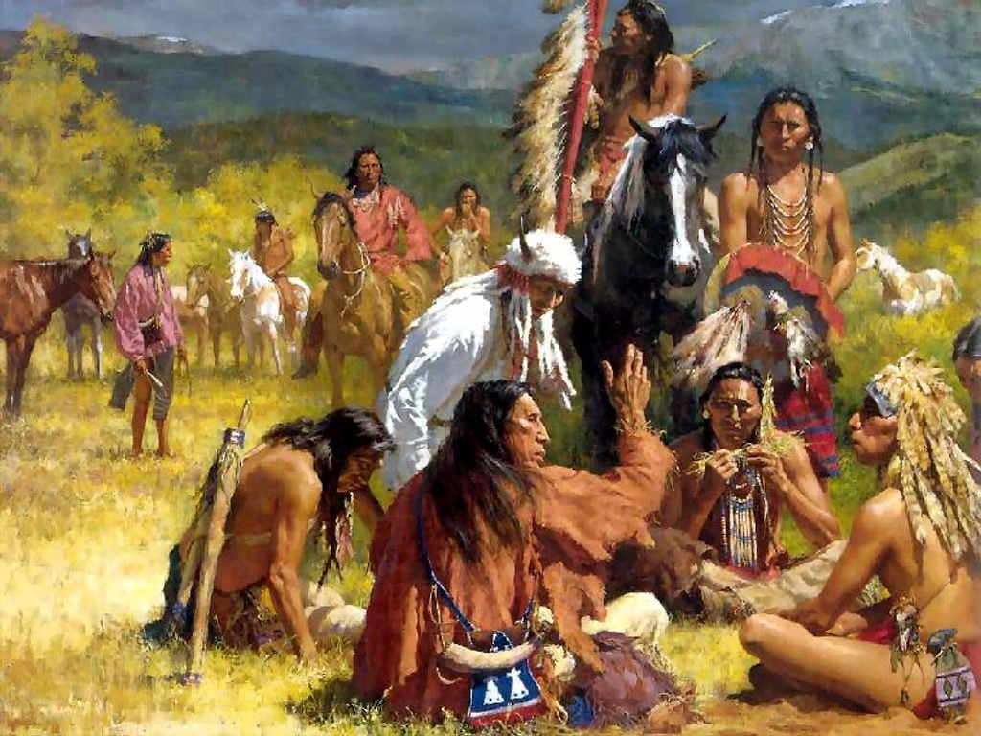
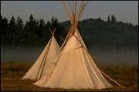
The End of a Way of Life
I. Culture of the Plains Indians
Nomadic – follow buffalo
A. Cultures under Pressure
1. Dakota Sioux Uprising
a. Minnesota Reservation
- receive annuities
*uprising
2. Lakota Sioux
a. Red Cloud, Crazy Horse, Sitting Bull

Slide 18
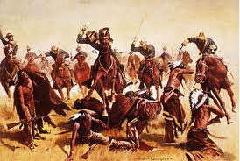
Sand Creek Massacre
b. Sand Creek Massacre
-Cheyenne and Arapaho
* lead raids against settlers
- Forced Surrender at Fort Lyon
* Chief Black Kettle
*Col. Chivington
c. Congress passes
Indian Peace
Commission

Slide 19
Who proposed creating two large reservations on the Plains in 1867, one for the Sioux and another for the Plains Indians?
10
Chief Little Crow
George A. Custer
Indian Peace Commission
General Nelson Miles

