Slide 1
Antebellum Reform in the U.S.
From the 2nd Great Awakening
to Abolition

Slide 2
Main Ideas
Antebellum Reform Movements are part of long tradition of reform in America
Ideas of reform: Puritan “City on a Hill”; Revolutionary tradition; Jacksonianism
Shared belief that humans could understand and change society for the better
Reform could take many shapes, small “p” populist, progressive, radical, and right-wing
Different methods and goals of reform efforts

Slide 3
Tradition of Association and Reform
Alexis de Tocqueville: Americans associate, form groups for common interests, more than Europeans
Examples of antebellum reform movements: abolition, women’s rights, utopian settlements, labor, temperance, socialists
Later examples: labor movement, Populists, New Deal, civil rights, women’s

Slide 4
Impact of Jacksonianism
Celebration of common people
Equality of white males
Political language of equality
Against elites
Empowered working white men
Political campaigns and expanded voting
Rallies and BBQs
Anti-Bank – against concentrated wealth and power

Slide 5
Growth of the American Middle-Class
Increase in middle-class, particularly in north
Associated with industrialization and urbanization
Middle-class whites in northern towns and cities developed ideas about their role in society
Open to new religious movements
Organized
Willing and able to project their ideas outwards on society: reform
Attempted to both control and reform society

Slide 6
Impact of the
Second Great Awakening
“Spiritual Reform From Within” [Religious Revivalism]
Social Reforms & Redefining the Ideal of Equality
Temperance
Abolitionism
Education
Asylum & Penal Reform
Women’s Rights
Link to PBS, “God in America,” Part 2
Notes:
Based on powerpoint by Ms. Susan M. Pojer Horace Greeley HS Chappaqua, NY

Slide 7
Importance of Popular Religion in America
In France, I had almost always seen the spirit of religion and the spirit of freedom pursuing courses diametrically opposed to each other; but in America, I found that they were intimately united, and that they reigned in common over the same country… Religion was the foremost of the political institutions of the United States. -- Alexis de Tocqueville, 1832

Slide 8
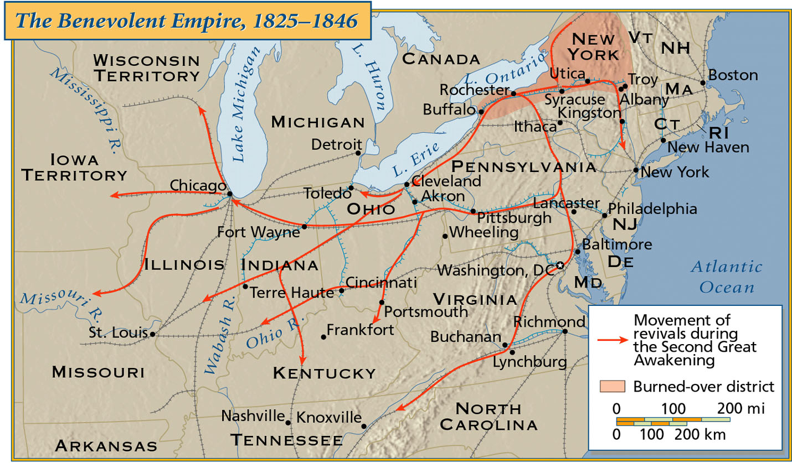
Spread of Religious Revivals
in Antebellum America

Slide 9
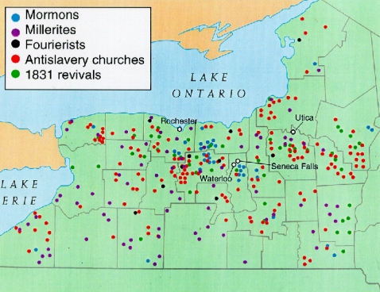
The “Burned-Over” District of New York
Religious sects
and revivals
Followed spread
of market economy
Often followed the
course of the new
Erie Canal
Spread of religion
and reform

Slide 10
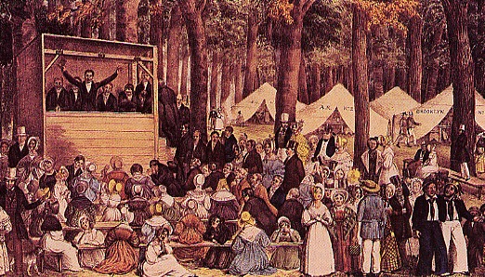
Revival Meeting

Slide 11
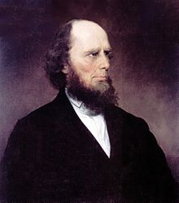
Charles G. Finney
Revivalist minister
Similar to 1st Great Awakening revivals
Personal experience of god and faith
Christians had duty to remake the world in God’s image
Reform efforts: mixed-sex services, abolition
“soul-shaking” conversion
R1-2

Slide 12
The Shakers
Radical religious sect that began in 1740s or 1750s
Influenced by 1st and 2nd Great Awakenings
Led by Mother Ann Lee, Lucy Wright
God is both male and female
Equality of sexes under god
Personal revelations from god
Called “Shakers” b/c of ecstatic religious expression
Members observed celibacy, simplicity, and creation of self-sufficient Shaker communities
Shaker communities were utopian settlements: attempts to create equality and perfection on earth

Slide 13
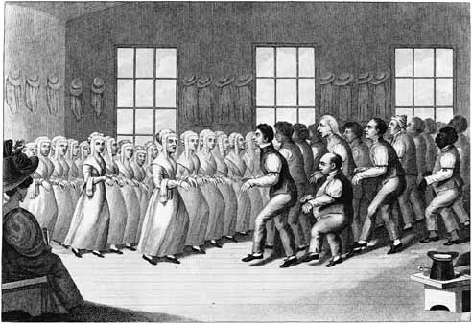
Shaker Religious Meeting
Is this THRILLER?

Slide 14
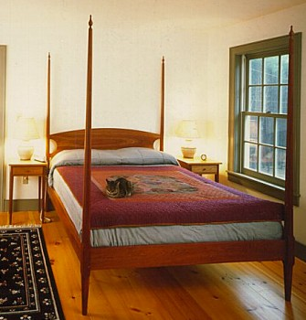
Shakers Emphasized Simplicity, Practicality, and Utility

Slide 15
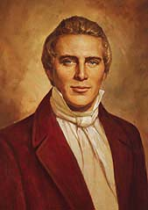
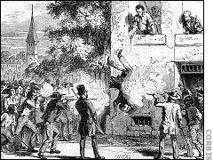
The Mormons (Church of Latter-Day Saints)
Based on Joseph Smith’s revelations from the angel Moroni
1823 → Golden Tablets
1830 → Book of Mormon
1844 → Murdered in Carthage, IL
Persecution led to Mormon beliefs: chosen people, exile to Utah, self-reliance, and communitarianism
Joseph Smith (1805-1844)

Slide 16
The Mormons (Church of Latter-Day Saints)
Mormon Church mixed different strands of revival and reform
Part of 2nd Great Awakening
New religious sect (1st wholly American religion?)
Radical (communitarian, equality under god) AND conservative (patriarchal and exclusive)
Patriarchal church and family - stability
Only males could be church or family leaders
Polygamy as practice of patriarchal rule
Originally excluded blacks and Native Americans, similar to Jacksonian democracy

Slide 17
Transcendentalism
Major beliefs:
“Transcend” the limits of intellect and allow the emotions, the SOUL, to create an original relationship with the Universe
Moral authority and feeling over rationality
Infinite benevolence of God
Appreciation for Nature: God can be seen in nature, both power and benevolence
Humans are divine, good, and changeable
Rejection of formal authority
Personal ethics and morality
Related to Romanticism in Europe

Slide 18
Transcendentalism
If man was divine, it would be wicked that he should be held in slavery, or his soul corrupted by superstition, or his mind clouded by ignorance
Thus, the role of the reformer was to restore man to that divinity which God had endowed them
Humans had power over their own lives
They could remake themselves and their world in God’s image

Slide 19
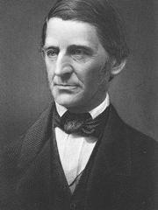
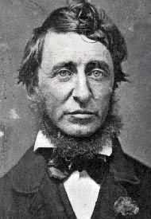
American Transcendental Thinkers in Concord, MA
Ralph Waldo
Emerson
Henry David
Thoreau
Nature (1832)
Resistance to Civil Disobedience (1849)
Self-Reliance (1841)
Walden (1854)
“The American Scholar” (1837)
R3-1/3/4/5

Slide 20
Transcendental Agenda
All humans share part of a common soul; reconnect humans to one another and god
Reconnect humans with nature (and god)
Give freedom to the slave
Give well-being to the poor and the miserable
Give learning to the ignorant
Give health to the sick
Give peace and justice to society

Slide 21
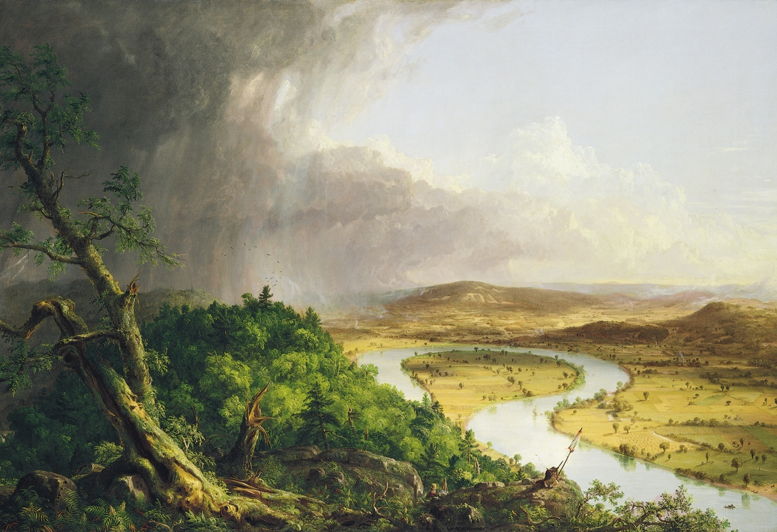
Thomas Cole & the Hudson River School of Painters
Hudson River
School
U.S. artists tried
to distinguish
themselves from
Europeans
U.S. greatness
could be seen in
natural world
God could be
seen in nature:
Power, fury,
beauty
Thomas Cole, The Oxbow, 1836

Slide 22
Utopian Communities in America
Remaking the world to fit God’s image
Related to Puritan “City on a Hill”
Religious communities
Secular communities
Early socialist communes
Examples:
George Ripley’s Brook Farm, West Roxbury, MA
Robert Owens’s utopian socialist communities
Fourierist communes

Slide 23
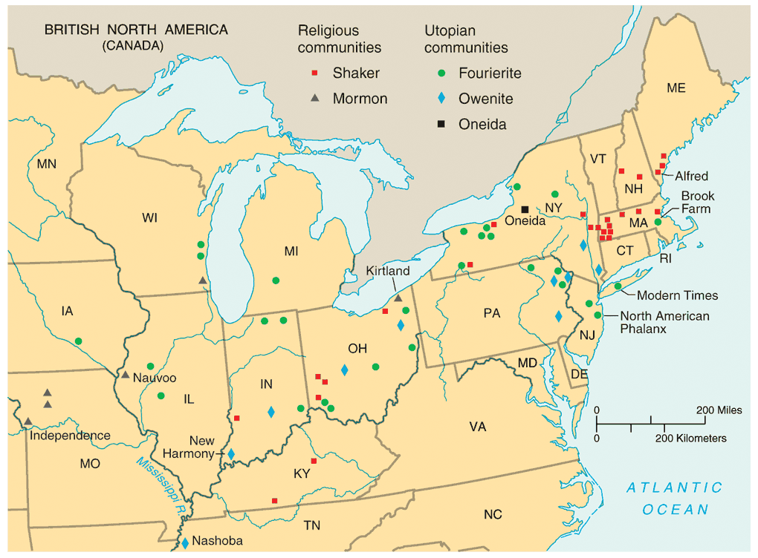
Utopian Communities in America

Slide 24
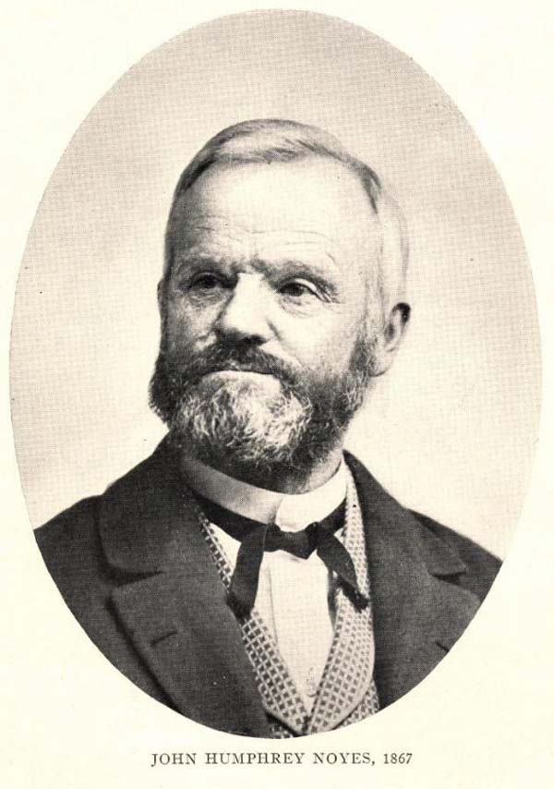
The Oneida Community, New York, 1848
THE FIRST HIPPIES?
Millenarianism --> the 2nd coming of Christ had already
occurred
Humans were no longer obliged to follow the moral rules of the past
All members married to each-
other
Carefully regulated “free love”
John Humphrey Noyes (1811-1886)

Slide 25
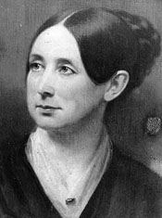
Prison Reform
Dorothea Dix (1802-1887)
1821 → first penitentiary founded in Auburn, NY
Quakers and others concerned with brutality of prisons and capital punishment
Separation of criminals and mentally ill
Penitentiaries intended to reform inmates, heal sick
R1-5/7

Slide 26
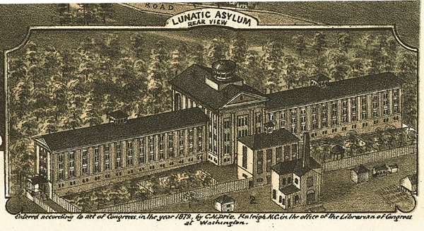
First Penitentiary, 1849

Slide 27
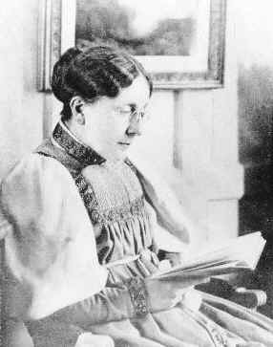
Temperance Movement
1826 – American Temperance Society
Attacked “demon rum”
Weakened republic
Men wasted earnings
Led to domestic violence
Prevented men from rational political participation
Prevented hard work and self-improvement
Frances Willard

Slide 28
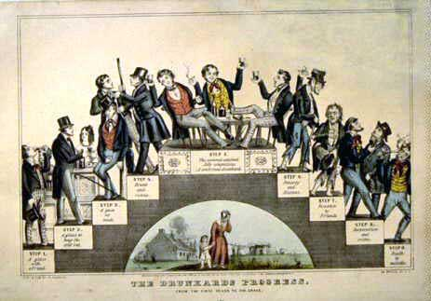
“The Drunkard’s Progress”
From the first glass to the grave, 1846

Slide 29
Educational Reform
Transition from religious training to secular education
Widening of education to general population
MA → always on the forefront of public educational reform
1st state to establish tax support for local public schools
By 1860 every state offered free public education to whites
US had one of the highest literacy rates in the world

Slide 30
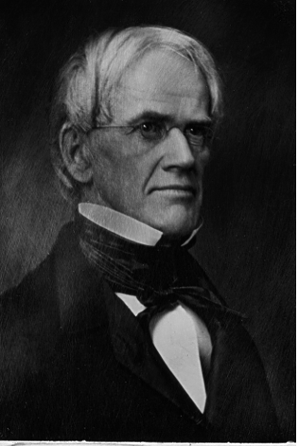
Horace Mann (1796-1859)
“Father of
American Education”
children were clay in the hands of teachers and school officials
children should be “molded” into a state of perfection
discouraged corporal punishment
established state teacher- training programs
R3-6

Slide 31
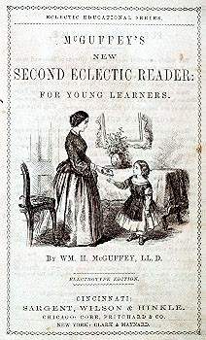
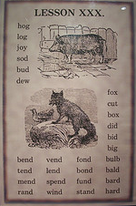
The McGuffey Eclectic Readers
Used religious parables to teach “American values.”
Teach middle class morality and respect for order.
Teach “3 Rs” + “Protestant ethic” (frugality, hard work, sobriety)
R3-8

Slide 32
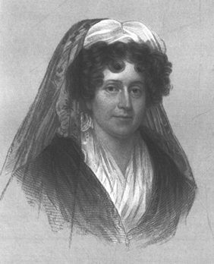
Women Educators
Emma Willard (1787-1870)
Troy, NY Female Seminary
Curriculum: math, physics, history,
geography
Trained female teachers
Mary Lyons (1797-1849)
1837 → she established Mt. Holyoke
[So. Hadley, MA] as the first college
for women

Slide 33
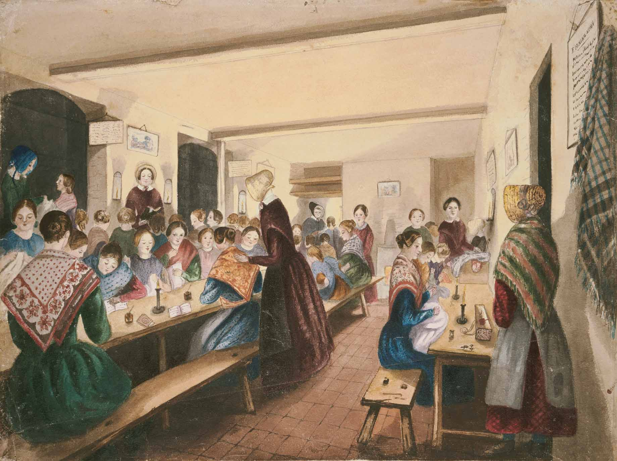
The Female Seminary

Slide 34
19th-Century Gender Roles: Separate Spheres
“The Cult of Domesticity”/REPUBLICAN MOTHERHOOD
A woman’s “sphere” was in the home (it was a refuge from the cruel world outside)
Her role was to “civilize” her husband and family
An 1830s MA minister: “The power of woman is her dependence. A woman who gives up that dependence on man to become a reformer yields the power God has given her for her protection, and her character becomes unnatural!”

Slide 35
19th-Century Women
Expected to remain dependent on man for entire life (father, husband, or other)
Could not vote
Legal status of a minor
If single, could own property
If married, no control of property or children
Could not initiate divorce
Could not make will, contracts, or bring suits in court without husband’s permission

Slide 36
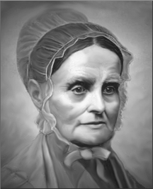
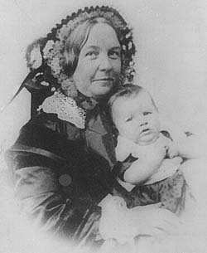
Women’s Rights Movement
1840 → split in the abolitionist movement over women’s role in it
Lucretia Mott
Elizabeth Cady Stanton
1848 → Seneca Falls Declaration of Sentiments

Slide 37
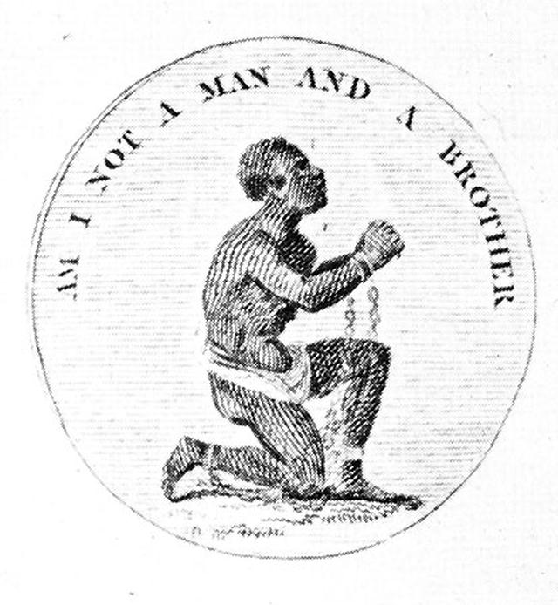
The Abolitionists
Varieties of abolition
Sympathy for slaves – sympathy for whites
Freed slaves should be incorporated as American citizens – transported away
Nonviolent – violent
Religious – rational
Black and white
Men and women
Link to PBS,
“God in America,”
Part 3, “A Nation Reborn”
(religion & abolition)

Slide 38
Early Abolitionist Efforts
1816 → American Colonization Society created (gradual, voluntary emancipation)
Freed slaves to be transported back to Africa
Create a free slave state in Liberia, West Africa.
No real anti-slavery sentiment in the North in the 1820s & 1830s

Slide 39
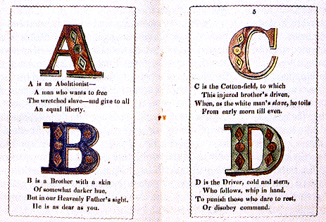
Abolitionist Alphabet

Slide 40
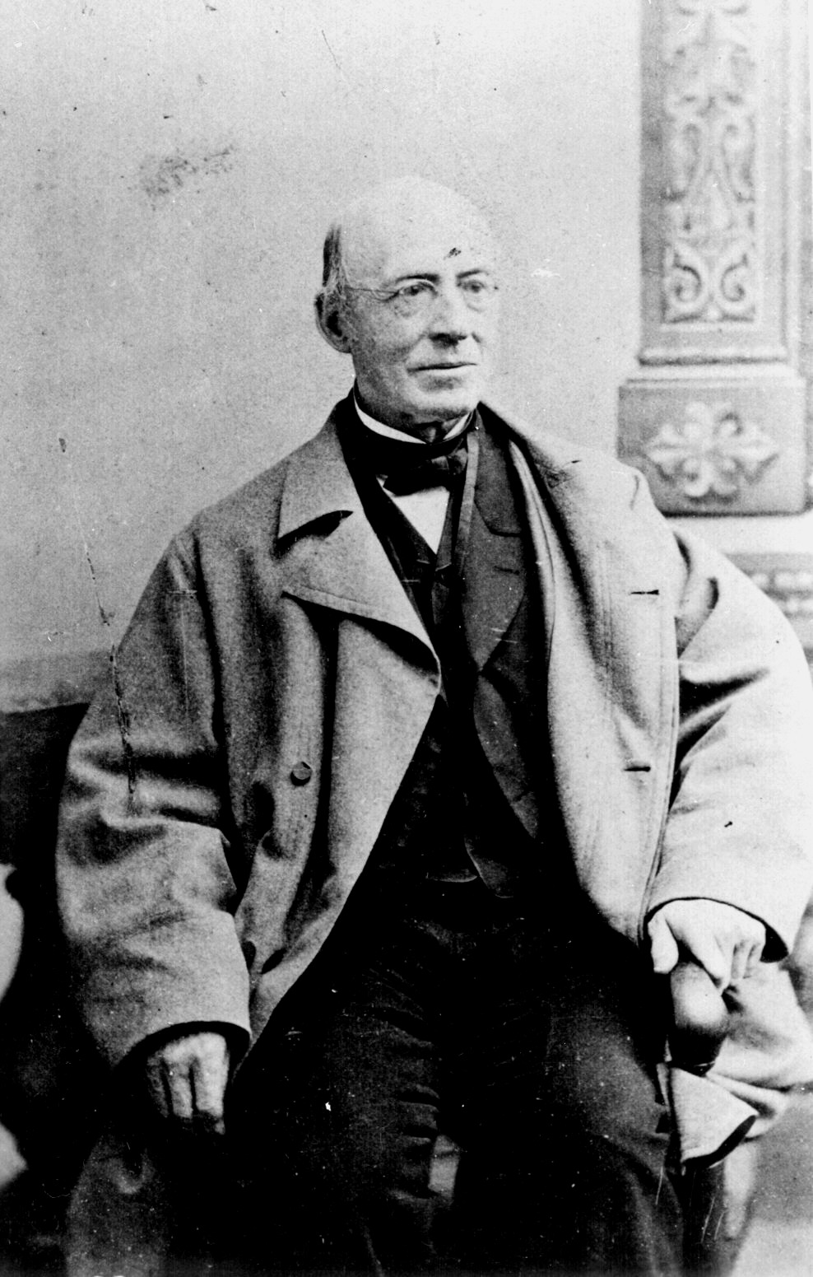
William Lloyd Garrison (1801-1879)
Slavery was a moral evil
It undermined the republic
Constitutionality of slavery was blight on America
Immediate emancipation w/o compensation
Started newspaper, The Liberator

Slide 41
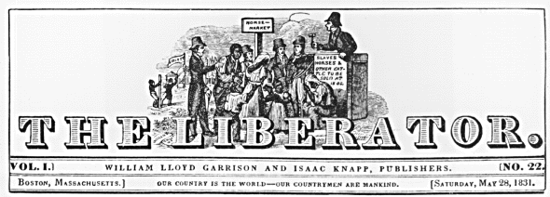
The Liberator
Premiere issue → January 1, 1831

Slide 42
Black Abolitionists
David Walker (1785-1830)
1829 → Appeal to the Coloured Citizens of the World
Fight for freedom rather than wait to be set free by whites
Harriet Jacobs (1813-1897)
North Carolinian slave
Escaped slavery and became writer and abolitionist
Wrote account of her life as a slave, Incidents in the Life of a Slave Girl, 1861
Link to PBS, “Slavery and the Making of America,” episode 3, “Seeds of Destruction” – information on Jacobs, Frederick Douglass, and abolitionism

Slide 43
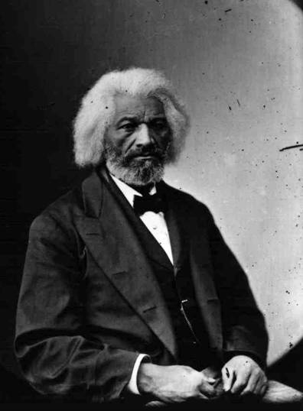
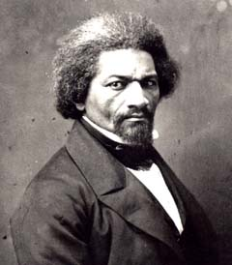
Frederick Douglass
1845 → The Narrative of the Life of Frederick Douglass
1847 → “The North Star”
R2-12

Slide 44
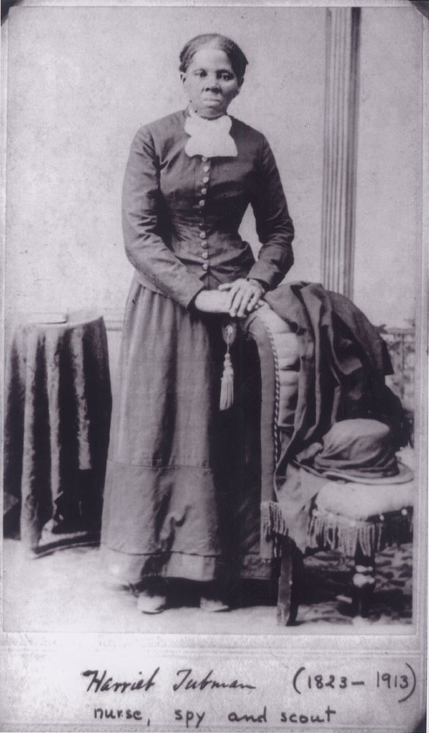
Harriet Tubman (1820-1913)
Helped over 300 slaves to freedom
Called “Moses” for her efforts to lead slaves north to “the promised lands” of northern states and Canada
$40,000 bounty on her head
Served as a Union spy during the Civil War

Slide 45
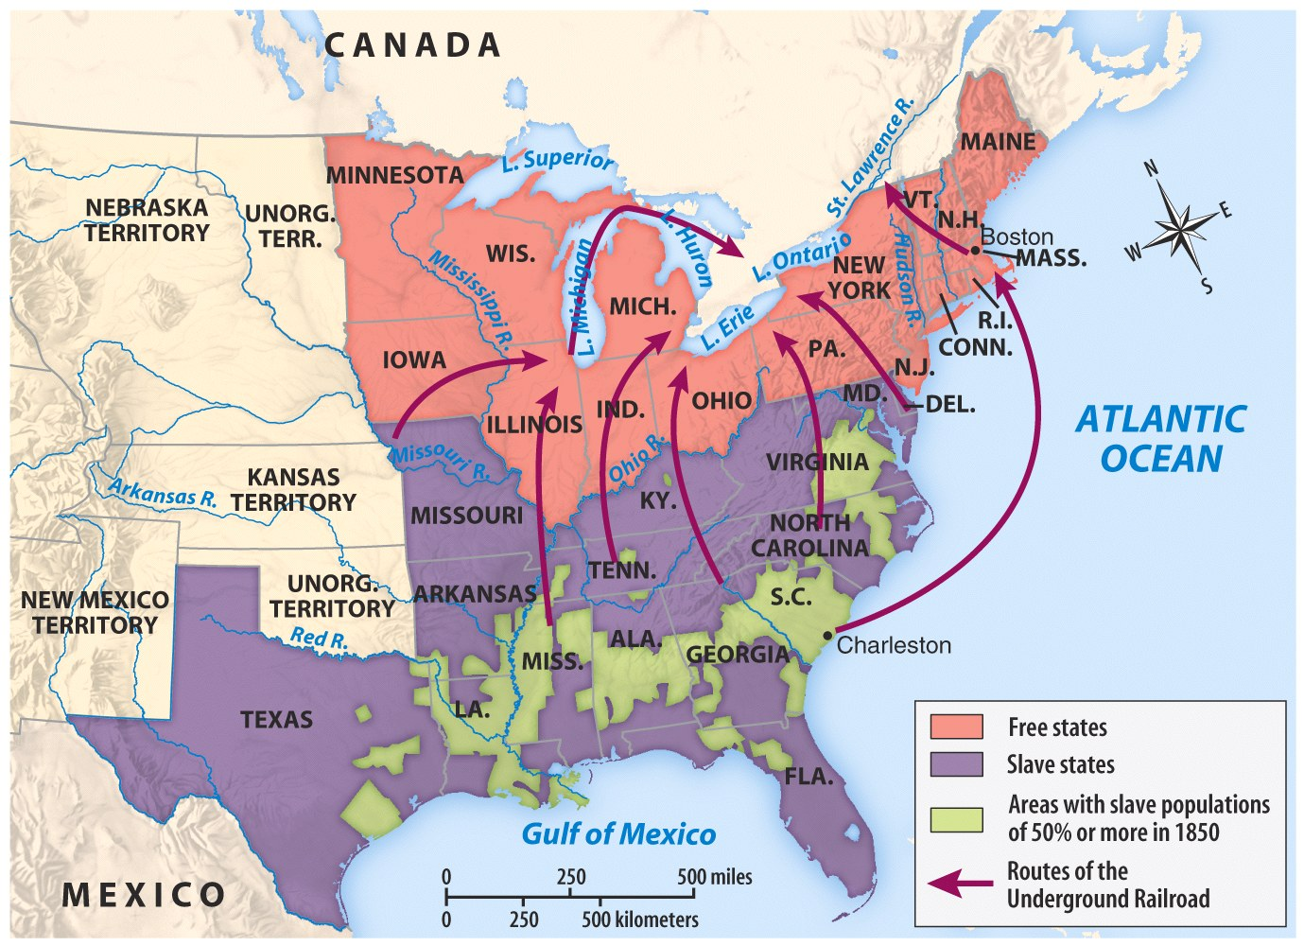
The Underground Railroad

Slide 46
The Underground Railroad
“Conductor” ==== leader of the escape
“Passengers” ==== escaping slaves
“Tracks” ==== routes
“Trains” ==== farm wagons transporting the escaping slaves
“Depots” ==== safe houses to rest/sleep
Escaped slaves were hidden in the homes and barns of abolitionist whites and free blacks

