Slide 1
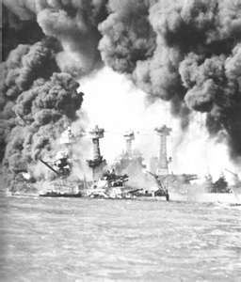
America Enters the War
WWII – Supporting the Allies, Pearl Harbor

Slide 2
Objectives
Explain how Roosevelt helped Britain while maintaining official neutrality.
Trace the events that led to increasing tensions, and ultimately war, between the U.S. and Japan.

Slide 3
Pearl Harbor

Slide 4
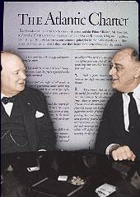
FDR Supports England
I. FDR Supports England
A. Revised Neutrality Act
B. Destroyers for Naval Bases
II. Isolationist Debate
III. Edging Toward War
A. Lend-lease Act
1. $50 Billion weapons/supplies
B. Hemispheric Defense Zone
C. Atlantic Charter

Slide 5
Roosevelt and Churchill met near Newfoundland in 1941 and agreed on the text of the
a.Export Control Act.
b. Neutrality Act.
c. Lend-Lease Act.
d. Atlantic Charter.

Slide 6
Fastest Responders
Seconds | Participant | Seconds | Participant

Slide 7
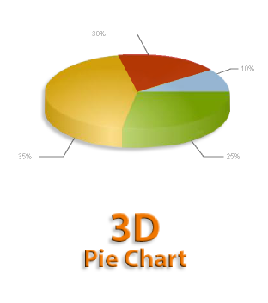
What did Roosevelt want to build on British-controlled land that compelled him to bypass the provisions of the Neutrality Act and trade 50 old destroyers with Britain?
a.new industries
b. military bases
c. research centers
d. schools

Slide 8
Fastest Responders
Seconds | Participant | Seconds | Participant

Slide 9
In 1941 President Roosevelt began sending lend-lease aid to
a. China.
b. Britain.
c. the Philippines
d. France.

Slide 10
Fastest Responders
Seconds | Participant | Seconds | Participant

Slide 11
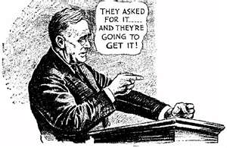
Japan attacks U.S.
IV. Japan attacks U.S.
A. America Embargoes Japan
1. Export Control Act
*Strategic Materials
2. Attack on Pearl Harbor
a. Dec. 7th 1941

Slide 12
In June 1941, in violation of the Nazi-Soviet pact, Hitler launched a massive invasion of
a. Norway.
b. Bulgaria.
c. the Soviet Union.
d. Czechoslovakia

Slide 13
Fastest Responders
Seconds | Participant | Seconds | Participant

Slide 14
What finally brought the United States into World War II?
a. sinking of the Reuben James
b. Americans’ horror at the persecution of people by Nazis
c. Japanese attack on Pearl Harbor
d. the Atlantic Charter

Slide 15
Fastest Responders
Seconds | Participant | Seconds | Participant

