Slide 1
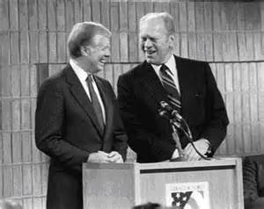
Gerald Ford and Jimmy Carter
Ch. 27.2

Slide 2
Objectives
Explain the reasons for economic troubles in the U.S. during the 1970’s
Discuss Jimmy Carter’s domestic and foreign policies

Slide 3
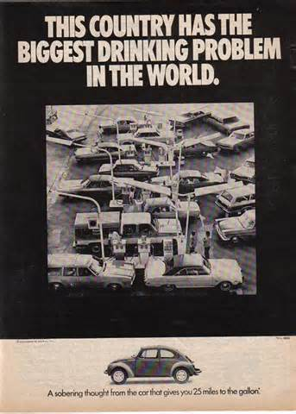
Economic Crisis of the 1970’s
I. Economic Crisis
A. Slowing Economic Machine
1. inflation
2. Organization of Petroleum Exporting Countries (OPEC)
a. embargo
b. $3 (1973) - $30 (1980)
B. Stagnant Economy
1. World Competition in Manufacturing
a. “stagflation”

Slide 4
Two things that economists who emphasized the demand-side of economic theory, including supporters of Keynesianism, did not think could occur at the same time were recession and
a. bull market.
b. peace.
c. inflation.
d. stagflation.

Slide 5
The Organization of Petroleum Exporting Countries announced that its members would embargo, or stop shipping, petroleum to countries that supported
a. Iraq.
b. Egypt.
c. Iran.
d. Israel.

Slide 6
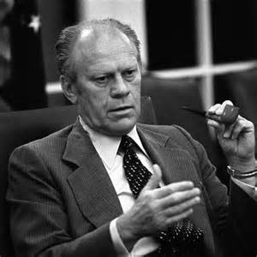
Nixon controls Inflation
i. how to combat stagflation?
- gov. spending = inflation
- taxes = prolong recession
b. Nixon controls inflation
i. cuts deficit spending
ii. Raises taxes
II. Gerald Ford
A. Economic Concerns
B. Foreign Policy

Slide 7
In August 1975, President Ford met with leaders of NATO and the Warsaw Pact to sign the
a.Helsinki Accords.
b. Camp David Accords.
c. OPEC Agreement.
d. Nixon pardon.

Slide 8
Like the presidents immediately preceding him, President Ford encountered problems in Southeast ____________________, particularly in Cambodia.
Europe
Israel
Asia
Afghanistan

Slide 9
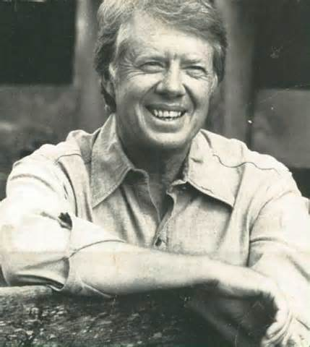
Jimmy Carter
III. Jimmy Carter
A. War Against Consumption
1. Department of Energy
B. Foreign Policy
1. Panama Canal
2. Embargos USSR & Boycotts 1980 Olympics in Moscow
C. The Middle East
1. Camp David Accords

Slide 10
What virtually collapsed under the Carter administration?
A. the Cold War
b. the economic crisis
c. human rights
d. détente

Slide 11
President Carter felt that the nation’s most serious problem was its dependence on
A. détente.
b. foreign oil.
c. the federal government.
d. industry.

Slide 12
To remove a major symbol of U.S. interventionism in Latin America, President Carter moved to give the Panamanians control of the Panama ____________________.
A. Peninsula
B. Capital
C. Canal
D. Economy

Slide 13
Hostage Crisis in Iran

Slide 14
Finish Homework

