Slide 1
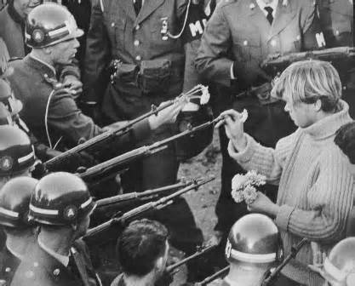
The War Winds Down
Ch. 25.4

Slide 2
Objectives
Explain the events of Nixon’s first administration that inspired more antiwar protests.
Summarize the major lessons learned by the U.S. from the war.

Slide 3
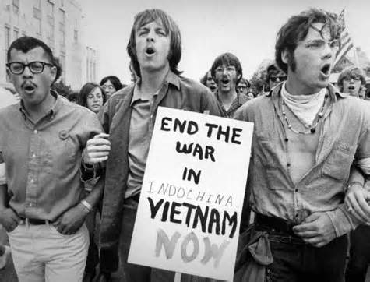
Nixon’s move to end war
I. Ending the War
A. Policies & Personnel
1. Henry Kissinger
a. linkage
2. Vietnamization
-troop reduction
II. Volatile Homefront
A. My Lai Massacre
B. Invasion of Cambodia

Slide 4
Student Movements: Kent State

Slide 5
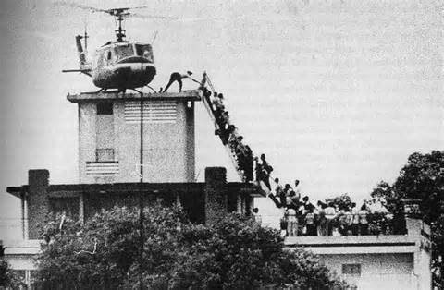
U.S. Pulls Out of Vietnam
III. U.S. Leaves Vietnam
A. Peace Talks & Bombings
1. Concessions:
-POW’s released
-U.S. Troop Withdraw
-N. Vietnamese Troops in S.
B. South Vietnam Falls
1. April 30th 1975

Slide 6
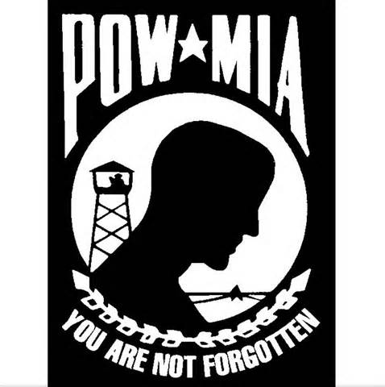
Legacy of Vietnam
IV. Vietnam Legacy
A. Human Toll
1. 58,000 U.S. Deaths
2. 300,000 injured
3. POW/MIA
B. Impact of War
1. War Powers Act
2. Isolationism
3. cynicism toward government

