Slide 1
Vietnam Divides the Nation
Ch. 25.3

Slide 2
Objectives
Analyze why support for the war began to weaken.
Describe the motives of those in the antiwar movement.

Slide 3
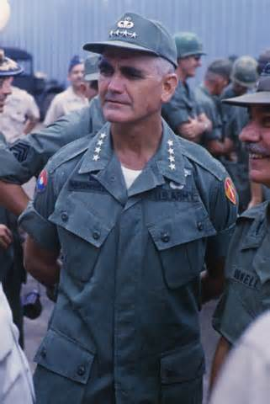
Growing Credibility Gap
I. Credibility Gap
A. William Westmoreland
1. credibility gap
2. educational hearings
II. Antiwar Movement
A. teach-ins
1. issues:
a. S. Vietnam corrupt
b. Civil War
c. Draft

Slide 4
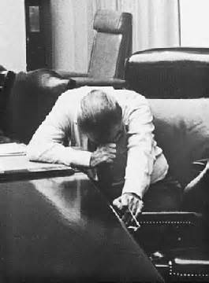
THE DRAFT!
i. College Deferment
ii. Draft Dodgers
iii. Anti-War Protests
2. Hawks vs. Doves
III. 1968
A. Tet Offensive (1/30)
-pg. 788
B. Johnson leaves Presidential Race

Slide 5
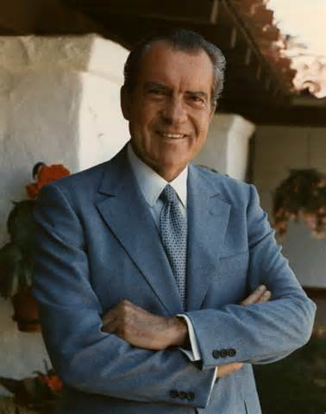
Nixon Elected
C. Nixon Elected
1. Nixon (R), vs.Humphrey (D), vs. Wallace (SD)
a. Issues:
-The War
- Civil Rights Protests

