Slide 1
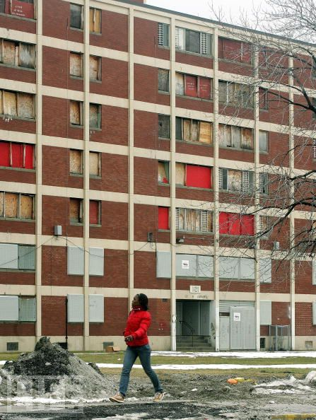
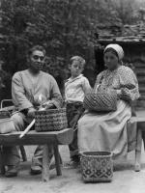
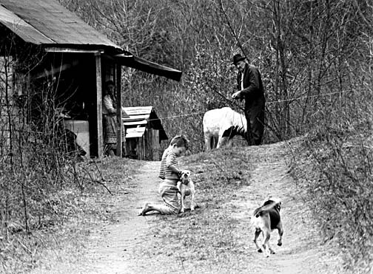
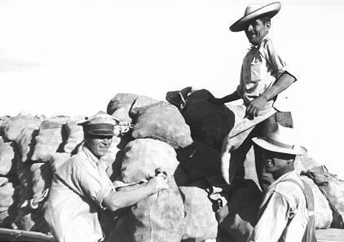
Poverty Amidst Prosperity
Ch. 22.4
African Americans
Native Americans
Mexican Farm Workers→
←Appalachia

Slide 2
A figure set by the government to reflect the minimum cost to support a family?
10
Termination Policy
Poverty Line
Juvenile Delinquency
Native Americans

Slide 3
Antisocial or criminal behavior of young people?
10
Juvenile Delinquency
Poverty Line
The Other America
Termination Policy

Slide 4
The federal governments withdrawal of all official recognition of all Native American groups as official entities?
10
Minorities
Poverty Line
Termination Policy
Policy of containment

Slide 5
By the mid 1900’s, what group was the poorest in the U.S.?
10
German Americans
Mexican Americans
African Americans
Native Americans

Slide 6
What government programs tried to end poverty by tearing down low income housing, and replacing them with high rise buildings?
10
Bracero Program
Termination Program
Urban Renewal Program
Welfare Program

Slide 7
The Bracero Program allowed for a sharp increase of agricultural workers from where?
10
Portugal
Netherlands
Spain
Mexico

Slide 8
Studies of life in Appalachia revealed high infant mortality rates as well as what?
10
Juvenile Delinquency
Polio
Suicide
Nutritional Deficiencies

Slide 9
The core of inner-city areas declined as middle class residents moved to suburbs and took what with them?
10
Tax Dollars
Minorities
Cultural Events
Termination Policies

