Slide 1
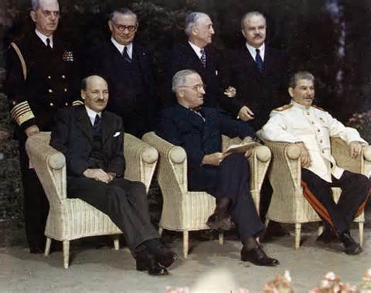
Origins of the Cold War
Ch. 21.1

Slide 2
Objectives
Explain the growing tensions between the U.S. and Soviet Union at the end of WWII
Identify the goals of Stalin’s foreign policy immediately after the war.

Slide 3
Concerns of the World Powers
United States
Soviet Union
Economic Problems
Promote trade & economic strength
Promote democracy & capitalism
SECURITY
Keep Germany weak
Pro-Soviet Governments to their West
Spread of Communism

Slide 4
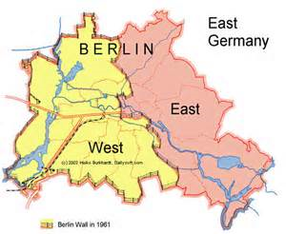
Yalta Conference
I. Yalta
A. Poland
1. U.S. & G.B. recognize communist government
2. Stalin agrees to Polish elections
a. Declaration of Liberated Europe
B. Germany
1. Divided into 2 parts

Slide 5
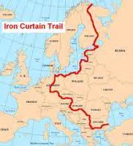
Truman
II. Potsdam Conference
A. Tension over Germany & Poland
*Means 4 Reparations
*Free Elections
*Borders
III. Iron Curtain
A. Satellite Nations
-Bulgaria, Romania, Hungary, Poland, Czechoslovakia

