Slide 1
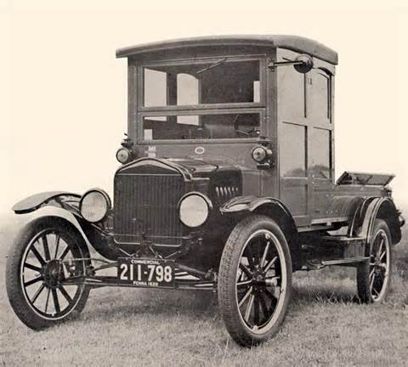
Roaring 20’s: Boom Times!
Automobile Industry, Assembly Line, Welfare Capitalism, Consumer Credit

Slide 2
Objectives
Analyze how the growing importance of the automobile and other new industries improved the U.S. standard of living.
Describe how Welfare Capitalism offered incentives for workers that drove productivity and wage increases.

Slide 3
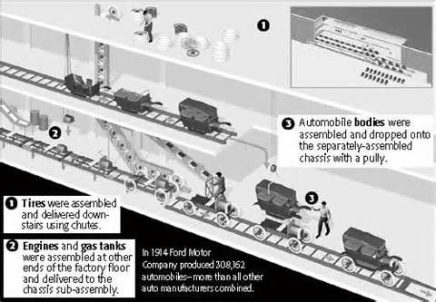
New Industries
I. Auto Industry
A. Henry Ford
1. Assembly Line
a. Model T
II. Consumer Goods
III. Aviation Industry
A. Postal Service
1.Charles Lindbergh

Slide 4
What system of manufacturing adopted by Henry Ford divided operations into simple tasks that unskilled workers could do and cut unnecessary motion to a minimum?
a. assembly line
b. mass production
c. Flivver
d. apprentice system
3

Slide 5
Henry Ford almost single-handedly changed the auto from a toy of the wealthy to an affordable necessity for the
a. delivery industry.
b. middle class.
c. farmers.
d. city dwellers.
3

Slide 6
The consumer goods industry created many new products for
a. factories.
b. the airline industry.
c. businesses.
d. the home.
0

Slide 7
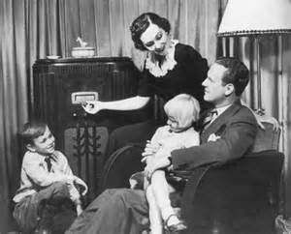
New Industries
IV. Radio Industry
A. Edwin Armstrong (1913)
1. Nat’l Broadcasting Co. [NBC]
2. Columbia Broadcasting System [CBS]
a. Advertising

Slide 8
To create consumers for their new products, manufacturers turned to
a. television.
b. mass production.
c. advertising.
d. newspaper and magazine articles.
10

Slide 9
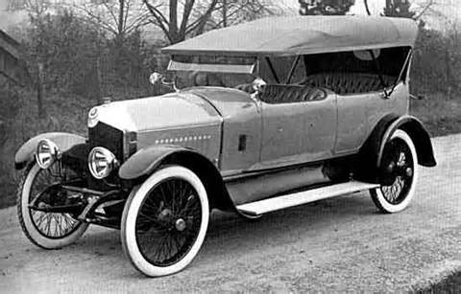
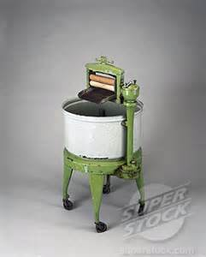
Consumer Society
V. Consumer Credit
A. “Buy now pay later”
1. Installments
a. Accepting debt
VI. Welfare Capitalism
A. Worker Benefits:
-Stock Options
-Profit Sharing
-Medical Care
-Pension
**Decline in Unions**

Slide 10
Many consumers in the 1920s began to feel confident that they could buy now and pay later, so many bought everything from radios to cars on the ____________________ plan.
4
Credit
Consumer
Installment
Debt

