Slide 1
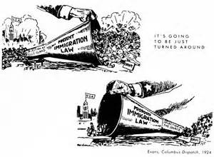
1920’s: A Clash of Values
Isolationism, Nativism, and Immigration Controls in the 1920’s

Slide 2
Objectives
Explain the rise of racism and nativism in the 1920’s
Describe the limitations placed on immigration to the U.S. during the 1920’s

Slide 3
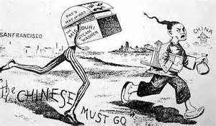
Political Cartoon Analysis
Chinese Exclusion Act

Slide 4
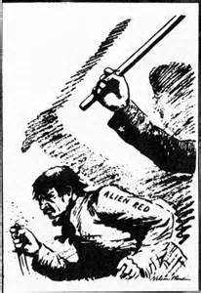
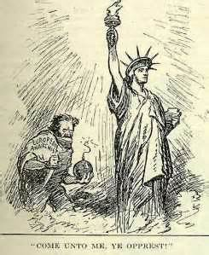
Political Cartoon Analysis
Red Scare

Slide 5
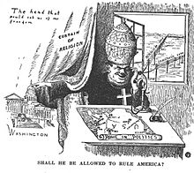
Political Cartoon Analysis
Catholicism

Slide 6
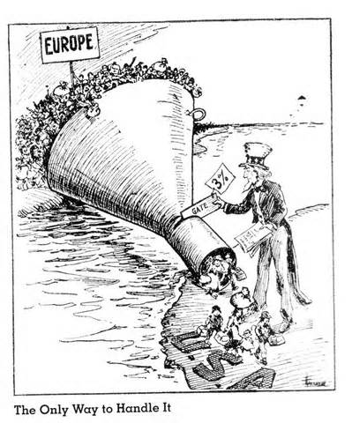
Political Cartoon Analysis
Immigration
Controls

Slide 7
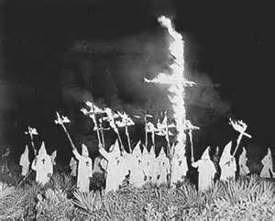
Clash of Values
I. Nativism Resurges
A. Sacco-Vanzetti Case
1. Anti-Immigrant feel
a. Anarchism – oppose all forms of government.
B. Eugenics – selective breeding
C. Return of the KKK
1. “fighting for Americanism”
a. 4 million by1924

Slide 8
What was the name of the science that lent authority to racist theories and reinvigorated the nativist argument for strict immigration control?
a. nativism
b. creationism
c. evolution
d. eugenics
:07

Slide 9
Clash of Values
II. Controlling Immigration
A. Emergency Quota Act (1921)
1. enacted the 3% Rule
-meant to limit Eastern European immigration
Why??→ Red Scare
B. National Origins Act (1924)
1. 2% rule based upon 1920 census
a. 87% of immigrants from Northern Europe
b. Mexican immigration

Slide 10
The National Origins Act of 1924 and the demand for cheap farm labor in California and the Southwest contributed to the large wave of immigration from
a. China.
b. South Americ
c. Mexico.
d. Canada.
:06

Slide 11
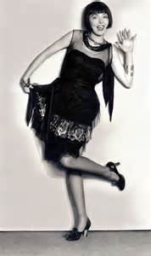
Clash of Values
III. The “New” Morality
A. Glorification of youth and freedom
Examples: -loving family
-women in college
-women in workforce
-the automobile
B. Women of the 1920’s
1. Flappers →
2. Moving in the workforce
a. Margaret Sanger – Planned Parenthood

Slide 12
What did many of the groups who wanted to restrict immigration and preserve what they considered traditional values fear was taking over the nation?
a. Communists
b. anarchists
c. a “new morality”
d. a new religion
:05

Slide 13
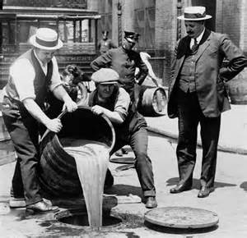
Clash of Values
IV. Fundamentalism
A. Fundamentalist Beliefs:
-protection of Protestant faith
**against evolution
1. against:
-modern consumer culture
-relaxed ethics
-growing urbanism

Slide 14
Many Americans feared that the country was losing its traditional values and responded by joining a religious movement known as
a.Fundamentalis
b.Quakerism.
c.Protestantism.
d.Catholicism.
:06

Slide 15
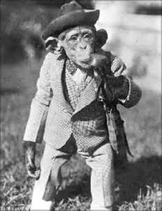
Clash of Values
B. Scopes Trial
1. Butler Act
-outlawed teaching evolution
a. American Civil Liberties Union
i. John T. Scopes
V. Prohibition
A. 18th Amendment
1. Volstead Act
a. policing powers to federal gov.

Slide 16
Where did the debate over science and religion and their place in education take place during the summer of 1925?
a. at Billy Sunday’s revivals
b. in the Scopes trial
c. in Florence Sabin’s research
d. in Lyman Stewart’s book, The Fundamentals
:06

