Slide 1
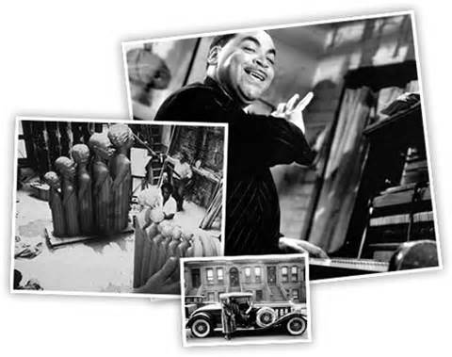
Roaring 20’s: Harlem Renaissance
Jazz & Blues, Literature, and African American Politics

Slide 2
Objectives
Describe the Harlem Renaissance and the rediscovery of African American culture.
Explain the increase in African American political activism.

Slide 3
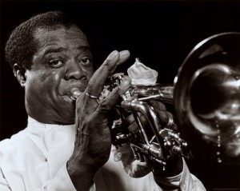
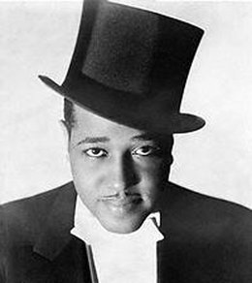
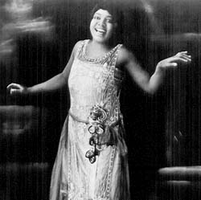
Opening Activity
Turn your books to page 433.
Read “Harlem Renaissance Writers
Answer the three questions.
Group Activity: (5 Minutes)
*Research a leading African American associated with the Harlem Renaissance during the 1920’s.
-be prepared to tell your classmates about said individual

Slide 4
What music with its bold solos and improvisational freedom is recognized around the world as the distinctive American contribution to music?
a. ragtime
b. jazz
c. country
d. classical
5

Slide 5
Harlem Renaissance

Slide 6
Two striking characteristics of Harlem Renaissance writing found in the poetry of Claude McKay are an expression of proud defiance and a bitter contempt of
a. nationalism.
b. anarchists.
c. racism.
d. Communists.
5

Slide 7
The Great Migration had a significant impact on the political power of African Americans in the
a. presidential election.
b. Democratic Party.
c. South.
d. North.
5

Slide 8
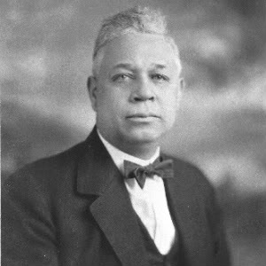
African Americans in Politics
II. A.A. Politics
A. Blacks vote in North
1. voting blocks
a. Republican Party
- Oscar DePriest
B. NAACP Battles Lynching
1. Anti-lynching legislation
2. Judge John J. Parker

Slide 9
One of the NAACP’s greatest political triumphs occurred in 1930 with the defeat of Judge John J. Parker’s nomination to the
a. U.S. Supreme Court.
b. House of Representatives.
c. Senate.
d. Circuit Court.
3

Slide 10
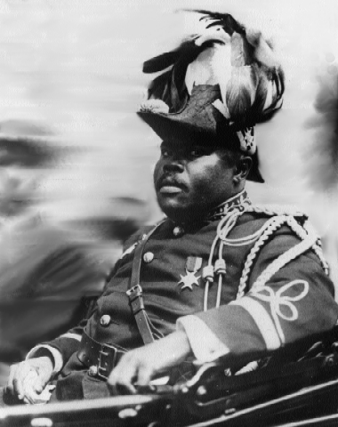
African American Politics
C. Black Nationalism
1. Marcus Garvey
a. “Negro Nationalism”
-Universal Negro
Improvement Association (UNIA)
*Education
b. Back to Africa Movement
Homework: Read 430 – 437
Complete: #’s 1 & 4

Slide 11
The Universal Negro Improvement Association was founded by a dynamic black leader from Jamaica,
a. Langston Hughes.
b. Paul Robeson.
c. Duke Ellington
d. Marcus Garvey.
5

