Slide 1
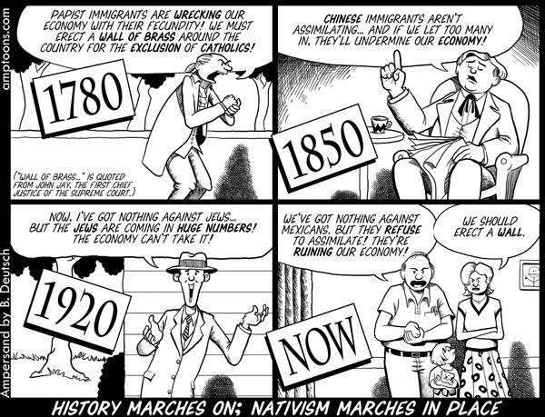
Immigration
Ch. 10.1

Slide 2
Objectives
Analyze the circumstances surrounding the great wave of immigration after the civil war.
Evaluate how Nativism affected immigration policies

Slide 3
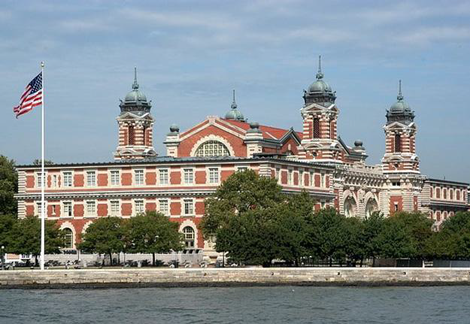
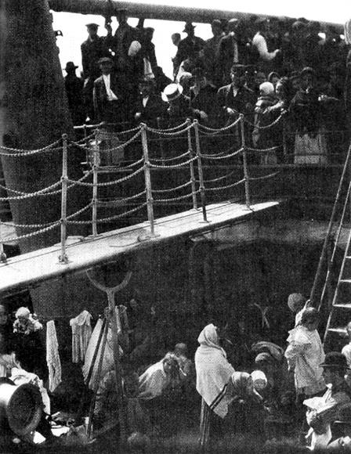
Europeans to the U.S.
I. Europeans to U.S.
A. Reasons:
-jobs
-avoid social issues
-religious persecution
B. Journey: (pg. 337)
C. Ellis Island
-physical inspections

Slide 4
The processing center for the vast majority of immigrants arriving on the East Coast was at
a. Angel Island.
b. Staten Island.
c. Ellis Island.
d. Long Island.

Slide 5
Moving to the United States offered immigrants a chance to break away from Europe's ____________________ system and move to a democratic nation where they could move up the social ladder.
Medical
Class
Labor
Religious

Slide 6
The most basic and cheapest accommodations on a steamship was called…?
Stowage
Steerage
Coach
The Poop Deck

Slide 7
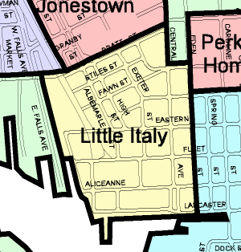
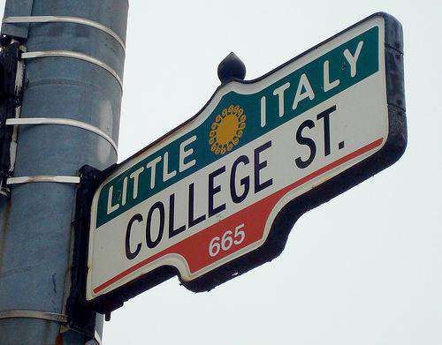
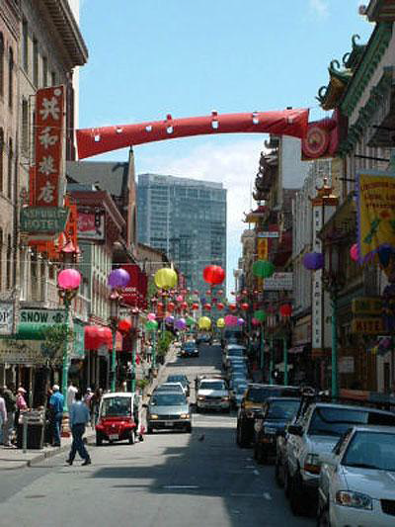
Ethnic Cities
D. Ethnic Cities
1. Metropolitan Areas
-”Little Italy”
-”Lower East Side”
-”China Town”
2. Culture:
-languages
-religions
-ethnic heritage

Slide 8
By the 1890s, immigrants made up significant percentages of some of the country’s largest
a. plantations.
b. cities.
c. farms.
d. suburbs.

Slide 9
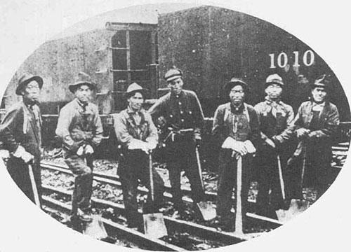
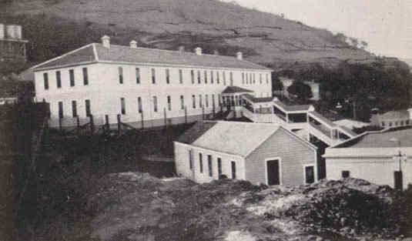
Asian Immigration to the U.S.
II. Asian Immigration
A. Reasons:
-overpopulation
-unemployment
-poverty
-famine
B. California Gold Rush (1848)
C. Railroad
D. Angel Island (SF)

Slide 10
Where did many Chinese immigrants settle?
a. western cities
b. eastern cities
c. southern plantations
d. along the New England coast

Slide 11
Resurgence of Nativism
III. Nativism–extreme dislike for foreigners by native people and a desire to limit immigration.
A. Prejudice
1. American Protective Association
2.Workingmans’sParty of California

Slide 12
Nativism had focused primarily on Irish immigrants but grew to include Asians, Jews, and
a. Canadians.
b. eastern Europeans.
c. the British.
d. Scandinavians.

Slide 13
Some native-born Americans feared that the influx of Catholics from Ireland and southern and eastern Europe would swamp the mostly ____________________ United States, giving the Catholic Church too much power in the American government.
Hindu
Muslim
Buddhist
Protestant

Slide 14
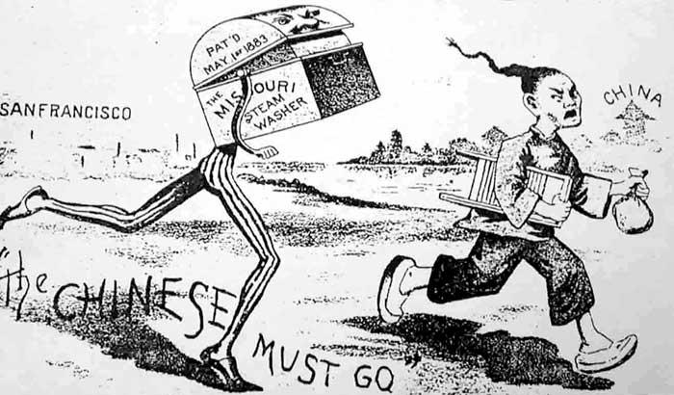
Anti-Immigrant Impact
B. Impact
1. Laws:
-no convicts, paupers, mentally disabled
-$.50 head tax
2. Chinese Exclusion Act
a. banned immigration
b. refused citizenship

Slide 15
What law, passed in 1882, barred Chinese immigration for 10 years and prevented the Chinese already in the country from becoming citizens?
a.Workingman’s Party of California Act
b. Chinese Immigration Act
c. Taiping Act
d. Chinese Exclusion Act

