Slide 1
The War Ends
Ch. 20.5

Slide 2
Objectives
Explain the tactics used to invade Germany and to Defeat Japan.
Outline the reasons the Allies created the United Nations and held war crimes trials.

Slide 3
Battle of Bulge & Fall of Nazi Germany

Slide 4
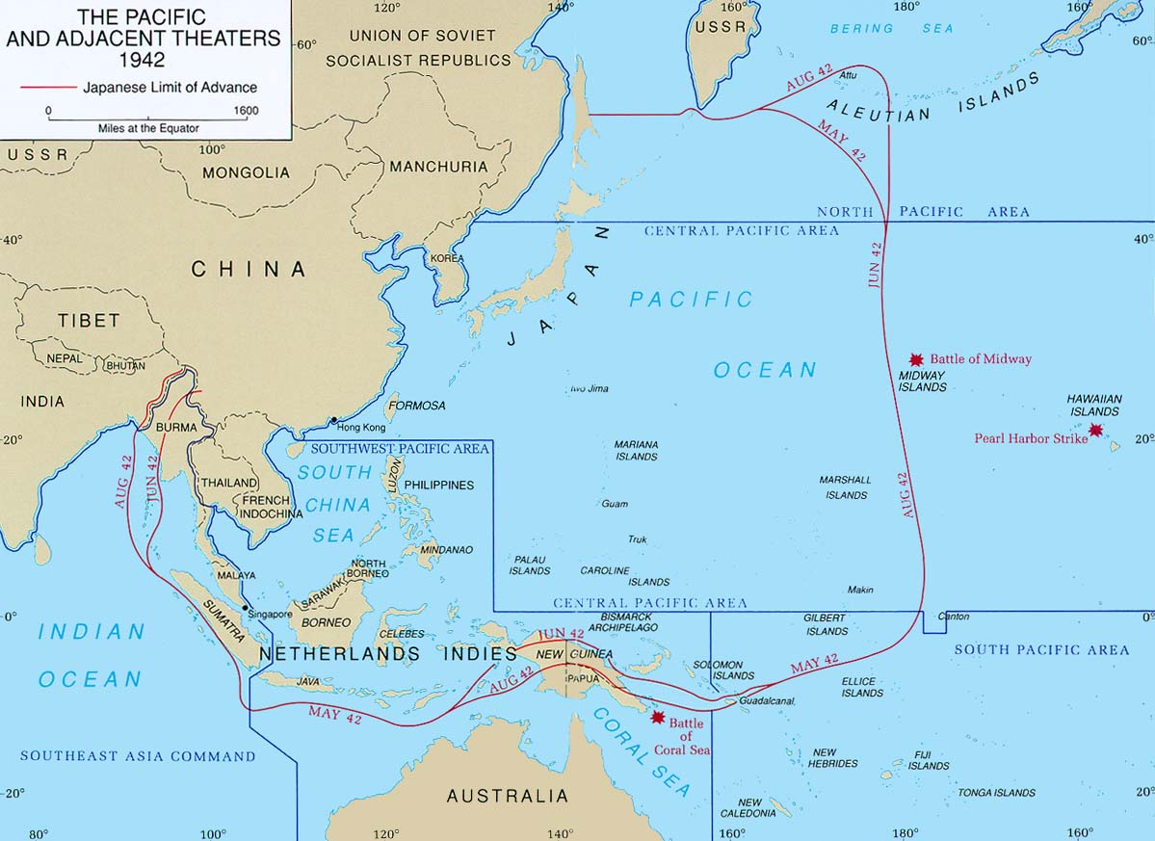
The Asian Theater
I. Asian Theater
A. Battle of Midway
1. Naval Battle
B. Island Hopping
1. Philippines
2. New Guinea
3. Solomon Islands

Slide 5
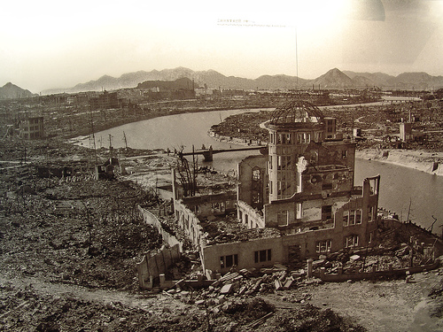
Frontline Civilians: Bombing of Cities
II. Bombing
A. Japan
1. Fire Bombings
ex.) Tokyo
2. Atomic Bombs
a. Hiroshima (Aug 6)
b. Nagasaki (Aug 9)
*Fat Man
*Little Boy

Slide 6
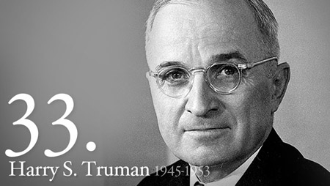
End of WWII
III. End of WWII
A. Harry S. Truman
1. Atomic Weapons or Troop Assault
- Hiroshima
- Nagasaki
Aug. 14th, 1945 = End of War

Slide 7
United Nations
IV. United Nations
A. 50 Countries
1. General Assembly
2. Security Council
a. 11 members
-U.S., G.B., USSR,
France, China
** purpose = promote peace

