Slide 1
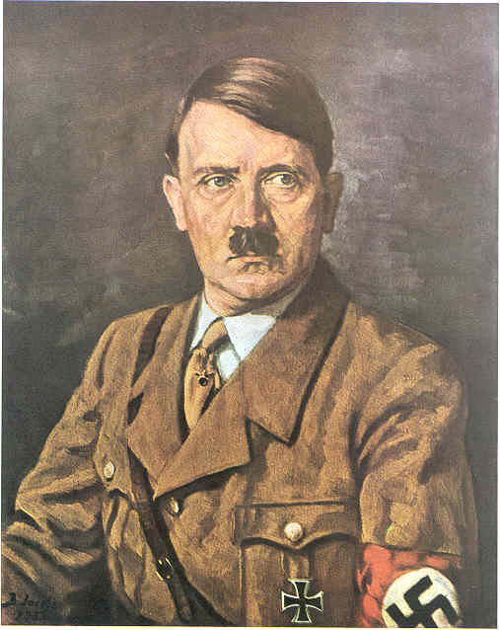
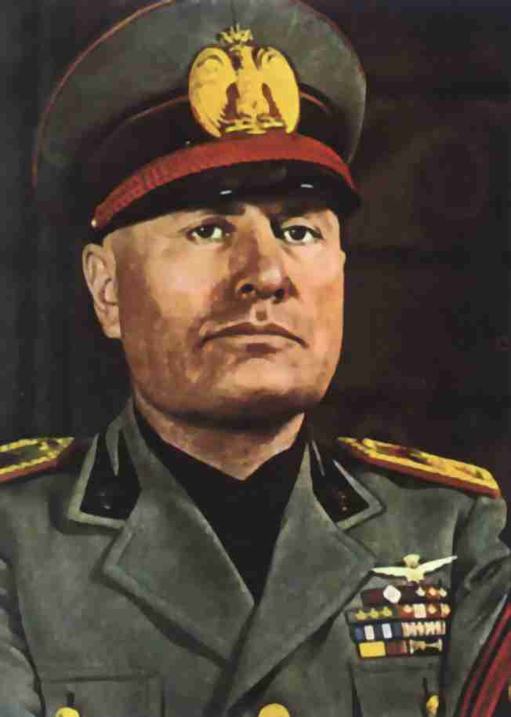
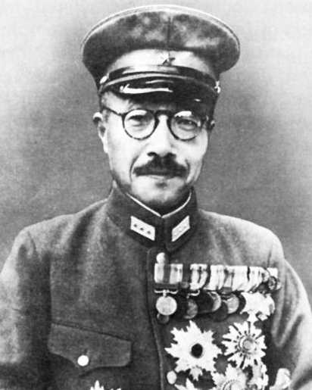
Pushing Back the Axis

Slide 2
Objectives
Describe the goals of the two major offensives the Allies launched in Europe in 1943.
Explain the American strategy for pushing the Japanese back in the Pacific.

Slide 3
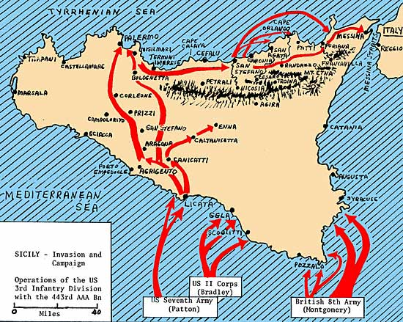
Striking the Third Reich
I. Striking 3rd Reich
A. Casablanca Conf.
1. Bomb Germany
a. weaken morale
b. destroy military
c. destroy industry
2. Attack Sicily
a. “Soft Underbelly”
- U.S. & British
*300,000 casualties

Slide 4
It took the Allies five months to break through the German lines at Cassino and
a. Pas-de-Calais.
b. Anzio.
c. Salerno.
d. Guadalcanal.
8

Slide 5
The bombing campaign between January 1943 and May 1945 did not destroy Germany’s economy or undermine German morale, but it did destroy many aircraft factories, wrecked the railroad system, and caused a severe
a. water shortage.
b. ecological crisis.
c. oil shortage.
d. political scandal.
8

Slide 6
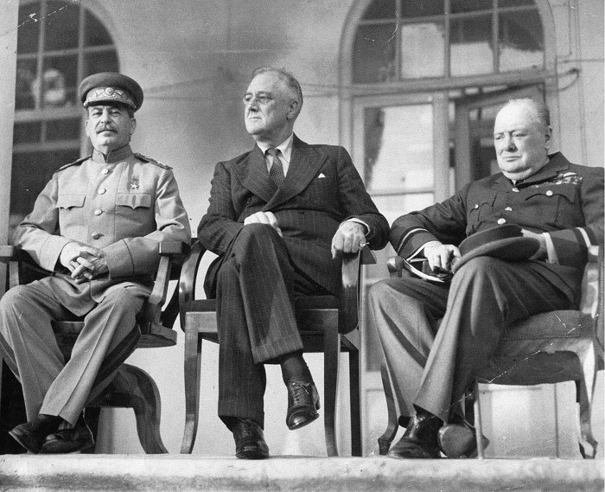
Tehran Conference
B. Tehran Conference
1. Invasion of Europe
a. Soviet Offensive
2. After the War
a. Division of Germany
II. Landing in France 4/15
A. Gen. Eisenhower
1. Operation Overlord
a. Pas-de-Calais

Slide 7
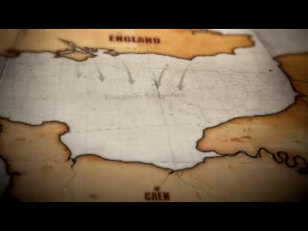
D-Day

Slide 8
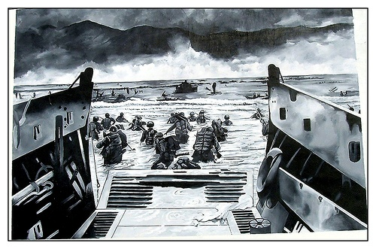
Invasion of Normandy
B. Invading Normandy
1. D-Day
a. June 6th 1944

Slide 9
On June 6, 1944, nearly 7,000 ships carrying more than 100,000 soldiers set sail for the coast of
a. Northern Africa.
b. the Philippines.
c. Japan.
d. Normandy.
8

Slide 10
Island Hopping in the Pacific

Slide 11
General MacArthur’s campaign in the southwest Pacific began with the invasion of
a. Australia.
b. Vietnam.
c. Guadalcanal.
d. Normandy.
8

