Slide 1
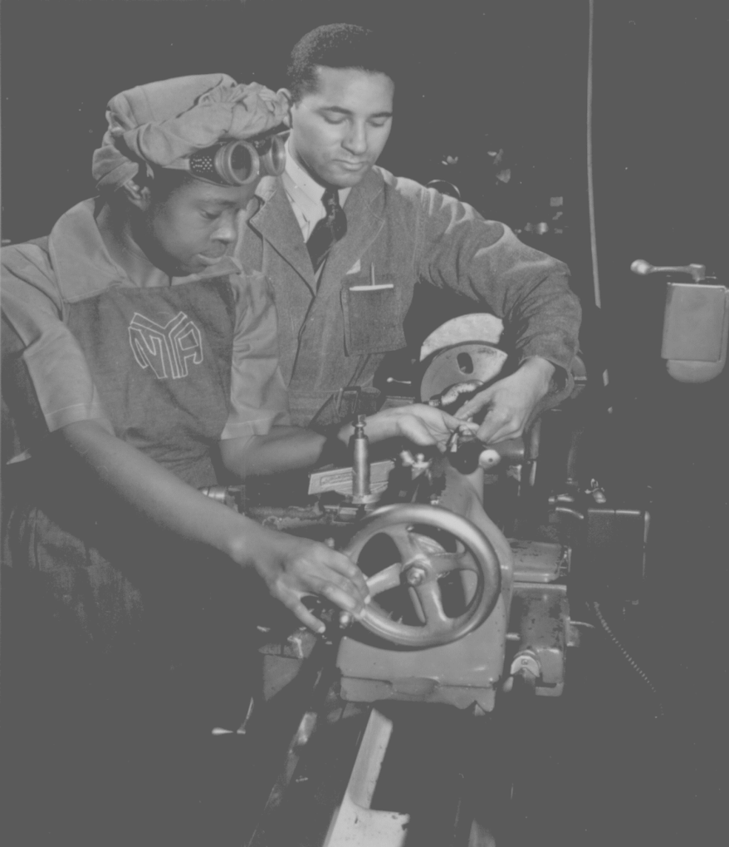
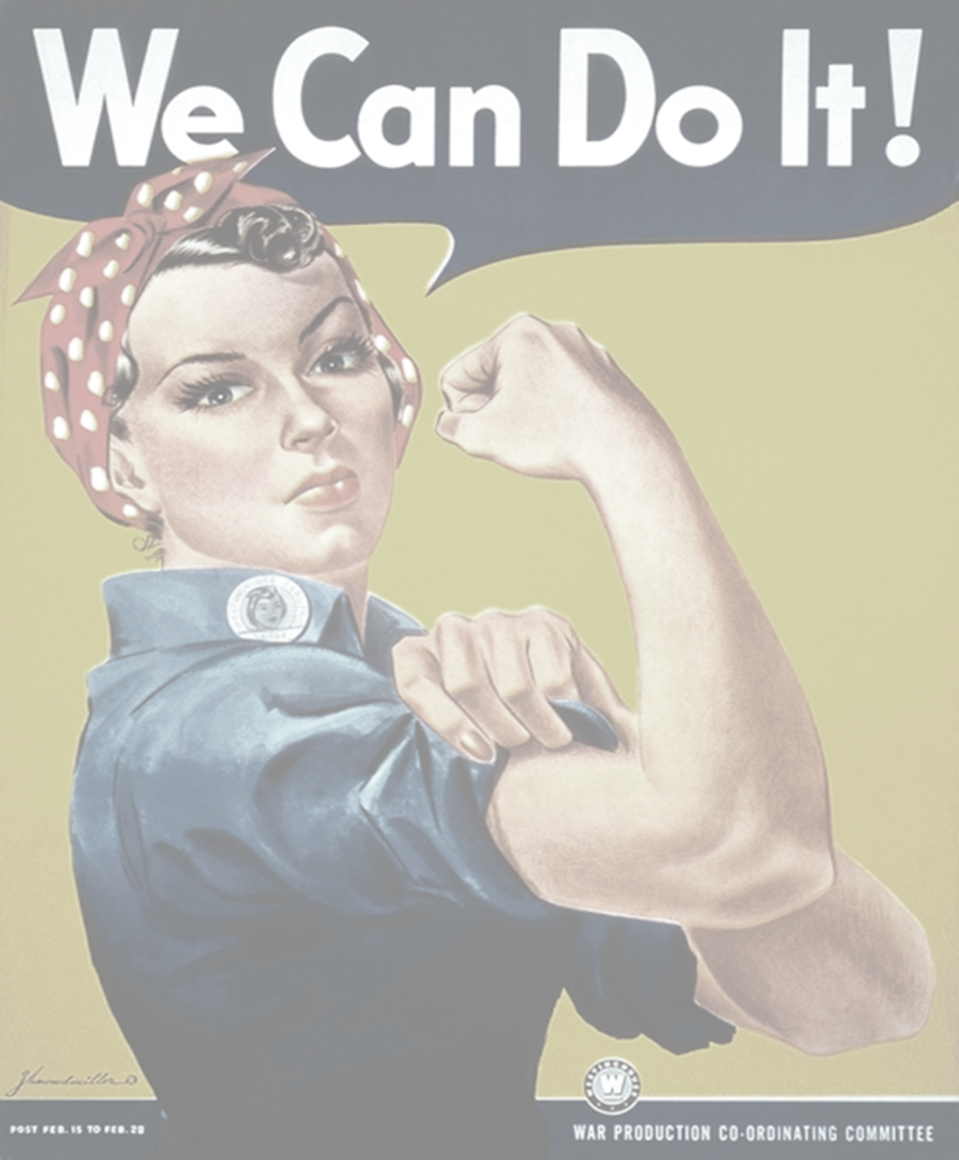
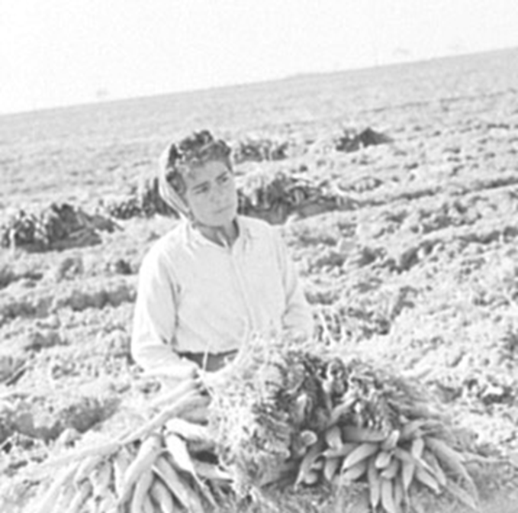
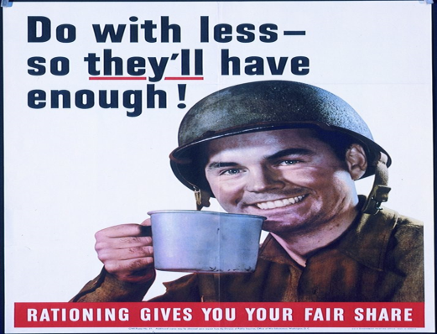
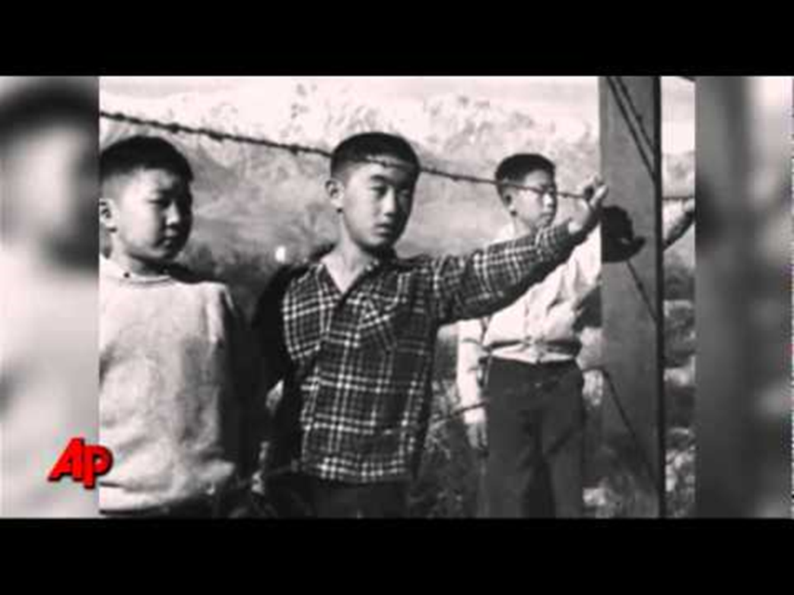
The American Homefront
WWII

Slide 2
Objectives
Describe how the wartime economy created opportunities for women and minorities.
Discuss how Americans coped with shortages and rapidly rising prices.

Slide 3
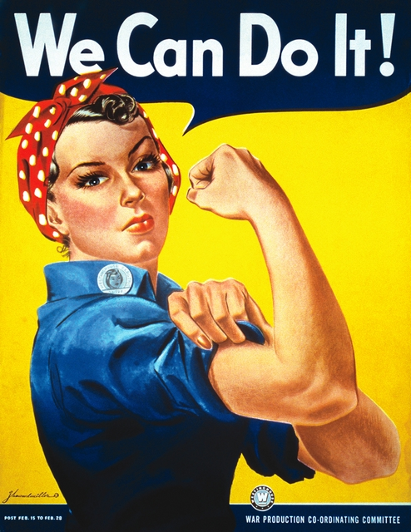
Women in the Work Force
Originally clerical
Wanted young Women
Later Housewife's
began working in Industry
Recruited into Military

Slide 4
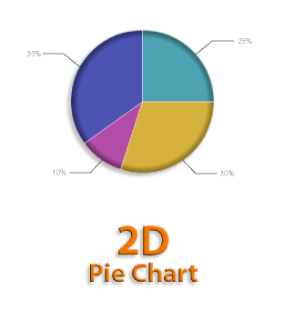
During World War II, women were recruited into the military to
serve in light combat.
b. serve as cooks and nurses.
c. release men for combat.
d. entertain the troops.
8

Slide 5
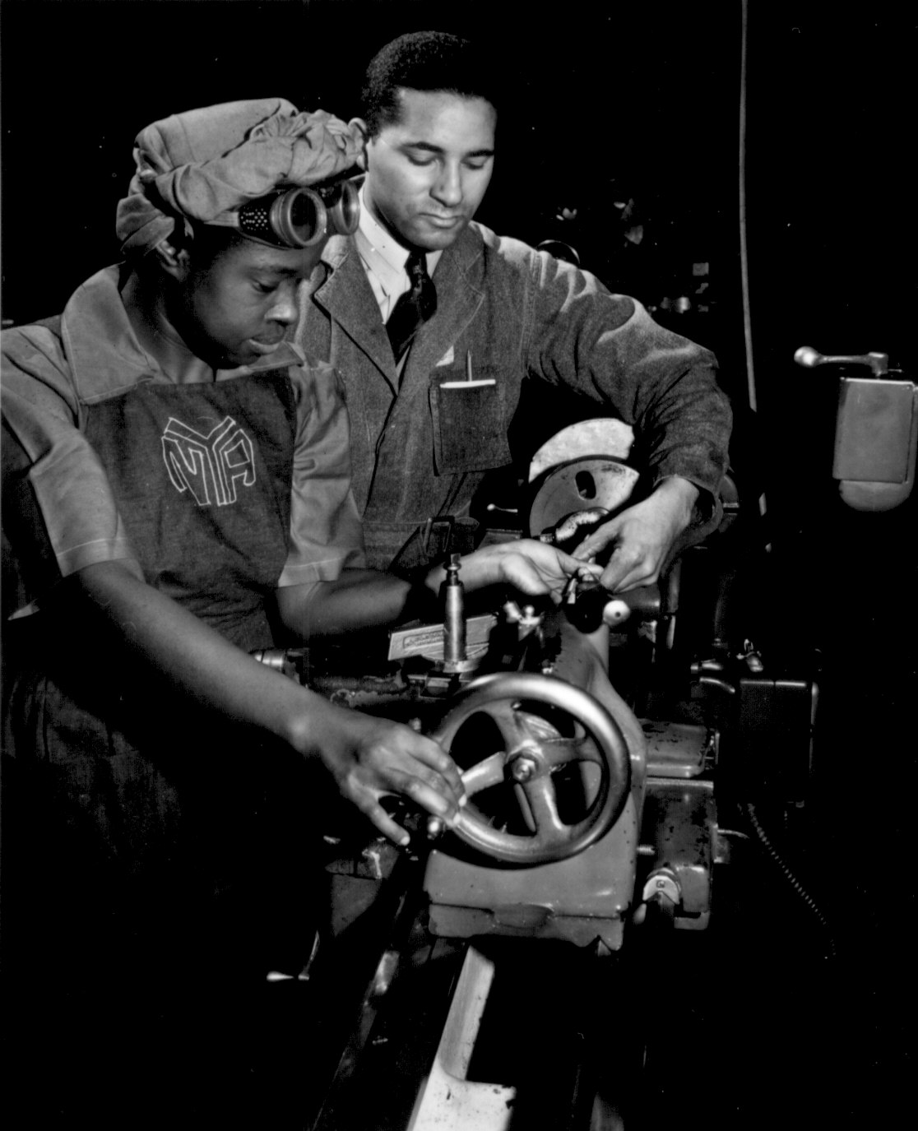
African Americans
2nd Great Migration
Industrial Jobs
Double V Campaign
Sparks racial violence
Detroit

Slide 6
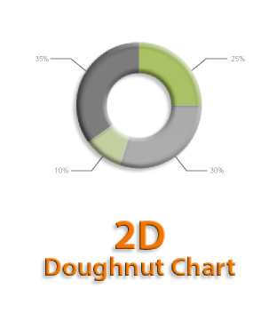
The “Double V” campaign meant
a. victory in Europe and victory in the Pacific.
b. victory over Hitler’s racism abroad and victory over racism at home.
c. victory over the Nazis and victory over the Fascists.
d. victory on land and victory on the seas.
10

Slide 7
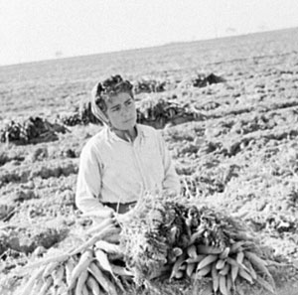
Mexican Workers
Bracero Program
Farm Labor
Railroads

Slide 8
Migrant farmworkers became an important part of the Southwest’s agricultural system as a result of
Planting of Victory Gardens
A relaxation of immigration quotas
The Bracero Program
The Great Migration
5

Slide 9
Japanese Internment

Slide 10
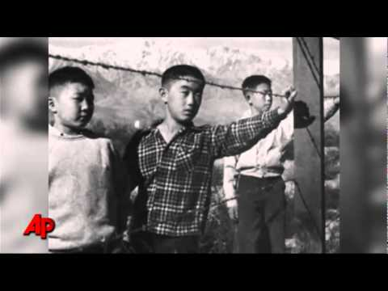
Japanese Internment
Relocation Camps
Executive Order
Military Zone
Korematsu V. U.S.

Slide 11
As a result of a presidential order allowing the military to declare any part of the United States to be a military zone,
a. many areas of the West became off-limits to civilians.
b. many Japanese Americans were moved to internment camps.
c. much of the Nevada desert became a weapons testing ground.
d. many military installations sprang up along the West Coast.
10

Slide 12
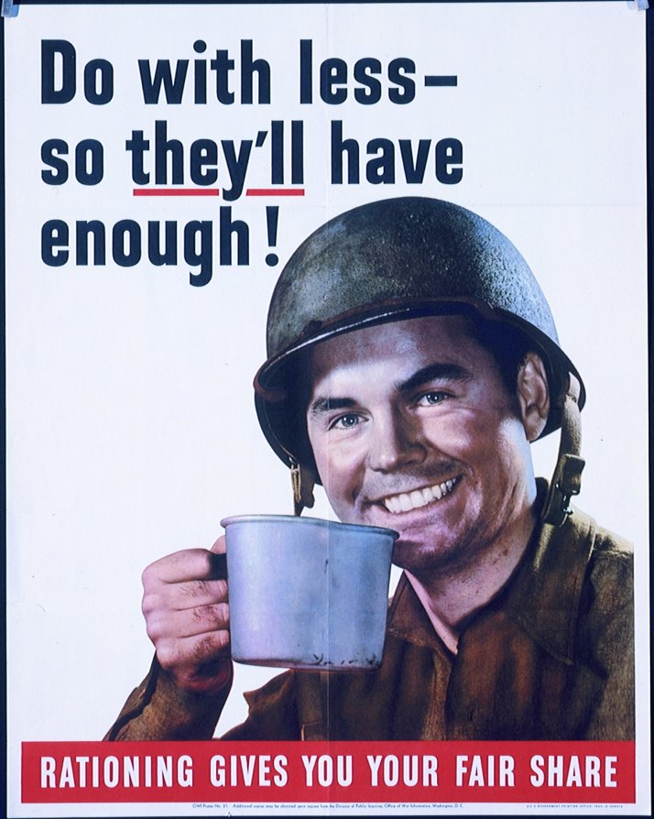

Slide 13
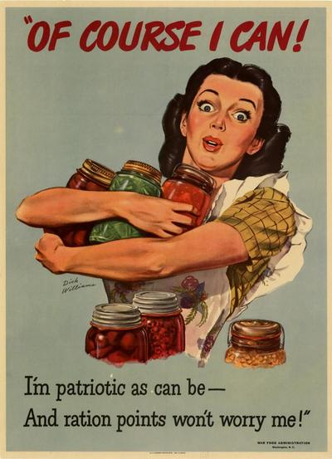

Slide 14
Blue points and red points were a system for
a. rewarding American civilians.
b. rationing goods.
c. prioritizing targets for attack.
d. mapping opposing forces.
5

