Slide 1
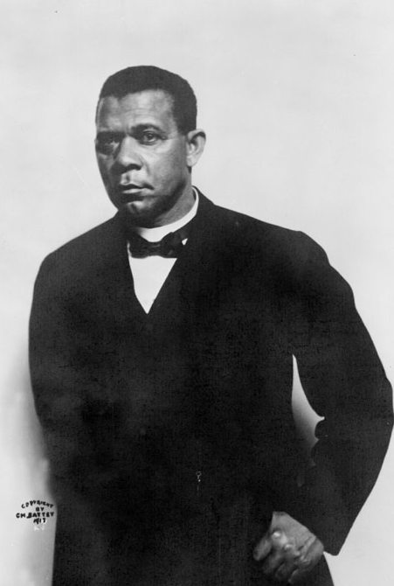
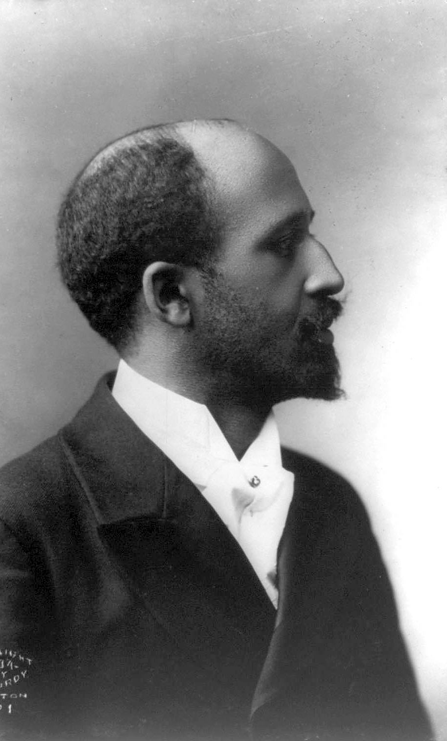
The Great Debate Place the phrases in the appropriate portion of the Venn diagram. Then write three phrases of your own in the diagram.
Booker T. Washington
W.E.B. DuBois
Born a slave
Born in 1863
Born in 1856
Born free
Died in Ghana in 1963
Died in Alabama in 1915
“Talented Tenth”
Civil rights leader
Pan-Africanism
Founder of Tuskegee Institute
Founder of NAACP
Founder of the Niagara Movement
Advocated industrial education
Critic of lynching
Author of Up From Slavery (1901)
Author of The Souls of Black Folk (1903)
Editor of The Crisis
Consultant to Teddy Roosevelt
“The Great Accomodator”
Advocated professional education
Ph.D. from Harvard
Wanted blacks to have a better way of life
Both
Created by Mr. Johnson

