Slide 2
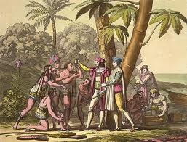
The New World
Unit 1.2

Slide 3
A European’s Understanding

Slide 4
Why travel beyond the known world?
Europeans wanted luxuries from China, India & ‘Spice Islands’ that were prohibitively expensive to transport
Quicker trade routes needed
New technology of the caravel made alternate trade routes possible
Portuguese forays into coastal Africa had been successful for
Gold
labor (slaves)
establishment of plantations (sugar)

Slide 5
Late 15th Century European Trade

Slide 6
Causes of European Exploration of the New World
By late 1400s, Portuguese had shown feasibility of long range ocean navigation
Spain had developed into a united, wealthy, modern nation-state
Renaissance inspired spirit of optimism & discovery
Compass
Printing press helped spread knowledge quickly

Slide 7
Causes of European Success in the NW
Steel weapons & gunpowder
Disease (small pox, measles)
Surprise
Exploitation of tribal rivalries

Slide 8
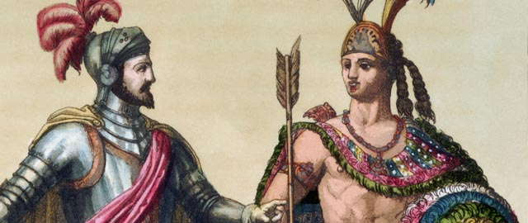
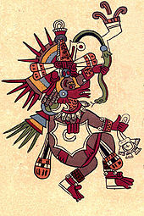
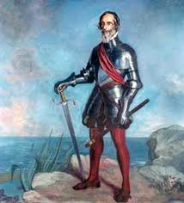
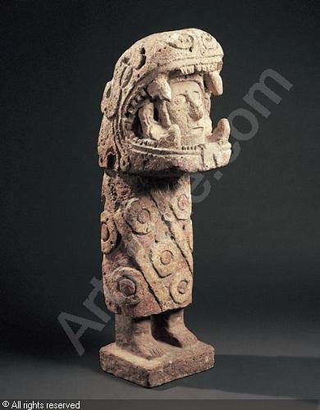

Slide 9
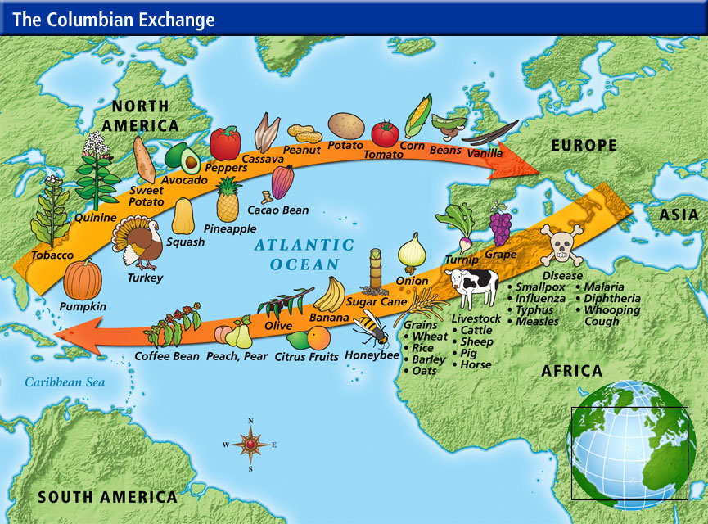

Slide 10
HAP-P
H historical context
A audience
P purpose
P point of view

Slide 11
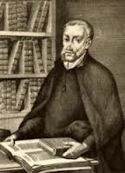
Juan Gines de Sepulveda
The Second Democrates 1547

Slide 12
Document 1
Questions: 1. What differences does Sepulveda emphasize between Europeans (especially Spaniards) and the Indians?
2. What grounds does he assert the superiority of European culture?

Slide 13
Fr. Bartoleme de la Casas The Destruction of the West Indies(1552)

Slide 14
Document 2
Questions: 1. How are his views of the Indians different from those of Sepulveda?
2. What ideas did the two debaters share?

Slide 15
Closure
What were the causes of European exploration?
What contributed to their success?

