Slide 1
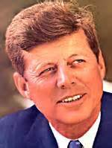
The New Frontier
Ch. 23.1

Slide 2
Objectives
Summarize Kennedy’s economic policies
Explain why Congress often did not support Kennedy’s proposals.

Slide 3
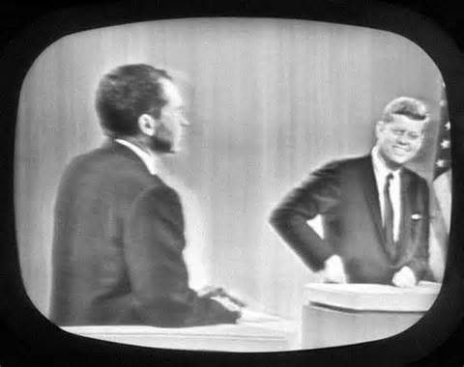
Election of 1960
I. Election of1960
A. Television In Politics
1. Debates
2. Advertisements
- $13.5 million
B. Issues:
-Economy
-Cold War
*Missile Gap
-Religion

Slide 4
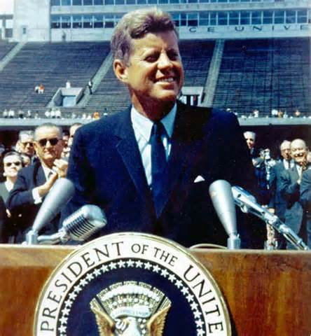
Domestic Front
II. Domestic Success & Setback
A. “New Frontier”:
-educational aid
-health insurance to old
-Dept. of Urban Affairs
-help migrant workers
B. Struggle with Congress
1. New Frontier=too $
a. strike down bills

Slide 5
Economy
C. Strengthening the Economy
1. Deficit Spending
a. defense
b. space exploration
2. Supply-Side Economics
a. tax cuts
D. Women’s Rights
1. Presidential Commission on the Status of Women

Slide 6
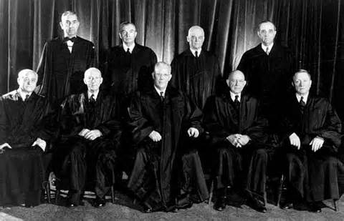
Warren Court
III. Warren Court Reforms
A. “One Man, One Vote”
1. reapportionment
ex.) Rural District/ 1 Rep/ 2,340 people
Urban Area/ 7 Reps/ 311,220 people
D. Extending Due Process
1. Mapp V.Ohio
2. Miranda V. Arizona

