Slide 1
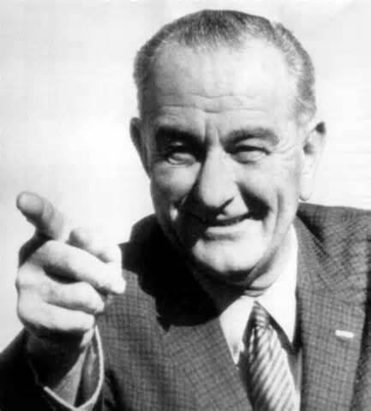
The Great Society
Ch.23.3

Slide 2
Objectives
Explain what inspired Johnson’s Great Society programs
Identify several specific health and employment programs of the Johnson administration.

Slide 3
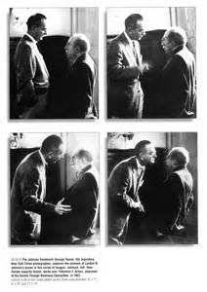
Johnson Takes the Reins
I. Leadership Style
A. Background:
-congressional staffer
-Rep to the House
-U.S. Senator
-Senate Majority Leader
-VP
B. The Johnson Treatment
1. consensus

Slide 4
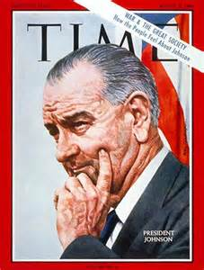
War on Poverty
C. Poverty
1. Johnson’s Personal Background
-Hill Country, TX
-Inner City School Teacher
a. War on Poverty
i. Economic Opportunity Act
ii. VISTA

Slide 5
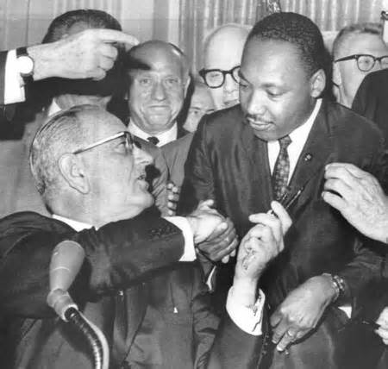
The Great Society
III. Great Society
A. Civil Rights Act 1964
-barred racial discrimination
B. Voting Rights Act 1965
-barred voting discrimination
**Chart on Pg. 736**

