Slide 1
Technological Revolution
Ch. 29.1

Slide 2
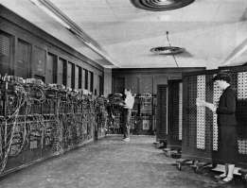
Compact Computer
I. Computer
A. ENIAC (WWII) 1946
B. Integrated Circuit (1959)
1. Robert Noyce
a. Silicon Valley
i. Intel
-micro-processor

Slide 3
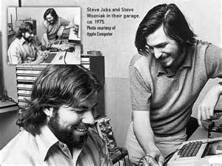
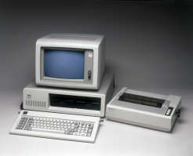
Computers for Everyone
C. Availability
1. Stephen Wozniak & Steve Jobs
a. Apple (1976)
i. Apple I & II
ii. Macintosh
2. International Business Machines(IBM)
a. Personal Computer (PC)

Slide 4
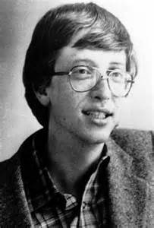
Bill Gates & Microsoft
D. Bill Gates
1. Microsoft
a. software
i. MS-DOS
ii. Windows
-telecommute
II. Telecommunications Revolution
A. Telecommunications Act (1996)

Slide 5
Rise of the Internet
III. Rise of the Internet
A. U.S. Defense Department
1. Advanced Research Project Agency (ARPANET) 1969
B. Supercomputers
1. National Science Foundation
a. nationwide service

