Slide 1
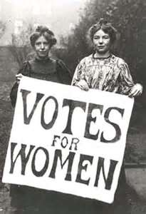
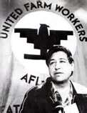
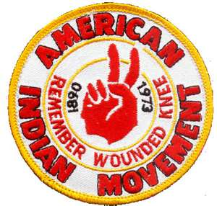
OGT – Civil Rights & Political Action Groups

Slide 2
NAACP

Slide 3
4. What perspective of African-Americans was reflected in the founding of the National Association for the Advancement of Colored People (NAACP) in 1909?
The desire for a return to their cultural heritage
the need to improve working conditions in factories
the desire to end legalized discrimination based on race
the belief in the importance of building a new country in Africa
index

Slide 4
11. What was one perspective of African-Americans that was reflected in the founding of the National Association for the Advancement of Colored People (NAACP)?
A. the hope of encouraging widespread emigration to Africa
B. the belief that racial segregation was justified in all circumstances
C. the goal of forming a new political party to represent African-Americans
D. the desire to bring about legal and social equality for African- Americans
index

Slide 5
National Organization for Women (NOW)

Slide 6
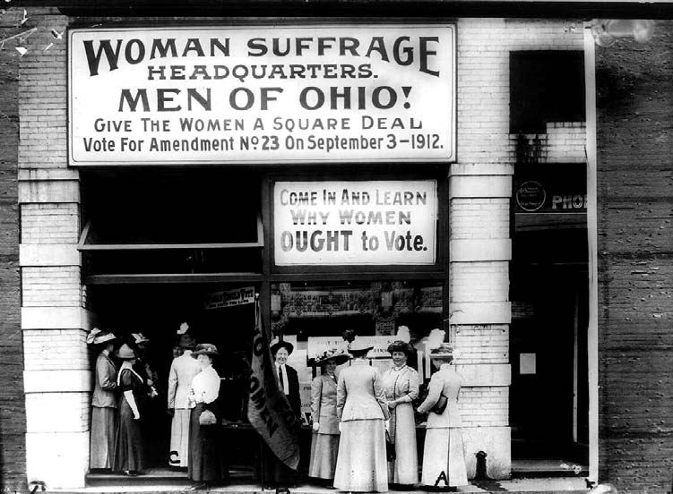
26. Actions taken by organizations such as those shown in the photo above helped bring about
A. the decision in Plessy v. Ferguson.
B. the decision in Brown v. Board of Education.
C. the 19th Amendment to the U.S. Constitution.
D. the 26th Amendment to the U.S. Constitution.
index

Slide 7
3. What was the perspective of women who founded the National Organization for Women (NOW) in 1966?
A. Women wanted to receive equal pay and opportunities for advancement in the workplace.
B. Women were afraid of being forced to work in physically challenging jobs.
C. Women were angry at the prospect of having to serve in the military.
D. Women wanted to gain the right to vote and to own property.
index

Slide 8
28. In 1963, Betty Friedan, founder of the National Organization for Women, wrote, We can no longer ignore that voice within women that says: “I want something more than my husband and my children and my home.” Source: Betty Friedan, Excerpt from The Feminine Mystique (1963) reprinted in 100 Key Documents in American Democracy, ed. by Peter Levy, Praeger Pub., 1994, p. 436. The excerpt above could be used to support the thesis that
The U.S. birthrate would increase as more women entered the workforce.
the 19th Amendment guaranteeing women the right to vote should be ratified.
increased numbers of women in the workforce would result in unemployment for men.
in the 1950s and 1960s, many American women were redefining their roles in society.
index

Slide 9
42. The United States Constitution is a living document that changes over time as a result of amendments and Supreme Court decisions. How did the Constitution change as a result of the 19th Amendment?
A. The voting rights of women were expanded.
B. The civil rights of Native Americans were restricted.
C. The civil rights of African- Americans were protected.
D. The voting rights of property owners were expanded.
index

Slide 10
American Indian Movement (AIM)
I. 1968 Minneapolis, Minnesota
A. “The Trail of Broken Treaties” march 1972
1. AIM’s Aim:
-form a committee to review treaty commitments & violations
-land reform of lands granted to Native Americans
-Office of Federal Indian Relations and Community Reconstruction
-tax immunities
-Native American Institutions

Slide 11
25. In the 19th century, many Americans considered Native Americans to be inferior to people of European ancestry. This resulted in discrimination and conflict between European settlers and Native Americans. One consequence of this discrimination was that many Native Americans were
A. displaced from their homelands.
B. forced to maintain their cultural heritage.
C. prevented from trading with European settlers.
D. persecuted for killing buffalo on the Great Plains.
index

Slide 12
25. The Indian Tribal Justice Act of 1993 is an example of federal civil rights legislation. Read the following excerpt from the act: Indian tribes possess the inherent authority to establish their own form of government, including tribal justice systems ... traditional tribal justice practices are essential to the maintenance of the culture and identity of Indian tribes. ... This act was an attempt to redress the consequences of
the use of internment camps during World War II.
past government policies that oppressed and discriminated against Native Americans.
granting citizenship to Native Americans under the 1924 General Citizenship Act.
Jim Crow legislation enacted by southern states during the late 1800s and early 1900s.
index

Slide 13
1. What was one result of discrimination against American Indians by white settlers in the United States in the late 19th century?
A. American Indians were displaced from their homelands.
B. American Indians were forced to maintain their cultural heritage.
C. American Indians were prevented from trading with European settlers.
D. American Indians were persecuted for killing buffalo on the Great Plains.
index

Slide 14
United Farm Workers

Slide 15
36. Hispanic-American farm workers organized the United Farm Workers to persuade farm owners to treat them more fairly. One perspective of these workers was their belief that the owners’ unfair hiring practices denied them equal opportunity for employment. State two other perspectives of farm workers that led to the creation of the United Farm Workers. Write your answer in the Answer Document. (2 points)
Write the answer on separate paper.
index
Scoring Guidelines

Slide 16
41. In the 1960s and 1970s, Hispanic-American farm workers in the United States believed their employers were failing to provide reasonable wages and working conditions like those received by other American workers. For this reason, Hispanic-American farm workers
urged the exportation of agricultural produce.
organized the United Farm Workers Association.
encouraged farm producers to lower prices.
opposed passage of anti-discrimination laws.
index

Slide 17
35. Which change in U.S. society in the 20th century was an outgrowth of the success of the civil rights movement of the 1950s and 1960s?
A. the passage of laws to protect the natural environment
B. the increase in funding for elementary and secondary education
C. the expansion of the role of state governments in economic affairs
D. the creation of new groups to advocate for the rights of other minorities
index

