Slide 1
Because you slept in class too much

Slide 2
There was a connection between industrial expansion and European imperialism in the late 19th and early 20th centuries. • Did imperialism increase or decrease as a result of industrialization? • Explain why this change occurred.
Enter answer text...

Slide 3
Imperialism
Development of Imperialism
A. Four major reasons:
1. Sources of Raw Materials
-Usually because the stronger nation has industrialized
2. Markets for Goods
-In order to sell products to more people to make $
3. Spread of Religion/Civilization
-”White Man’s Burden”
4. Power & Prestige
-Being seen by others as a dominant nation (politically/militarily) -nationalistic

Slide 4
As British rule in India came to an end, violence sparked by religious differences between Hindus and Muslims led to the decision by Britain to divide the country into Hindu India and Muslim Pakistan. However, after the partition, many Muslims still lived within the borders of Hindu India. The perception of Hindus and Muslims that the cultural differences between them were greater than their similarities led to
invasion by neighboring countries.
a return to British rule to establish order.
continued violence and many refugees.
the end of democratic government in India.
10

Slide 5
The term “Latin America” is generally used to describe a unique cultural region which includes all of South America, Central America, and Mexico. What characteristic helps define Latin America as a region?
Islam is the most widely practiced religion.
Most countries in this region have command economies.
Spanish and Portuguese are the most widely spoken languages.
Most countries in this region are former colonies of France or Italy.
10

Slide 6
Imperialism
II. Governing New Territories
A. Direct Rule
1. Vice-royals (Viceroys)- run country as king/queen of controlling nation would see fit
ex. British in India
B. Indirect Rule
2. Controlling country allows for local leaders to operate society
-less expensive than Direct Rule

Slide 7
In the 19th century, European countries claimed that the conquest of Africa would bring the benefits of Western civilization to that continent. From the perspective of African peoples, the effect was
loss of political independence.
fewer agricultural products for foreign trade.
new national boundaries based on ethnic and cultural similarities.
global appreciation for African cultures and encouragement of their development.
20

Slide 8
How did the political systems in Africa change as a result of European colonialism in the 19th century?
Opportunities for self-rule increased.
Administrative units were set up along ethnic lines.
Traditional forms of tribal authority were weakened.
Administrative units became smaller for better control.
15

Slide 9
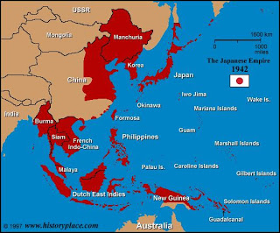
Imperialism
III. Japan
A. Isolationist (1185-mid1800’s)
1. feudalistic
a. shogun
B. U.S. Intervention
1. Commodore Mathew C. Perry
-Opens trade/Showcases Industrial Might
C. Shift of Power in Japan
1. Meiji Restoration
a. Industrialize Japan
b. Adopt foreign systems:
-Government = Germany
-Education = U.S.
-Military = G.B. & U.S.
D. Japan Imperializes
1. Manchuria, Taiwan, Korea

Slide 10
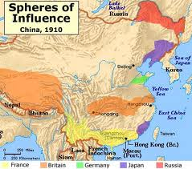
Imperialism
IV. China
A. Isolated into 1800’s
1. British weaken Chinese gov. & society to force trade
a. Opium War
i. Spheres of influences
-Taiping & Boxer Rebellions
ii. Open Door Policy

Slide 11
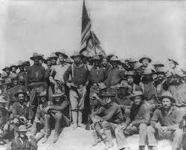
Imperialism
V. U.S. Imperialism
A. Japan
B. Hawaii – Planters & U.S. Marines
C. Spanish-American War
1. Battle’s in Philippines & Cuba against Spain
a. gain:
-Guam
-Philippines
-Puerto Rico
b. Cuba becomes an American protectorate
**America becomes a powerful force**

Slide 12
During the Spanish-American War, the U.S. Navy destroyed the Spanish fleet in Manila Bay in the Philippines. The U.S. Congress later voted for annexation of the Philippines. What was one reason for this act of U.S. imperialism?
to provide the U.S. with a valuable naval base in the Pacific
to provide the U.S. with a place to relocate its immigrant population
to decrease the U.S. need to export raw materials for industrialization
to increase the U.S. population by extending citizenship to the Filipinos
15

Slide 13
During the late 19th and early 20th centuries, U.S. foreign policy was closely tied to domestic economic concerns. The annexation of Hawaii, the Open Door Policy with China, and the construction of the Panama Canal in Latin America were all motivated by an interest in
10
breaking up monopolies and trusts.
extending land grants for railroad construction.
acquiring new markets and sources of raw materials.
limiting the power of labor unions to strike.

Slide 14
In 1898, U.S. support for Cuban independence led to war with Spain and contributed to the United States becoming an imperial power. What was a decisive factor in the decision to go to war?
the opportunity to annex Hawaii
the desire to acquire a naval base
the protection of U.S. commerce and trade
the need for a shorter route from the Atlantic to the Pacific
10

Slide 15
One factor that motivated U.S. imperialism during the late 19th and early 20th centuries was the
development of closer political ties with European nations.
closing of China to all foreign trade.
support of international peacekeeping operations.
acquisition of new markets and sources of raw materials.
10

Slide 16
The famous American writer Mark Twain expressed his opinion about U.S. actions in the Philippines after the Spanish-American War with the following words: “I have seen that we do not intend to free, but to subjugate (place under control) the people of the Philippines. We have gone to conquer, not to redeem (save). … I am opposed to having the [American] eagle put its talons on any other land.” The New York Herald, October 15, 1900 This statement would be helpful in supporting the thesis that Mark Twain believed that
U.S. imperialism was wrong.
U.S. imperialism would bring stable government to the Philippines.
U.S. imperialism was necessary for the United States to become a world power.
U.S. imperialism civilized the people of the Philippines.
20

Slide 17
The United States fulfilled one of its imperialist ambitions in the early 20th century by acquiring land to build the Panama Canal. State two reasons (political and/or economic) why U. S. imperialists wanted to build the canal.
Enter answer text...

