Slide 1
Because you haven’t learned it all!!!

Slide 2
The Industrial Revolution brought about major changes not only in cities, but in rural America as well. Before machines were used, one farmer could harvest about 7.5 acres of wheat per year. With machines, he could harvest wheat on 135 acres. Scientists also developed new kinds of wheat seeds that could survive northern winters. These developments were examples of what was happening in many areas of agriculture. Explain two additional ways farming changed as a result of the Industrial Revolution. Write your answer in the Answer Document. (2 points)

Slide 3
People from the countries of Scandinavia (Finland, Denmark, Norway and Sweden) immigrated to the United States mainly between the Civil War and World War I. In general, they settled in the American Midwest. Their reasons for leaving their homelands included overpopulation, poor farm production and dissatisfaction with their governments. Based on your knowledge of immigration patterns to the United States, identify two factors that attracted immigrants such as these to the United States.

Slide 4
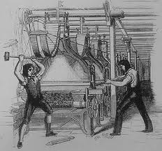
Industrialization
Aiding Industrialization
A. Growing Population
1. More Food
2. Better Medicines
B. Population Shift
1. rural to urban migration
C. Natural Resources
1. Coal & Iron Ore
-iron
-steam engines
D. Stable Governments
E. Large Supply of Capitol
-willing investors in companies

Slide 5
In the late 19th century, industrialization led to harsh working conditions in the United States. Which policies of the U.S. government allowed such conditions to develop and later led to the growth of labor unions to correct abuses of workers?
laissez-faire policies toward big business
antitrust policies toward monopolies
imperialist policies regarding territorial expansion
isolationist policies regarding international alliances
10

Slide 6
Consider the following changes that occurred in the United States in the late 19th century: • improvements in agricultural production; • increases in immigration from Europe; • advancements in networks of railroad and streetcar lines. These changes led to the
rapid growth of urban areas.
acquisition of overseas territories.
elimination of large suburbs around many cities.
movement of people from the urban to the rural areas.
7

Slide 7
During the Industrial Revolution of the late 19th century, farmers in the United States worked to increase their land holdings and modernize their equipment. A lasting effect of these changes was
higher prices for crops.
increased rural population density.
a shortage of land for farming.
greater productivity of farming.
8

Slide 8
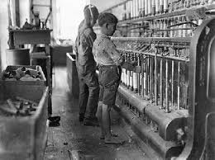
Industrialization
II. Growing Industries
A. New Machines
-steam engine, textiles, railroads
B. Entrepreneurs
1.locate businesses in urban areas
2.Growth of Cities
-Poor living conditions for lower class
*Slums
=disease, crime, overcrowding, etc.
C. Growing Middle Class
1. Middle Class Trades
-Social Darwinism (Herbert Spencer)

Slide 9
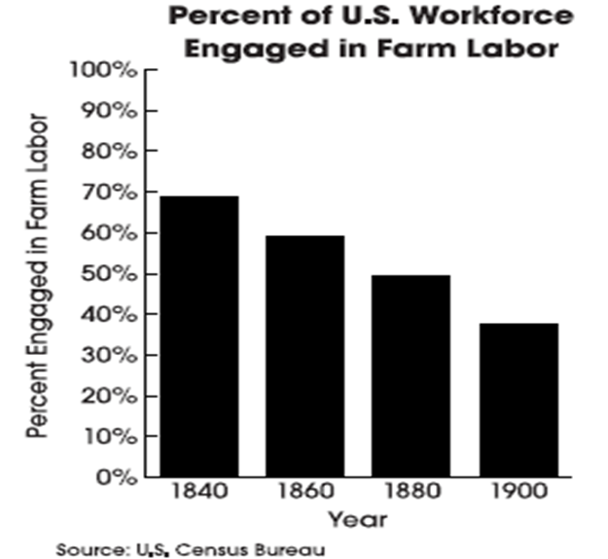
What effect of 19th-century industrialization in the United States is represented by the changes shown in the above graph?
increased regulation of child labor
B. modernization of agriculture
C. decreased demand for farm products
D. emigration from the United States
9

Slide 10
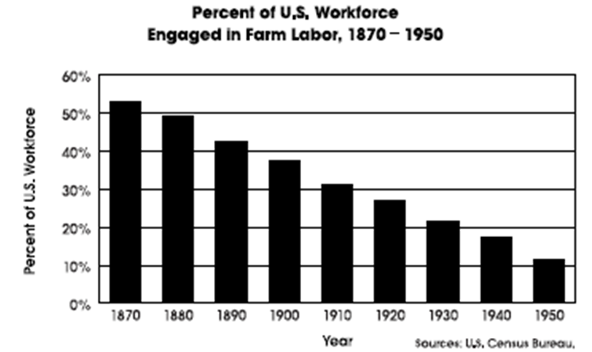
The economic development of the United States between 1870 and 1950 helped produce the results shown in the graph above. The trend shown in the graph is associated with
Increased urbanization.
decreased immigration.
advances in communication.
reduced population growth.
6

Slide 11
One effect of industrialization in the United States in the late 19th century was
a decrease in child labor.
an increase in demand for handicraft goods.
a decrease in immigration to the United States.
an increase in urbanization.
8

Slide 12
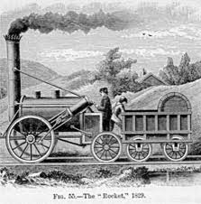
Industrialization
III. Rise of Unions
A. Industrial Unions vs. Trade Unions
1. Strikes to improve conditions
IV. Industrial Progress
A. Development of Technology
1. Steel
2. Electricity
3. Communication
4. Transportation

Slide 13
Why was the formation of labor unions an effect of U.S. industrialization in the late 1800s?
Unions were needed to guarantee a steady supply of workers.
Union membership was required for employment in new industries.
Factory owners set up labor unions in order to control their large workforce.
Unions organized industrial workers to protest unsafe working conditions and long workdays.
8

Slide 14
In the late 19th and early 20th centuries, improvements in steel technology allowed architects to design buildings taller than had previously been possible. As a result, skyscrapers began to be built in cities such as New York and Chicago. What was the result of this new technology on population patterns in the United States in the first half of the 20th century?
decreased growth of suburban areas
migration from the West to the Midwest
greater population density in urban areas
increased migration from urban to rural areas
0

Slide 15
In 1950, New York City was the only city in the world with a population of more than ten million people. By 2000, there were nineteen cities with populations of over ten million people. One reason for this increase in urbanization was
a decrease in birthrates around the world.
the spread of industrialization around the world.
an increase in air pollution in industrialized areas.
the collapse of the Soviet Union and the end of the Cold War.
0

