Slide 1
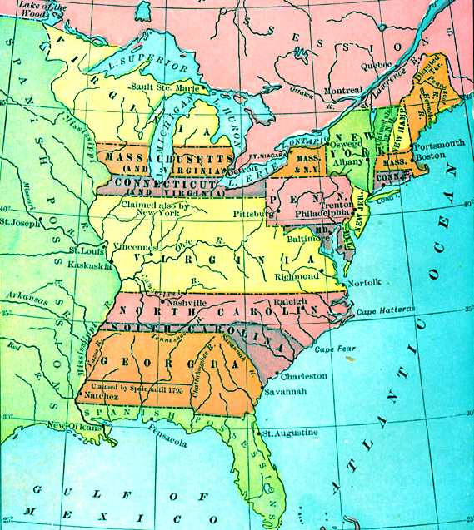
Eureka! Lets give em’ land!
Problem: The Confederation Congress needed to pay Continental Army troops

Slide 2
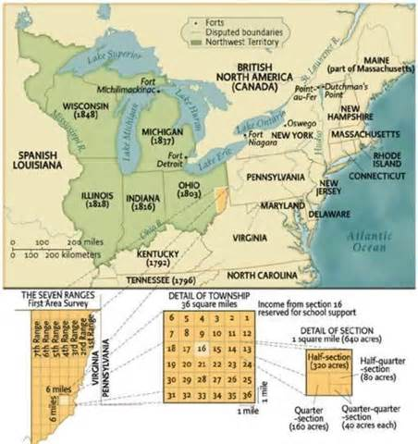
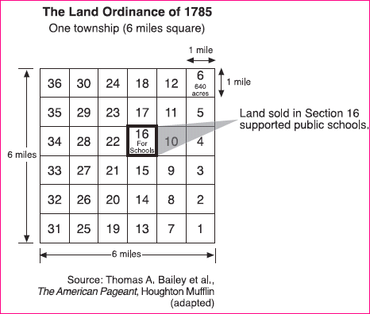
How should we settle these “Western Lands”?
The Northwest Ordinance of 1787

Slide 3
Group Activity
Analyzing the Northwest Ordinance
Complete questions provided by instructor
Compare similarities between Northwest Ordinance with the Bill of Rights (pg. 43)
Which proclamations were copied from the Northwest Ordinance?

Slide 4
Northwest Ordinance

