Slide 1
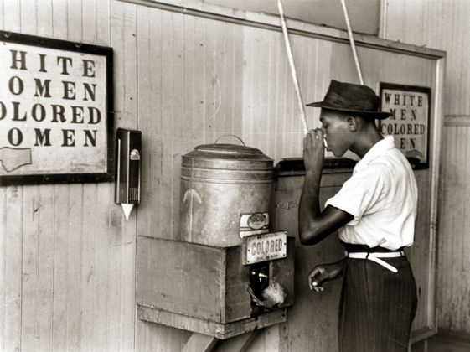
New South or Nadir?
Created by Mr. Johnson

Slide 2
The New South

Slide 3
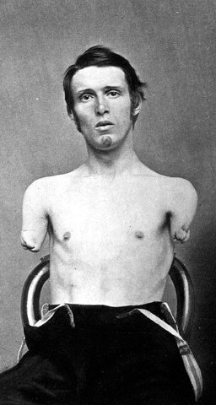
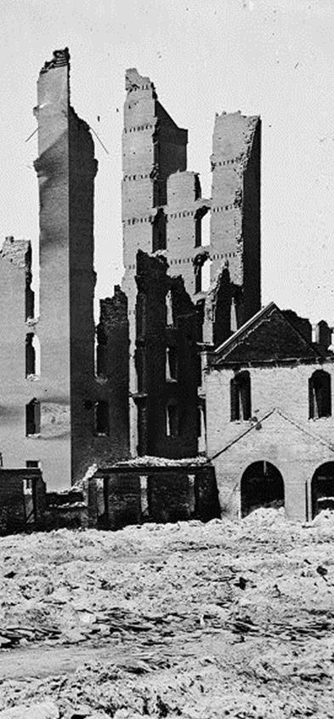
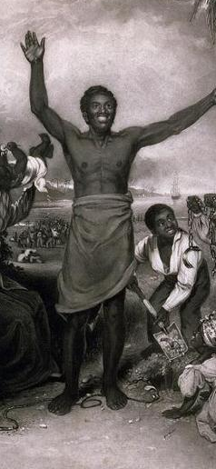
Reconstruction
Deaths, Injuries &
Lingering Resentment
Economic Devastation
Readmission of Southern States
Legal Status of Freedmen

Slide 4
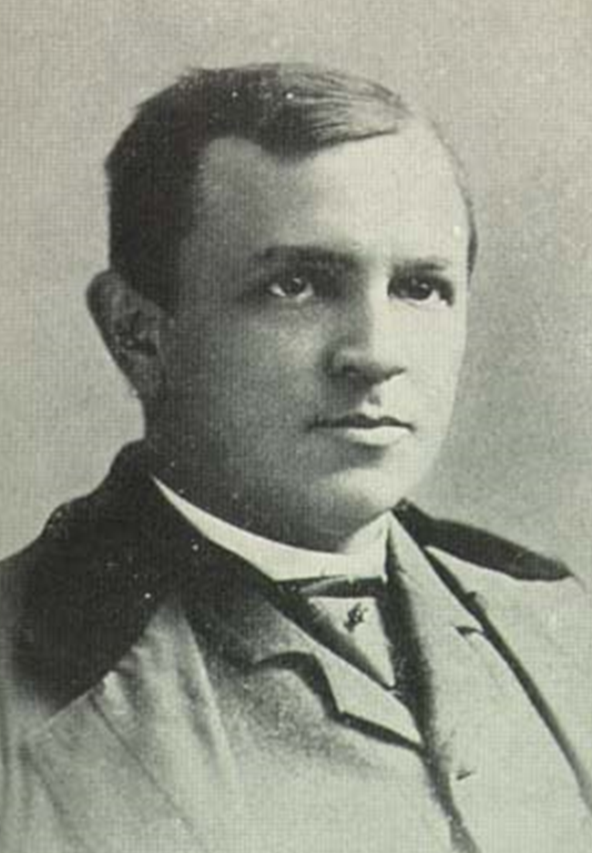
Henry Woodfin Grady
“There was a South of slavery and secession—that South is dead. There is a South of union and freedom—that South, thank God, is living, breathing, growing every hour.”

Slide 5
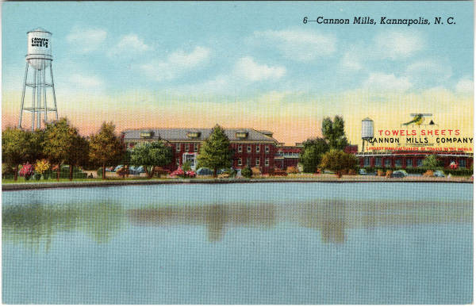
Southern Textile Industry

Slide 6
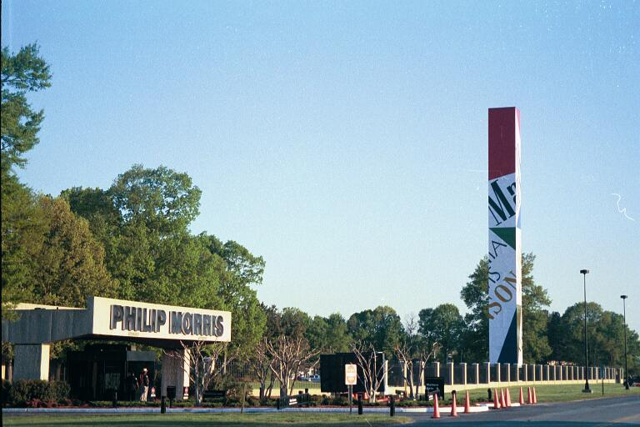
Southern Tobacco Industry

Slide 7
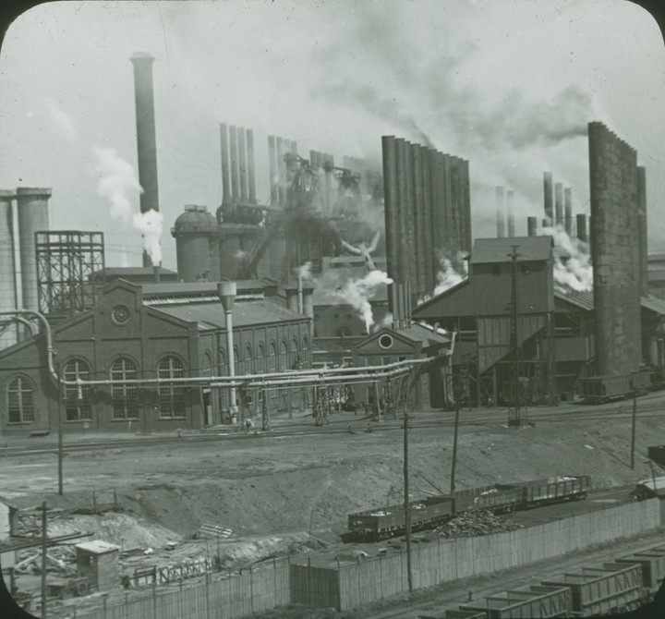
Birmingham: “Pittsburg of the South”

Slide 8
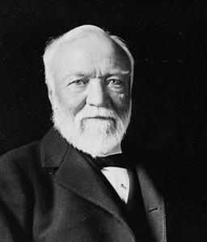
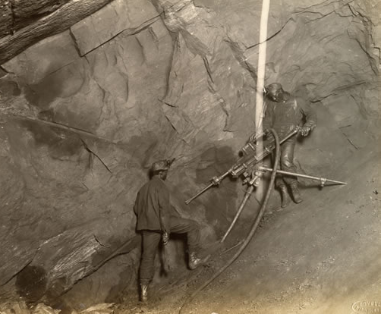
U.S. Steel Mines, Alabama
Convict labor
For more information, see http://www.npr.org/templates/story/story.php?storyId=89051115

Slide 9
The New South
Henry Woodfin Grady, proponent of progressive “New South”
  Industrialization & wage labor to replace plantation system
  Cordial race relations, albeit under segregation
Geography
  Wealth and power shifted inland from tidewater (coast) to piedmont (foothills)
  “Good Roads” movement to enable public education & link internal trade
Industry & Labor
  New industries: textile mills, tobacco factories, steel mills & mines
  Company towns exerted a great deal of control over workers’ lives

Slide 10
The Nadir

Slide 11
Reconstruction Amendments
13th Amendment
  Abolition of slavery
14th Amendment
  Citizenship
  Equal Protection
  Due Process
15th Amendment
  Universal Male Suffrage

Slide 12
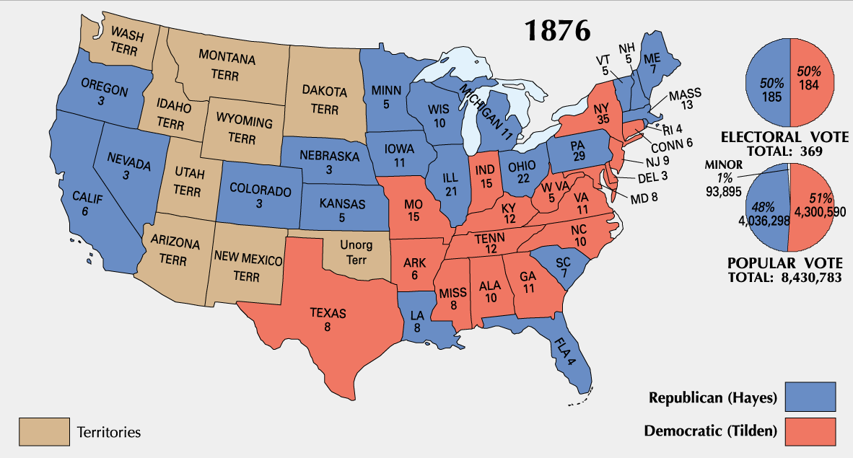
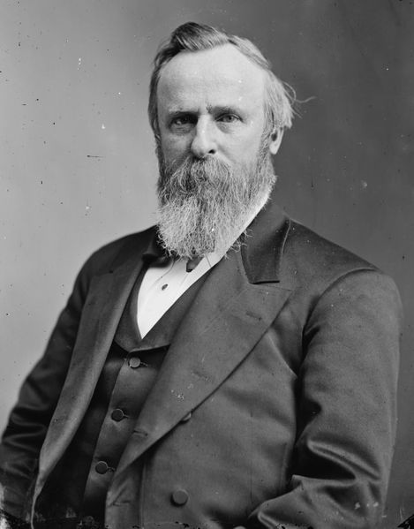
Compromise of 1877
Hayes becomes president
Union troops leave the south
End of reconstruction

Slide 13
The Nadir
The “lowest point” in American race relations (1890-1930)
  Dashed hopes of Reconstruction after Compromise of 1877
  Segregation & white supremacy, despite 14th Amendment
  Disfranchisement of black voters, despite 15th Amendment
  Lynching, race riots and resurrection of KKK

Slide 14
Jim Crow Segregation

Slide 15
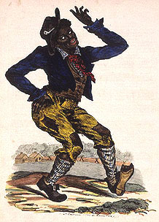
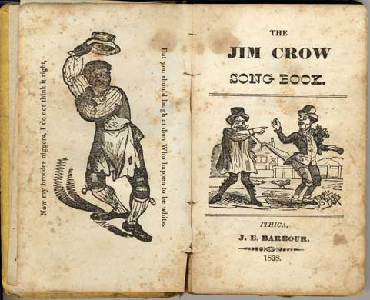
Origin of “Jim Crow”
Thomas D. Rice’s minstrel shows
“The Happy Slave”

Slide 16
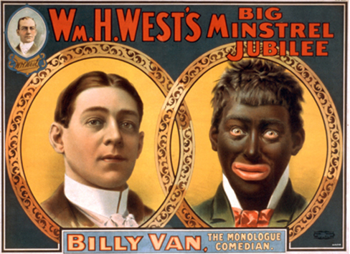

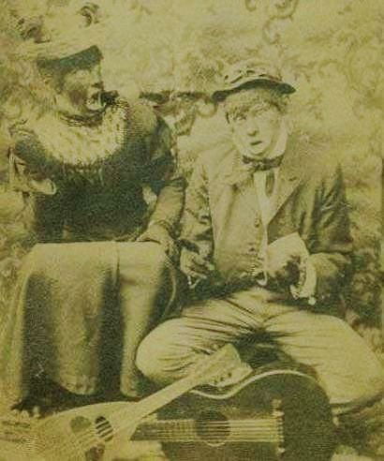
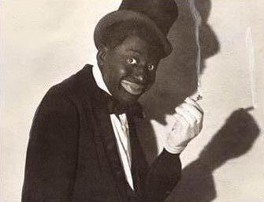
Minstrel Shows & Blackface

Slide 17
Jim Crow Laws
Segregation (Plessy decision)
Disfranchisement
  Poll Tax
  Literacy Test
  Grandfather Clause

Slide 18
Segregation in Law & Practice
De jure segregation
  segregation “by law”
  common in south
De facto segregation
  segregation “as a matter of fact”
  common in north & south
  often achieved by intimidation
  continues today

Slide 19
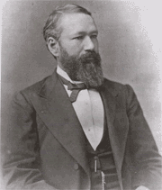
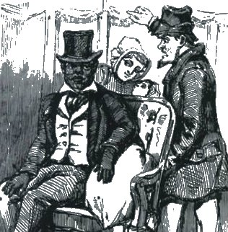
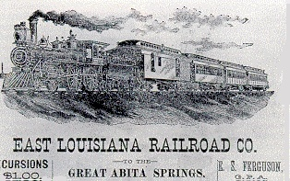
Homer Plessy

Slide 20

Plessy v. Ferguson (1896)

Slide 21
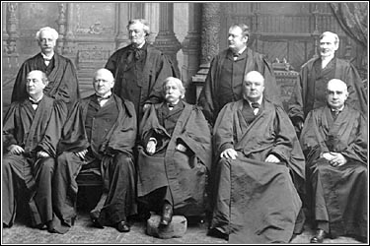
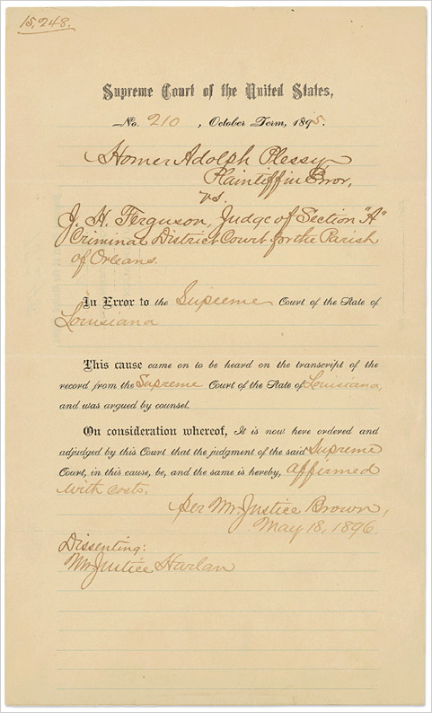
Plessy v. Ferguson (1896)
7-1 decision
Precedent for civil rights cases for nearly 50 years

Slide 22
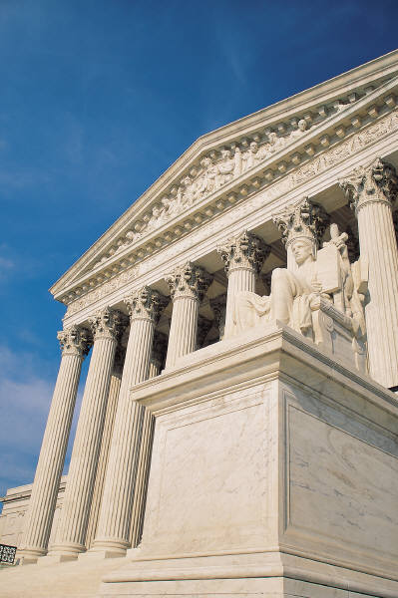

Plessy v. Ferguson (1896)
14th Amendment
Supreme Court decision
  Segregation is not unconstitutional
  “Separate but equal” standard
  Standing precedent until Brown v. Board, 1954

Slide 23
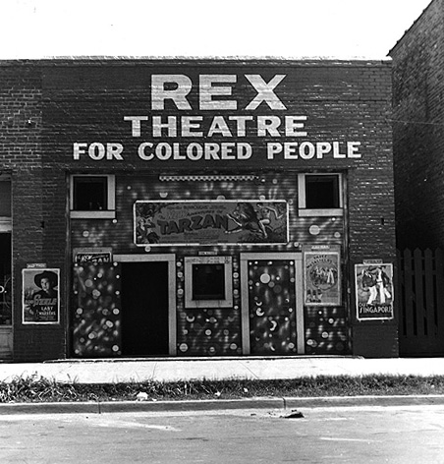
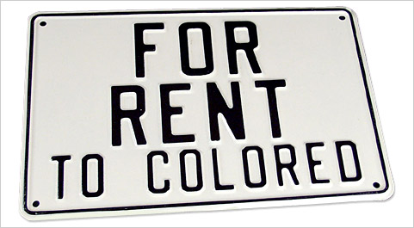

Segregation

Slide 24
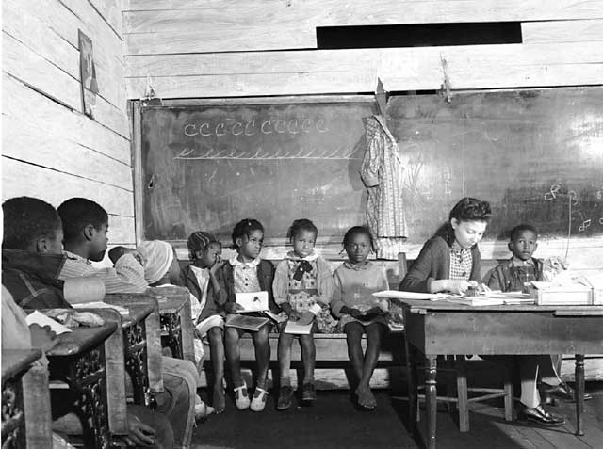
Segregated Schoolhouse

Slide 25
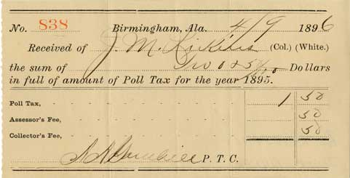
Poll Tax & Literacy Test
“Grandfather clauses” exempted many whites from these requirements

Slide 26
Jim Crow Segregation
Racial Stereotypes
  Jim Crow: happy, carefree days of slavery
  Minstrel shows: blackface & buffoonery
Challenging Segregation
  Ida Tarbell: civil disobedience against railcar segregation
  Plessy v. Ferguson, 1896: Supreme Court legalized segregation under “separate but equal” doctrine… lasted until Brown v. Board, 1954
Jim Crow laws enforced not only separation, but subjugation
  Voting disfranchisement: poll taxes & literacy tests
  Unequal facilities: schools, railcars,
Black segregation ran contrary to assimilation policy toward Native Americans and immigrants

Slide 27
Slavery by Another Name

Slide 28
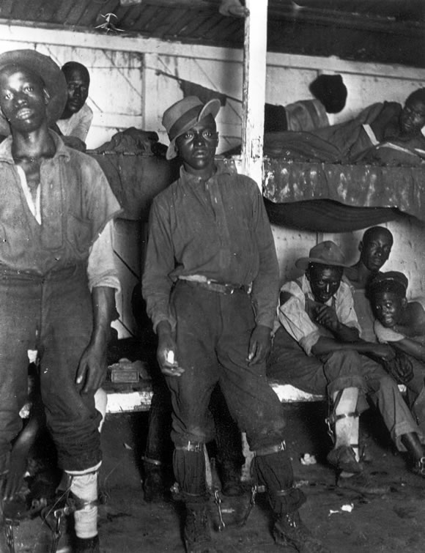
Vagrancy Laws & Convict Labor

Slide 29
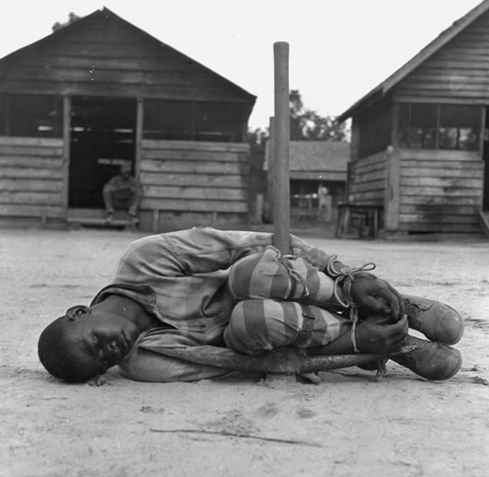
Convict Punishment

Slide 30
U.S. Steel Mines, Alabama
Convict labor

Slide 31
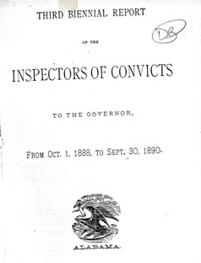
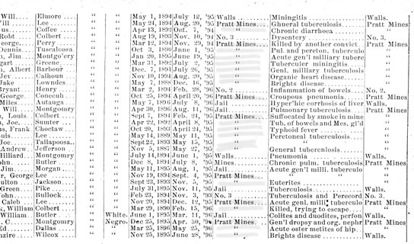
U.S. Steel Mines, Alabama
Death registry, 1894

Slide 32
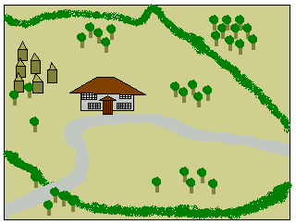
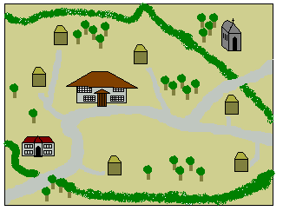
Sharecropping
Slave plantation
Sharecropping community

Slide 33
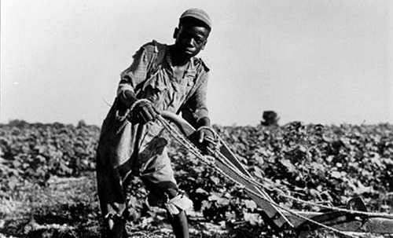
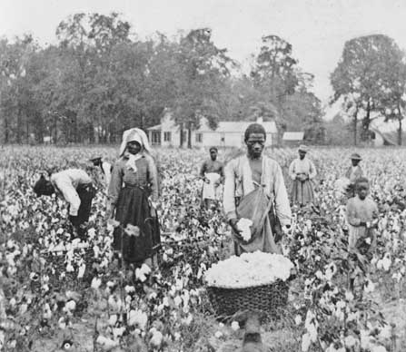
Sharecropping

Slide 34
“Slavery by Another Name”
Vagrancy laws
  African Americans were required to have written proof of employment
  Arrest meant becoming part of convict labor system
Debt Peonage
  Sharecropping
  Tenant farming

Slide 35
Racial Violence
& Intimidation

Slide 36
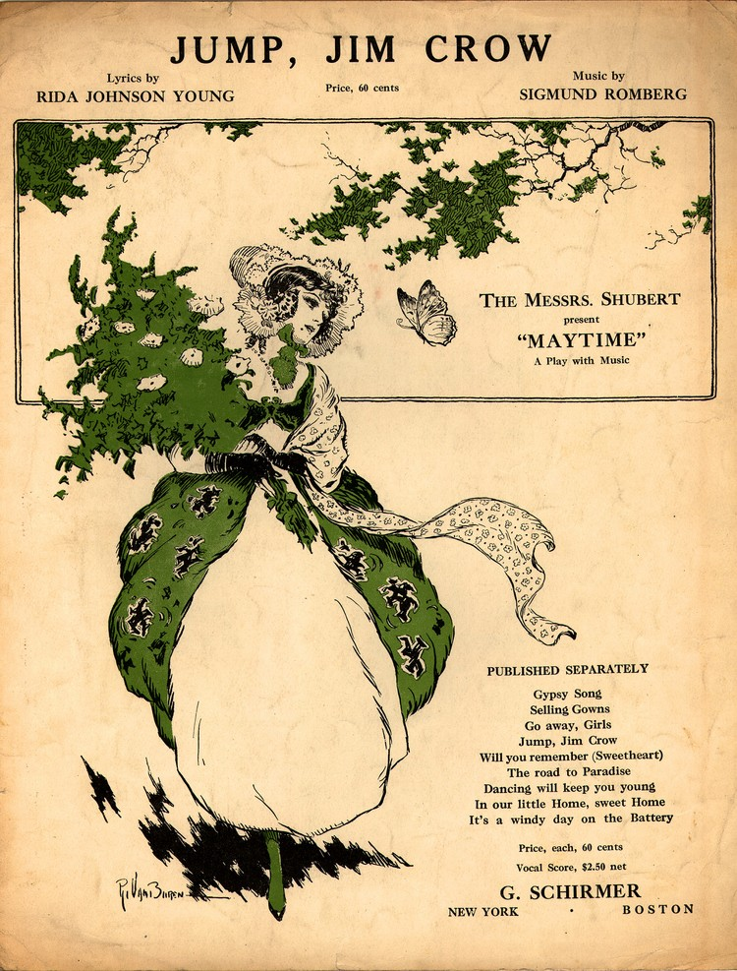
Racial Etiquette
“Boy” or “Mister”?
Removing hats & stepping aside
“Sanctity of white womanhood”

Slide 37
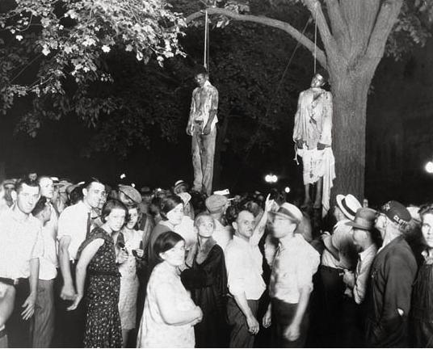
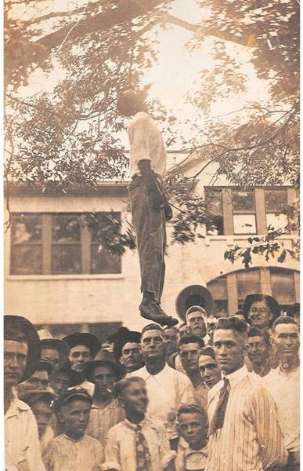
Lynching
Photographs sold as postcards

Slide 38
Ida B. Wells on Lynching
“Of the many inhuman outrages of this present year, the only case where the proposed lynching did not occur, was where the men armed themselves in Jacksonville, Fla., and Paducah, Ky, and prevented it. The only times an Afro-American who was assaulted got away has been when he had a gun and used it in self-defense…”

Slide 39
Ida B. Wells on Lynching
“…The lesson this teaches and which every Afro-American should ponder well, is that a Winchester rifle should have a place of honor in every black home, and it should be used for that protection which the law refuses to give. When the white man who is always the aggressor knows he runs as great risk of biting the dust every time his Afro-American victim does, he will have greater respect for Afro-American life. The more the Afro-American yields and cringes and begs, the more he has to do so, the more he is insulted, outraged and lynched.”

Slide 40
Lynchings by State
State | White | Black | Total
Alabama | 48 | 299 | 347
Arkansas | 58 | 226 | 284
Florida | 25 | 257 | 282
Georgia | 39 | 492 | 531
Kentucky | 63 | 142 | 205
Louisiana | 56 | 335 | 391
Mississippi | 42 | 539 | 581
Missouri | 53 | 69 | 122
North Carolina | 15 | 86 | 101
Oklahoma | 82 | 40 | 122
South Carolina | 4 | 156 | 160
Tennessee | 47 | 204 | 251
Texas | 141 | 352 | 493
Total Nationwide | 1,297 | 3,446 | 4,743

Slide 41
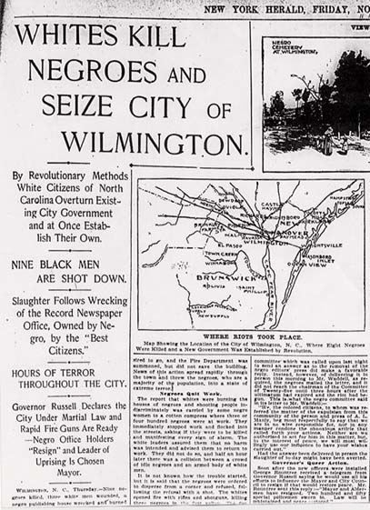
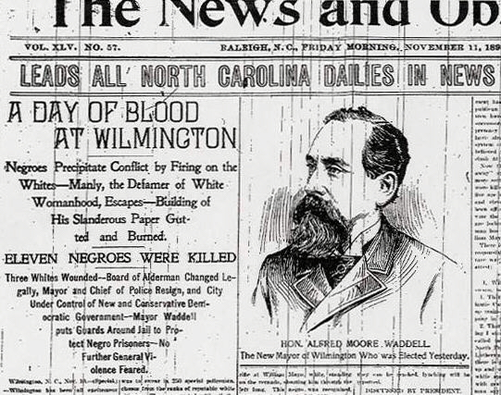
Wilmington Race Riot
1898
White supremacist coup d’etat

Slide 42
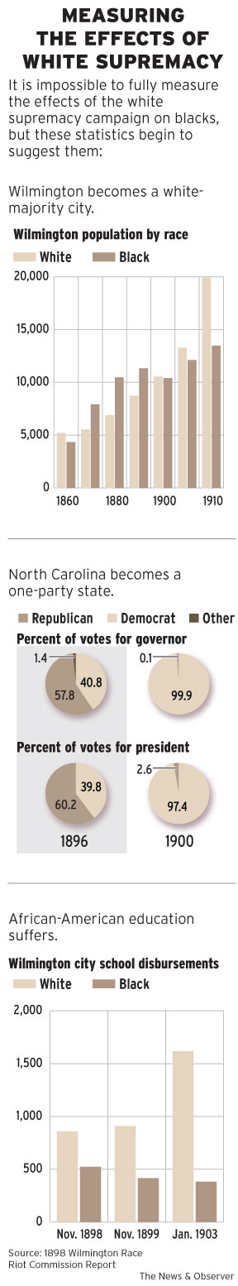
Effects of the “Riot”

Slide 43
Effects of the “Riot”
“Solid South”

Slide 44
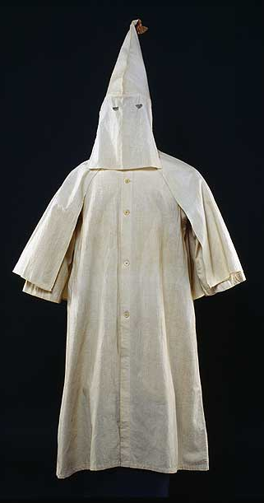
“Second” Ku Klux Klan
Membership
  1900 – 5,000
  1920 – 4 million
National organization
  Anti-black
  Anti-Semitic
  Anti-immigrant

Slide 45
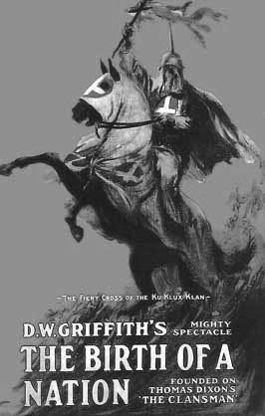
The Birth of a Nation (1915)
Based on “The Clansman” by Thomas Dixon
Epic scale larger than any previous film
  Civil War
  Reconstruction

Slide 46
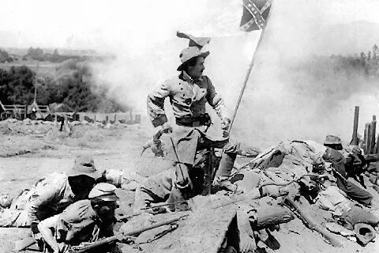
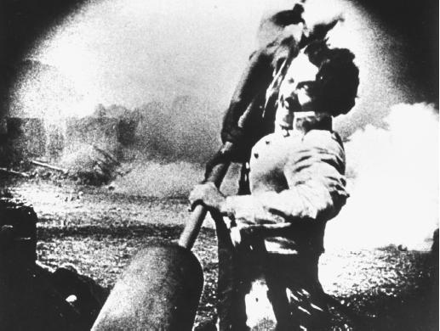
The Birth of a Nation (1915)

Slide 47
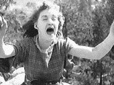
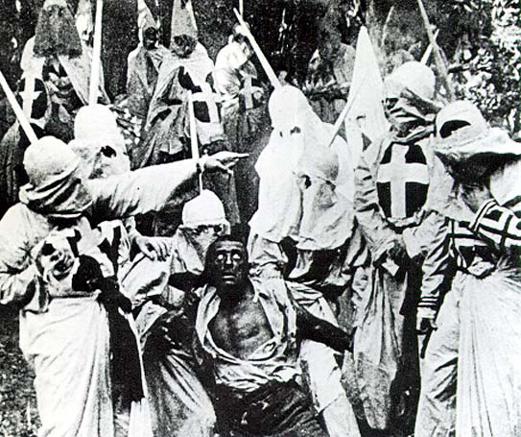
The Birth of a Nation (1915)

Slide 48
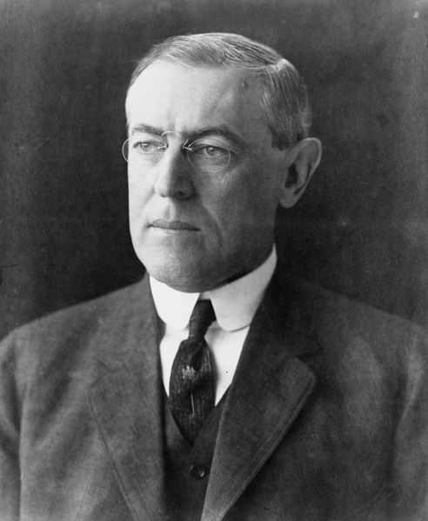
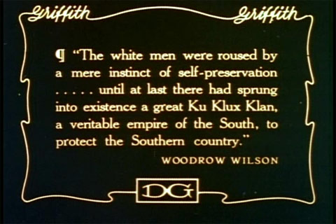
Reaction to the Film
Huge box office returns
Positive response from President Wilson
Protests by NAACP
Recruitment tool for KKK

Slide 49
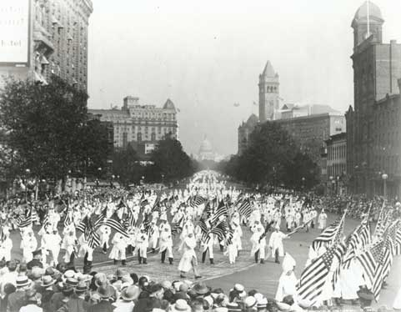
“Second” Ku Klux Klan

Slide 50
Racial Violence & Intimidation
Racial etiquette required African Americans to show deference to whites
Extra-judicial mob killings (lynchings) were common, especially for black suspects
Ida B. Wells-Barnett and other black leaders advocated self-defense and anti-lynching laws
Wilmington Coup (Wilmington Race Riot), 1898
  Death of black-white political fusion
  Triumph of Democratic Party and white supremacy (“Solid South”)
Rise of the “Second” KKK
  KKK became a mass movement in north and south
  Nativist and anti-Semitic, as well as racist
  Birth of a Nation glorified the Confederacy and KKK

Slide 51
The Great Migration

Slide 52

The Great Migration
Millions of African-Americans left the south to look for jobs in northern cities

Slide 53
The Great Migration
From 1910 to 1930, millions of African Americans moved from the south to the north to escape Jim Crow and find better job opportunities
They settled in urban areas, though they still faced considerable racial hostility

Slide 54
Lifting Ev’ry Voice

Slide 55





African-American Leaders

Slide 56
The Great Debate
?
?
?
?
?
?
?
?
?
How can African Americans improve their place in society?

Slide 57
Booker T. Washington
Born a slave
Founded Tuskegee Institute in 1881
Advocacy
  Vocational Training
  Self-help
  Gradualism

Slide 58

Booker T. Washington
“Atlanta Compromise” speech
Consulted by Teddy Roosevelt
Up From Slavery (1901)

Slide 59
“Atlanta Compromise” (1895)
“To those of my race who depend on bettering their condition… I would say: ‘Cast down your bucket where you are’ – cast it down… in agriculture, mechanics, in commerce, in domestic service, and in the professions… No race can prosper till it learns that there is as much dignity in tilling a field as in writing a poem.”
  Booker T. Washington

Slide 60

Tuskegee Institute

Slide 61

Memorial to Washington

Slide 62
W.E.B. DuBois
First African-American to earn a Ph.D. from Harvard
Advocacy
  Education
  Civil rights
  Pan-Africanism

Slide 63

W.E.B. DuBois
Racial pride
Niagara Movement
NAACP
Died in Ghana in 1963

Slide 64
The Negro Problem (1903)
“I insist that the true object of all true education is not to make men carpenters but to make carpenters men… The Talented Tenth of the Negro race must be made leaders of thought and missionaries of culture among their people. No others can do this work and Negro colleges must train men for it.”
  W.E.B. DuBois

Slide 65


Niagara Movement (1905)
Reaction to B.T. Washington’s “Atlanta Compromise” speech
  End to segregation
  Political rights
  Activism

Slide 66


NAACP
National Association for the Advancement of Colored People
Evolved from the Niagara Movement
Founded in 1909

Slide 67

The Crisis
NAACP’s monthly newsletter
Edited by DuBois

Slide 68

Marcus Garvey
Jamaican immigrant
Black nationalism
  Racial pride
  Black-owned business
  Return to Africa
Universal Negro Improvement Association (1914)
  Black Star Line (1919)
Controversial among blacks & whites

Slide 69
Marcus Garvey Quotes
“Up, you mighty race, accomplish what you will.”
“A people without the knowledge of their past history, origin and culture is like a tree without roots.”
“Do not remove the kinks from your hair--remove them from your brain.”

