Slide 1
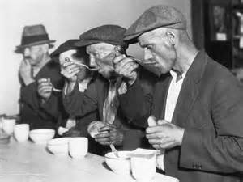
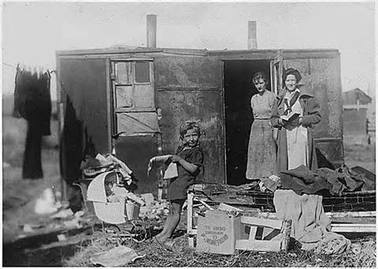
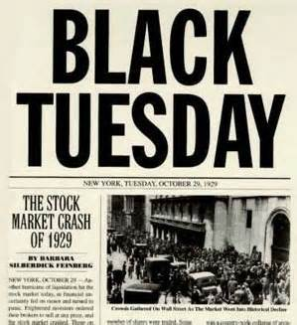
Causes of the Great Depression

Slide 2
Objectives
Describe the characteristics of the 1920’s stock market
Identify the causes of the Great Depression

Slide 3
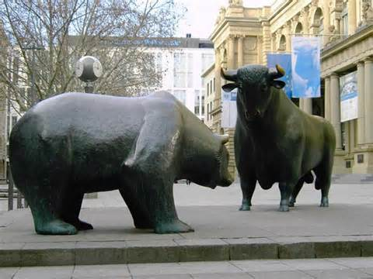
Causes of The Depression
I. Stock Market
A. Problems:
1. Margin (borrowing)
2. Speculation (guessing)
B. Turning Point:
1. Oct. 21st – Oct. 29th
^{*BLACK TUESDAY}
a. $30 billion lost

Slide 4
In order to protect loans made by stockbrokers to investors who bought stocks on margin, brokers could issue a
a. collateral.
b. speculation call.
c. margin call.
d. foreclosure.
5

Slide 5
October 29, 1929, the day when stock prices took the steepest dive of that time, is known as
a. Black Thursday.
b. Black Tuesday.
c. Bloody Monday.
d. Panic Tuesday.
5

Slide 6
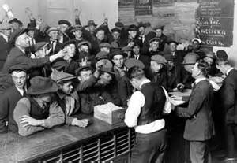
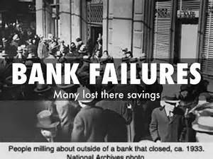
Banks in Tailspin
II. Bank Failures
A. Structure of Banks
1. No separation between
savings/investment banks
a. Banks would invest savings
to maximize bank profits
B. Bank Runs
1. 10% of nations banks close

Slide 7
For some banks, the losses they suffered in the crash were more than they could absorb and they were forced to
a. increase interest rates
b. approve more loans.
c. attract more depositors.
d. close.
5

Slide 8
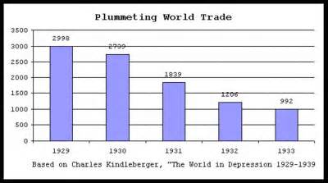
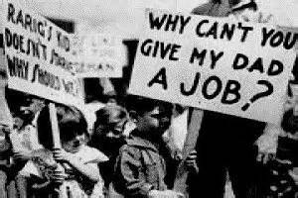
Overproduction
III. Overproduction
A. Uneven Wealth
1. 5% owned 30% of nations wealth
B. Buying on Credit/Installments
IV. Economic Isolationism
A. Overseas investing
B. Hawley-Smoot Tariff
- export trade

Slide 9
In 1929 the top 5 percent of all American households earned 30 percent of the nation’s income, which is
a. an uneven distribution of wealth.
b. supply-side economics.
c. a bull market.
d. a recession.
4

Slide 10
What severely dampened commerce on both sides of the Atlantic and intensified the Depression in the United States?
a. the bull market
b. the Federal Reserve
c. Black Tuesday
d. the Hawley-Smoot Tariff
10

Slide 11
Federal Reserve Mistakes
V. Mistakes by Federal Reserve
A. Interest rates fueled:
1. Risky bank loans
2. Buying on Credit
3. Speculation in Stocks
4. Companies to take loans to expand businesses

