Slide 1
Focusing on Vietnam
Ch. 25.1

Slide 2
Objectives
Describe the nationalist motives of Vietnamese leader Ho Chi Minh
Explain the origins of American involvement in Vietnam during the 1950’s

Slide 3
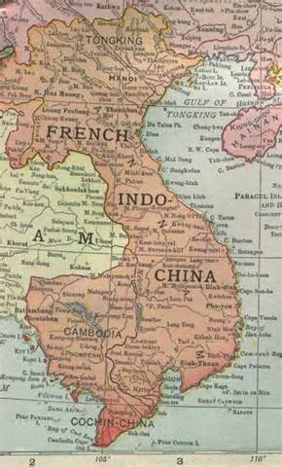
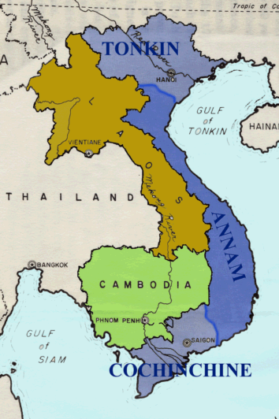
French Indochina / Geneva Accords

Slide 4
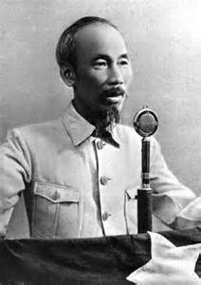
Early American Involvement
I. Early Involvement
A. Vietnamese Nationalism
1. Ho Chi Minh
a. Indochinese Communist Party
i. Vietminh
B. U.S. supports French
1. Domino Theory

Slide 5
In 1941 the Vietminh united both Communists and non-Communists in the struggle to expel the
a. French.
b. Chinese.
c. Japanese forces.
d. United States advisers.

Slide 6
What troops returned to Vietnam in 1946 and drove the Vietminh’s forces into hiding in the countryside?
a. Japanese
b. French
c. Chinese
d. American

Slide 7
American officials did not think France should control Vietnam, but they did not want Vietnam to be
a. Communist.
b. part of Indochina.
c. Socialist.
d. part of China.

Slide 8
Vietminh Drive Out French
II. Driving Out the French
A. Tactics:
1. guerrilla warfare
B. Dien Bien Phu
1. French Defeated
C. Geneva Accords
1. Divisions:
a. Laos, Cambodia, Vietnam
b. North Vietnam = Ho Chi Minh
South Vietnam = Ngo Dinh Diem

Slide 9
On May 7, 1954, where did a French force fall to the Vietminh?
a. Saigon
b. Cambodia
c. Geneva
d. Dien Bien Phu

Slide 10
Who was in control of North Vietnam after the Geneva Accords temporarily divided the country?
a. Ho Chi Minh and the Vietminh
b. Ngo Dinh Diem and a pro-Western regime
c. the Japanese
d. the United States

