Slide 1
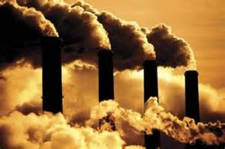
Environmental Concerns
Ch. 26.4

Slide 2
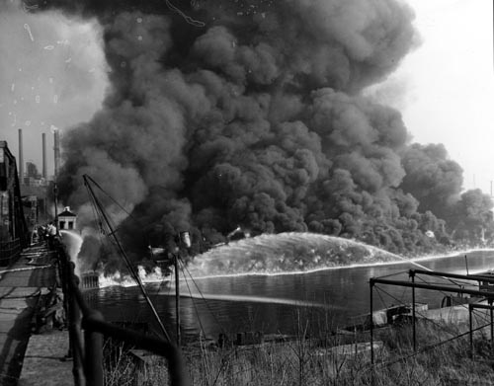
Objectives
Explain the origins of the environmental movement
Identify the significant
measures taken
to combat
environmental
problems

Slide 3
Beginnings of Environmentalism
I. Beginnings of Environmentalism
A. Yannacone Family
1. DDT – pesticide to kill unwanted insects
a. affected: -insect populations
-wildlife
B. Rachel Carson –Marine biologist
1. Silent Spring

Slide 4
Movement Blossoms
II. Movement Blossoms
problems: NW = deforestation
Cities = smog
open drainage
A. Grassroots Effort
1. Earth Day (April 1970)
B. Government Intervention
1. EPA –Envir. Protect Agency
2. Clean Air Act
3. Endangered Species Act

Slide 5
Love Canal Incident

Slide 6
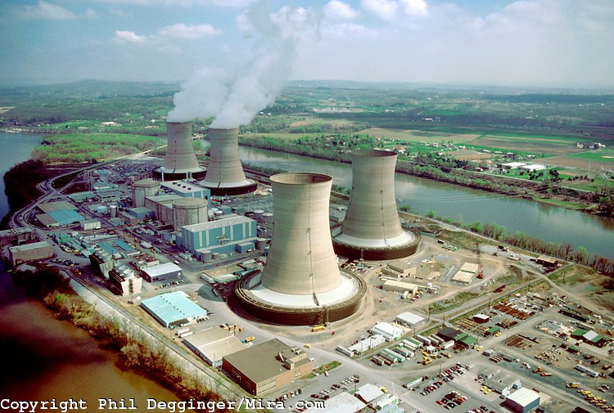
Concerns Over Nuclear Energy
C. Concerns / Nuclear Energy
1. Supporters:
- cleaner & less $
2. Opponents:
- dangers of radiation Harrisburg, PA
a. 3 Mile Island
III. Consumer Movement
A. Product Safety
1. Ralph Nader – Unsafe at Any Speed
a. Nat’l Traffic & Motor Vehicle Safety Act

