Slide 1
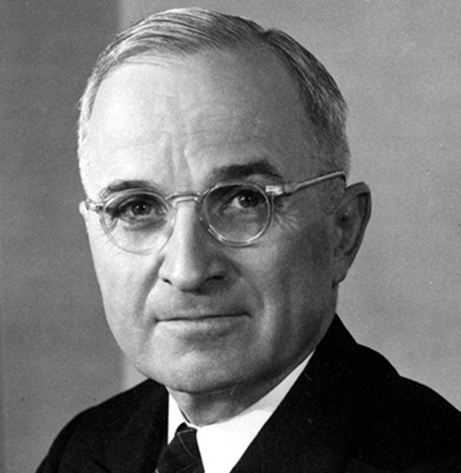
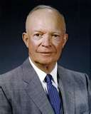
Truman and Eisenhower
Ch. 22.1

Slide 2
Opening Activity
Read “Why it Matters” at the top of pages 690-691, and formulate an answer to the following questions:
Why was the interstate system built?
How does the interstate system affect business?
How did the interstate system affect suburban sprawl in the U.S.?
What was the “New Road Culture”?

Slide 3
Objectives
Explain Truman’s efforts on the domestic front
Describe President Eisenhower’s domestic plan

Slide 4
Return to Peacetime Economy
I. Peacetime Economy
Post war = spending
GI Bill – offered veterans loans to start businesses, buy homes, and attend college
A. Inflation and Strikes
1. Demand = Price
a. Workers strike for better wages
-Truman works against strikes

Slide 5
The Sevicemen's Readjustment Act, popularly called the ____________________, boosted the economy by providing generous loans to veterans to help them establish businesses, buy homes, and attend college.
10
Dixiecrat
G.I. Bill
Liberal
senator

Slide 6
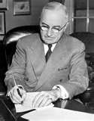
Truman’s Domestic Plans
B. Republicans take Congress
1. Taft-Hartley Act (1947)
a. anti-Union’s
II. Truman’s Domestic Plans
A. Proposals
-expand Social Security
- increase minimum wage
-full employment
-public housing initiatives
-national health insurance
(Fair Deal activity [688-89] CHART)

Slide 7
In 1947 the conservative Congress set out to curb the power of organized labor by passing the
10
A. Fair Deal.
b. Federal Highway Act.
c. Taft-Hartley Act.
d. GI Bill.

Slide 8
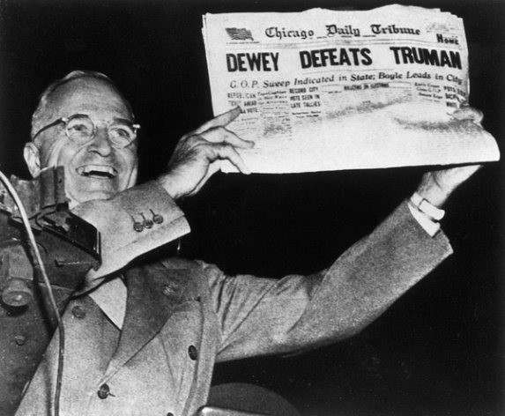
Election of 1948
B. Election of 1948
1. Truman vs. (R) Thomas Dewey
a. Democratic Party Divisions
-attacks Do-Nothing Congress
*Defeats Dewey
III. Eisenhower Years
A. Agenda:
-Grow Business through Free Enterprise
-Federal Highway Act (p. 690-91)

Slide 9
Truman won the election in 1948 with strong support from laborers, farmers, and
10
A. wealthy socialites.
b. Southern Democrats.
c. the new Progressive Party.
d. African Americans.

Slide 10
What did Eisenhower end that many conservatives had viewed as unnecessary federal control over the business community?
:10
A. government work programs
b. the GI Bill
c. government price and rent controls
d. union shops

Slide 11
President Eisenhower's political beliefs, which he described as "middle of the road," fell midway between conservative and ____________________.
10
Liberal
Communist
Socialist
anarchist

