Slide 1
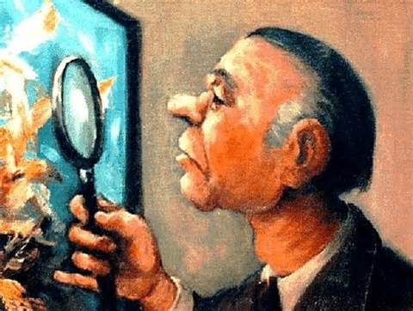
You’re the Art Critic!
Ch. 10.2-Urbanization

Slide 2
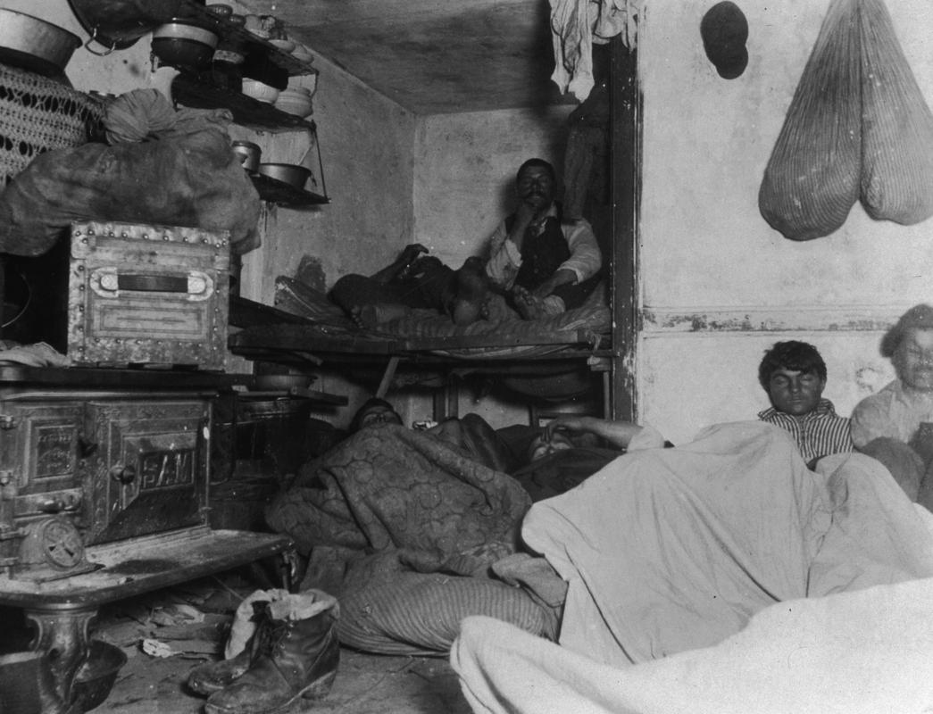
Photo #1 – How the Other Half Live

Slide 3
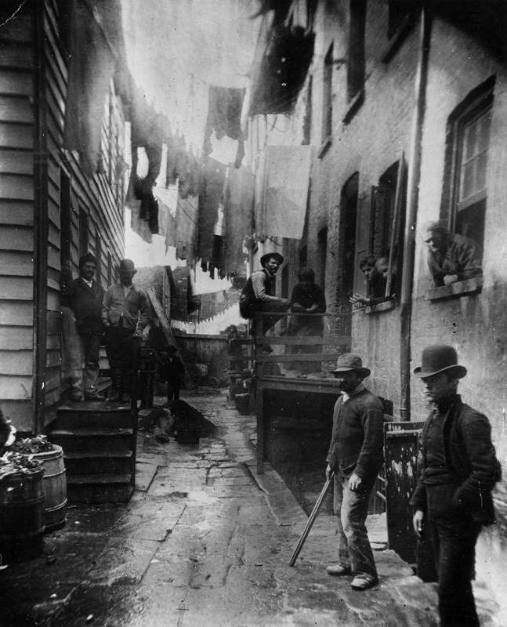
Photo #2 – How the Other Half Live

Slide 4
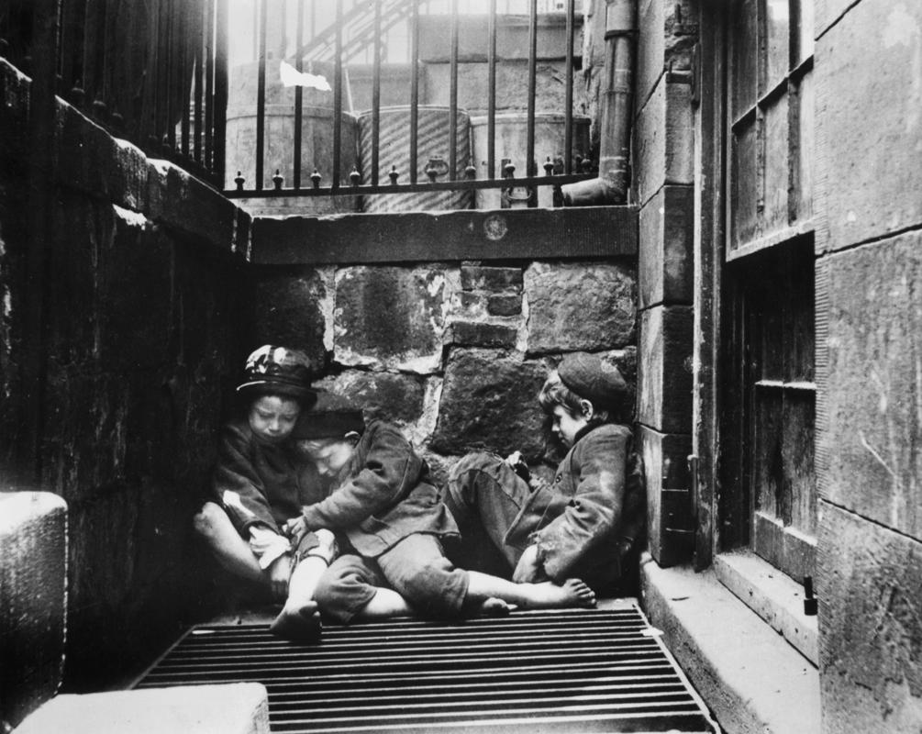
Photo #3- How the Other Half Live

Slide 5
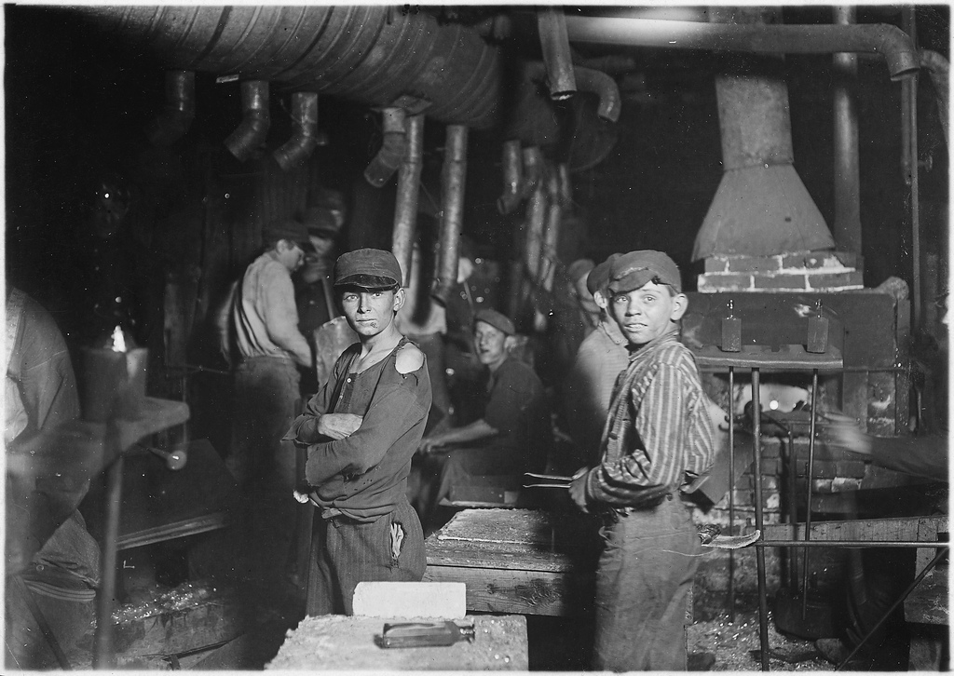
Photo #4 – Lewis Hine

Slide 6
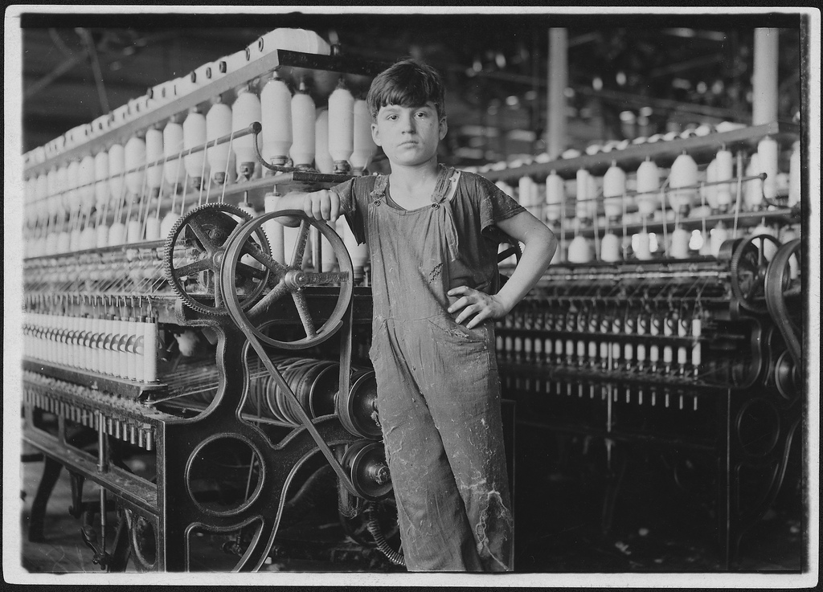
Photo #5 – Lewis Hine

Slide 7
Objectives for Learning:
Explain the technological developments that made the growth of cities possible.
Analyze problems that were caused by mass urbanization during the Industrial Revolution time period in the U.S.

Slide 8
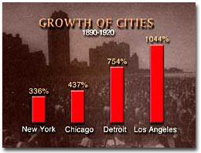
Urbanization in the U.S.
I. Migration to Cities
A. Causes:
1. Immigrants
2. Rural to Urban
Migration
*What are some
push & pull factors
leading to this
change?

Slide 9
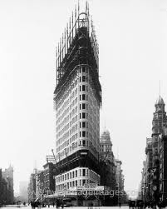
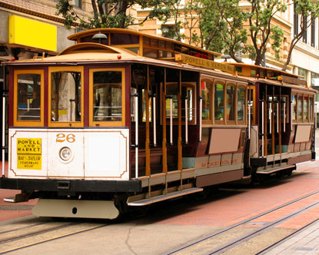
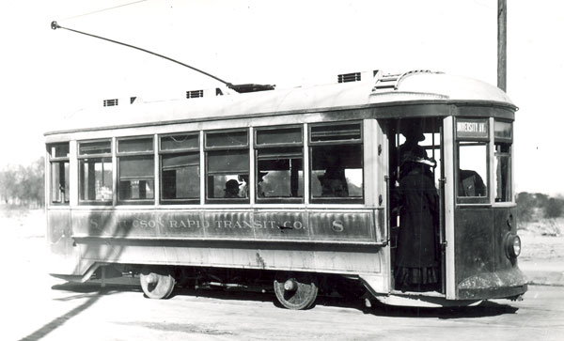
The New Urban Environment
II. New City Environments
A. Skyscrapers
1. Material Improvements
a. reinforced concrete
b. steel beams
2. Designers
a. Frank Loyd Wright
b. Louie Sullivan
B. Mass Transit
1. Cable Cars (SF)
2. Electric Trolley
3. Subways

Slide 10
No one contributed more to the design of skyscrapers than Chicago’s
a. Frank Lloyd Wright.
b. Potter Palmer.
c. Louis Sullivan.
d. Frank J. Sprague.

Slide 11
To alleviate congestion in city streets, Chicago built an elevated railroad, and both Boston and New York built the first
a. trolley cars.
b. tunnels.
c. overpasses.
d. subway systems.

Slide 12
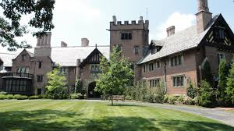
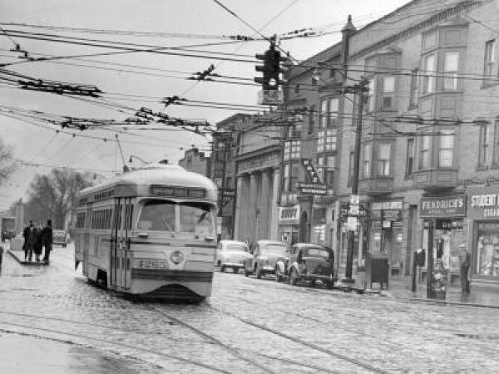
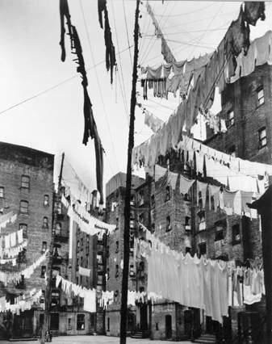
Separation by Class
III. Separation by Class
A. High Society
-American Castles
B. Middle-Class
Gentility
-streetcar suburbs
C. Working Class
-tenements–dark and crowded multi-family apartments

Slide 13
America’s industrialization not only made some people wealthy; it also helped create a growing
a. tenement system.
b. middle class.
c. agricultural system.
d. political machine.

Slide 14
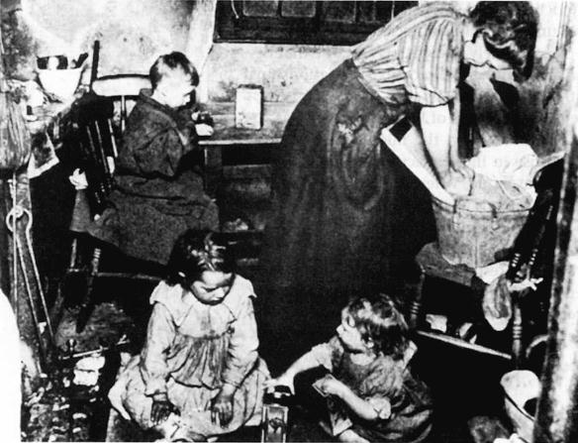
Urban Problems
IV. Urban Problems
A. Crime
B. Disease
C. Nativism
D. Child Labor
E. Pollution

Slide 15
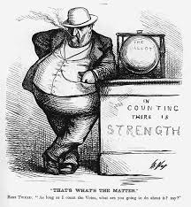
Political Corruption
V. Corrupt Urban Politics
A. Political Machines
ex: “Tammany Hall”
B. Party Bosses
1. George Plunkitt
2. William “Boss” Tweed
C. Graft
-gaining money dishonestly
through political means.

Slide 16
Who rose to be one of New York’s most powerful party bosses?
a.Thomas Pendergast
b. Cornelius Vanderbilt
c. George Plunkitt
d. Zalmen Yoffeh

Slide 17
What was the famous New York Democratic political machine called?
a.Tammany Hall
b. Tammany Tweed
c. Thomas Pendergast Machine
d. William M. Tweed Hall

