Slide 1
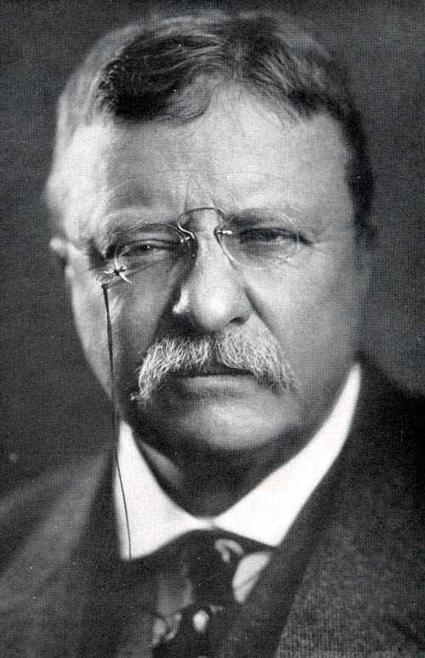
Roosevelt in Office
Chapter 13.2

Slide 2
Objectives
1. Describe various efforts to regulate concentrated corporate power
2. Discuss Theodore Roosevelt's interest in environmental conservation.

Slide 3
Roosevelt’s Trust Busting
I. Square Deal Reforms
A. Trust Busting
1. Gov. supervision
of business
a. regulate unfair
practices
ex.) Northern Securities Railroad
-Violated Sherman Anti-Trust

Slide 4
Anthracite Coals Strike of 1902
B. Anthracite Coal Strike
1. United Mine Workers
a. 150,000 strike
=coal shortage
2. arbitration - settlement imposed by an outside party
*U.S. Government
Pg.428

Slide 5
Bureau of Corporations
C. Bureau of Corporations
1. Dept. Commerce & Labor
a. investigate & report
ex:) U.S. Steel
D. Congress
1. Hepburn Act (1906)
a. Strengthen ICC
-set R.R. rates

Slide 6
Social Welfare
II. Social Welfare
A. Consumer Protection
1. Unsafe food & med.
ex:) -potions
-preservatives
2. Upton Sinclair
a. The Jungle
B. Response:
1. Meat Inspection Act
2. Pure Food and Drug Act

Slide 7
Conservation
III. Conservation
A. Development in West
1. Newlands Reclamation Act
-irrigation for farms
B. Gifford Pinchot
1. U.S. Forest Service
-preservation

Slide 8
HOMEWORK!!!
Page 431
Numbers 1-6

