Slide 1
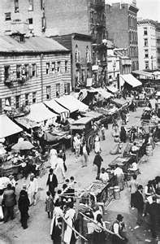
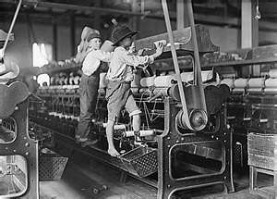
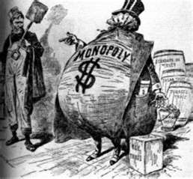
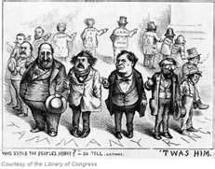
Roots of Progressivism
Ch. 13.1

Slide 2
Rise of Progressivism
I. Rise of Progressivism
A. Who:
-ed. Middle class
-collection of ideas
B. What:
1. Against:
-industrialism
-urbanization
-laissez-fair

Slide 3
Progressives campaigned against what emotional issue?
10
Suffrage
Prohibition
Child labor
muckraking

Slide 4
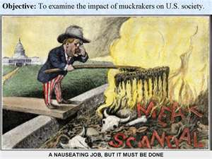
Muckrakers
C. Muckrakers
1. McClures Magazine
a. Ida Tarbell
-Standard Oil
b. Lincoln Steffens
-vote stealing
D. Jacob Riis
1. How the Other Half Lives

Slide 5
Group of crusading journalists who investigated social conditions and political corruption
10
Prohibitionists
Initiative
Muckraking
suffragists

Slide 6
Making Gov. Efficient
II. Making Gov. Efficient
A. Efficiency Progressives
1. scientific management
a. commission plan
-city depts.
III. Democracy and Progressivism
A. Robert La Follette (WI)
1. direct primary
2. initiative
3. referendum
4. recall

Slide 7
Political reform first came to the state level when Wisconsin voters elected who as their governor?
10
Charles Edward Russell
Frederick W. Taylor
Jacob Riis
Robert LaFollette

Slide 8
Allowed a group of citizens in a state to introduce legislation and required the legislature to vote on it
10
Suffrage
Referendum
Initiative
Recall

Slide 9
17th Amendment
IV. 17th Amendment
A. Direct Elections
1. Senators (fed.)
What was the impact of the 17th Amendment?

Slide 10
Suffrage Movement
Elizabeth Cady Stanton
Susan B. Anthony

Slide 11
Suffrage Movement
V. Suffrage Movement
A. Seneca Falls Convention (1848)
B. Problems:
-14 & 15 Amendments
*excluded women
1. theories:
-fed. Or state gov’s
pg.423

Slide 12
Building Support
C. Building Support
1. National American Women Suffrage Association (1890)
a. convincing women
-middle & lower class women
b. Carrie Chapman Catt
-”winning plan” 1915
c. Alice Paul
-National Women's Party
*Use force

Slide 13
19th Amendment
D. 19th Amendment
1. proposed amendment 1918
-rejected by senate
*Catt Chapman rallies
2. passed 1919
-goes into effect 8/26/1920

Slide 14
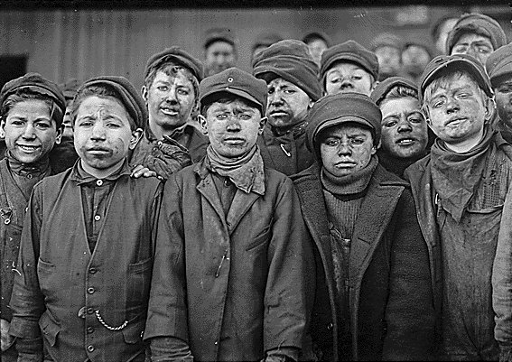
Social Welfare Progressives
VI. Social Welfare
A. Child Labor
1. Luis Hines
a. Child Labor Laws
b. Compulsory Education Laws
B. Health & Safety Codes
1. Triangle Shirtwaste Co

Slide 15
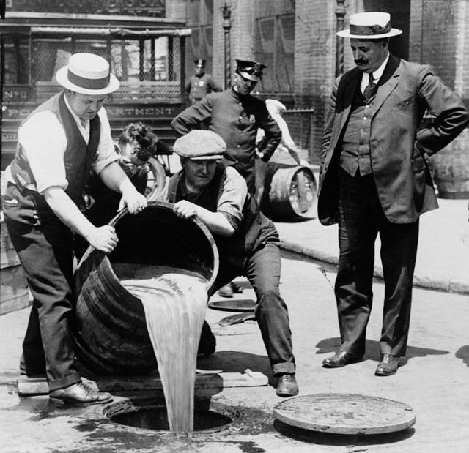
Social Welfare continued
C. Prohibition Movement
1. Women’s Christian Temperance Union
2. Billy Sunday
3. 18th Amendment

