Slide 1
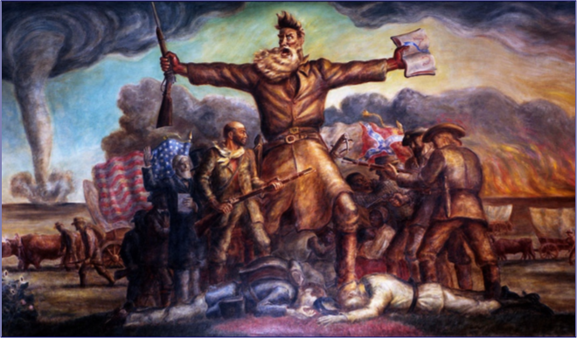
Causes of the Civil War
Harriet Beecher Stowe
“Uncle Tom’s Cabin”
Kansas Nebraska Act
Bleeding Kansas
Sumner-Brooks Affair

Slide 2
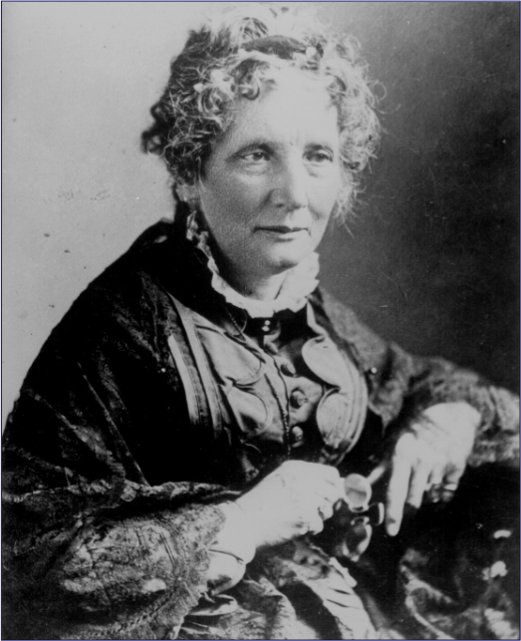
Harriet Beecher Stowe (1811 – 1896)
So this is the lady who started the Civil War. -- Abraham Lincoln

Slide 3
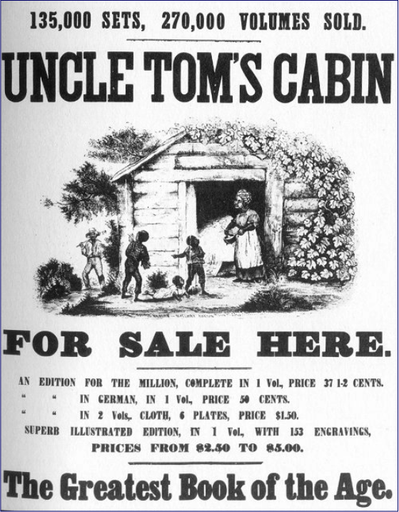
Uncle Tom’s Cabin
1852
Sold 300,000 copies in the first year.
2 million in a decade!

Slide 4
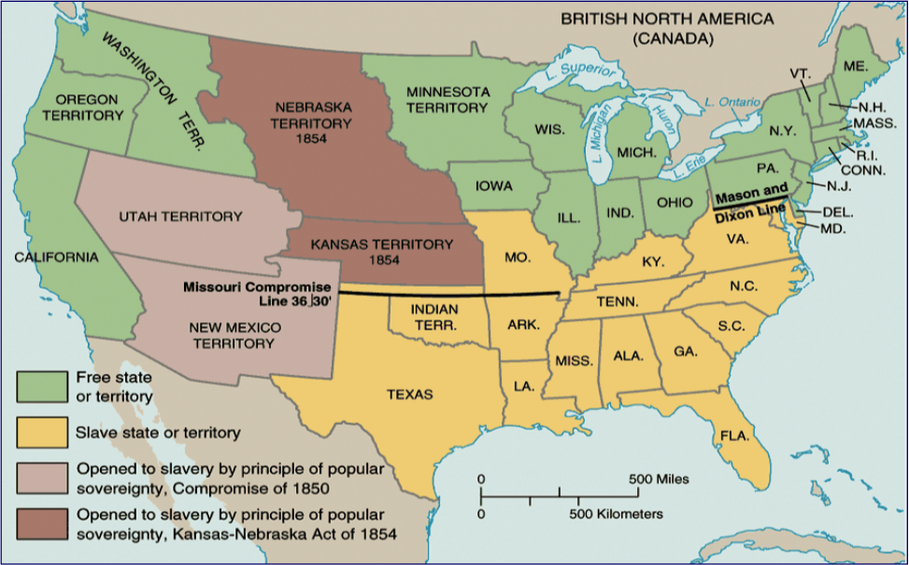
Kansas-Nebraska Act, 1854

Slide 5
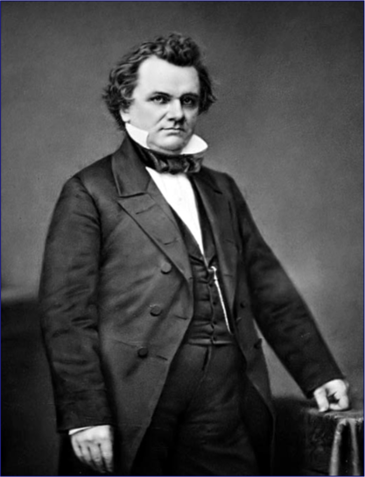
Stephen Douglas
Popular Sovereignty?

Slide 6
The Kansas Nebraska Act of 1854
It repealed the Missouri Compromise
It included the Idea of Popular Sovereignty
It was drawn up by a senator by the name of Stephen Douglass
Notes:
After the passage of the Kansas Nebraska Act which included the idea of Popular Sovereignty caused a lot of violence in Bloodshed over the slavery issue. Some people living here wanted Kansas to become a free state and others wanted it to become a slave state. It was a very emotional issue. Popular sovereignty said let the people decide for themselves whether or not Kansas would become a slave state or free state

Slide 7
Related Vocabulary
Popular Sovereignty-The belief that the people living in a territory should decide for themselves if the territory should become a slave state or free state
Repealed-Revoked. The Missouri Compromise was repealed with the passage of the Kansas Nebraska Act

Slide 8
Vocabulary (Continued)
Proslavery-People that were in favor of slavery and believed that Kansas should become a slave state
Antislavery-People that were not in favor of slavery and believed that Kansas should become a free state
Abolitionists-A radical that thought that slavery should be abolished or done away with because it was immoral
Land Speculators-People that obtained land in Kansas with the hopes of buying it at a low price and selling it at a high Price

Slide 9
Vocabulary Continued
Freesoiler-A person who came to Kansas after the passage of the Kansas-Nebraska Act.
Border Ruffian- A person who was in favor of slavery and came across the border from Missouri to vote illegally in elections

Slide 10
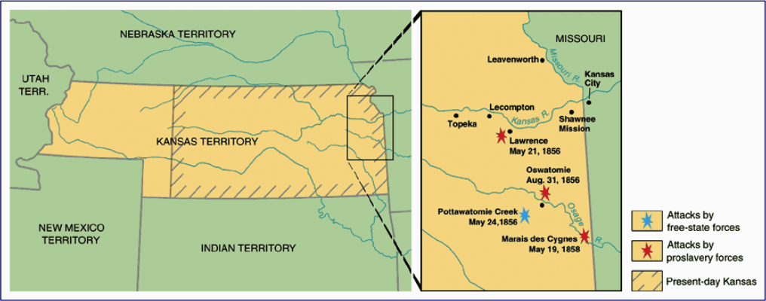
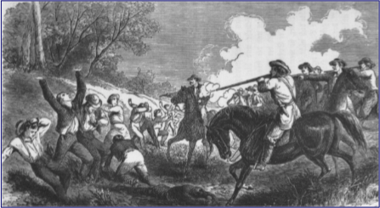
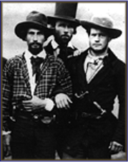
“Bleeding Kansas”
Border “Ruffians” (pro-slavery Missourians)

Slide 11
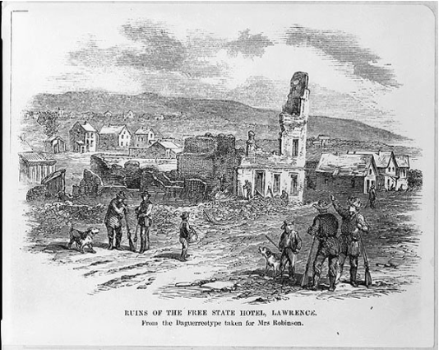
Bleeding Kansas Begins
Samuel Jones-Proslavery Sheriff who burned Lawrence in 1855
In the Wakarusa War, homes and businesses were burned along with the free-state Hotel. Several people were killed
http://www.territorialkansasonline.org/
Notes:
This attack on Lawrence by the Proslavers became known as the Wakarusa War. Why would Samuel Jones want to Burn Lawrence?

Slide 12
During the time that Kansas was a territory, there were 2 Territorial Governments
Topeka-This was where the free state government was located
Shawnee Mission-This was where the proslavery government was located
Neither government thought the other should be there

Slide 13
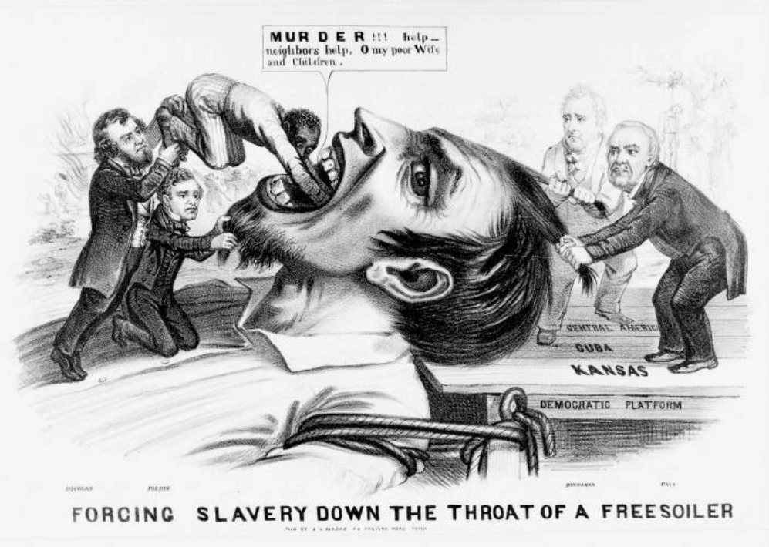

Slide 14
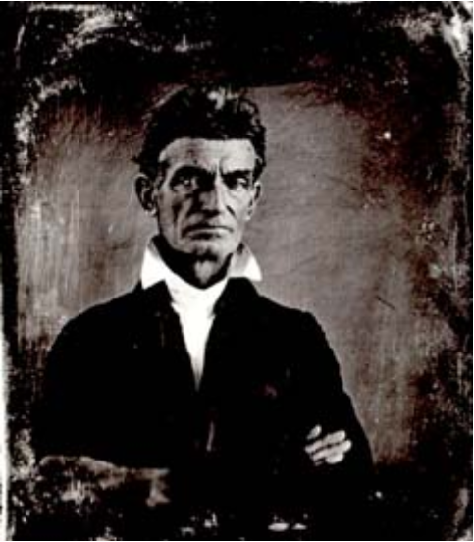
Violence Continues
John Brown-A fanatical Abolitionist who Killed 5 Proslavery settlers on the Pottawatomie Creek in eastern Kansas
http://www.pbs.org/
Notes:
This raid included his 4 sons and two other men. After this, Brown and his followers left Kansas and he was later put on trial for treason and took part in a raid in Harper’s Ferry Virginia.

Slide 15
Who wins the Battle of “Bleeding Kansas”
Eventually there were enough people that had moved into Kansas as a result of the Kansas-Nebraska Act that the government at Shawnee Mission was voted out of office

Slide 16
Kansas Becomes a Free State
On January 29, 1861, Kansas became the 34th state
The free State Constitution was also called the Wyandotte Constitution
The development of Kansas as a state was delayed because of the Civil War

Slide 17
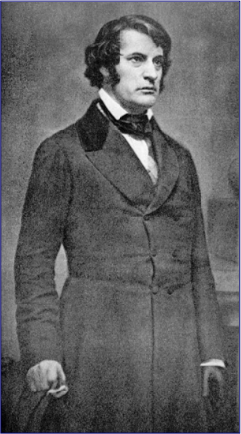
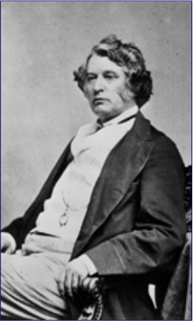
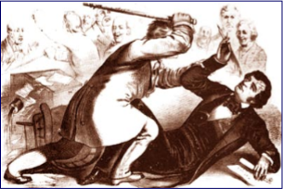
“The Crime Against Kansas”
Sen. Charles Sumner (R-MA)
Congr. Preston Brooks (D-SC)

Slide 18
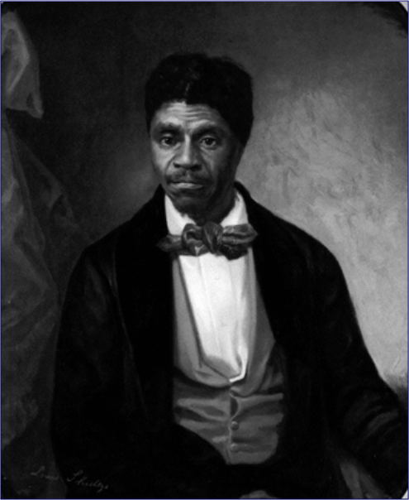
Dred Scott v. Sanford, 1857

Slide 19
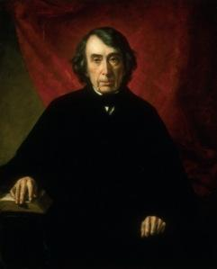
Desicion- Court ruled Dred Scott was still a slave therefore he had no rights, including the right to press charges in court.
Furthermore: The Supreme Court also ruled that it was unconstitutional for the government to put a ban on slavery, therefore officially repealing the Missouri Compromise.
Chief Justice Roger Taney,

Slide 20
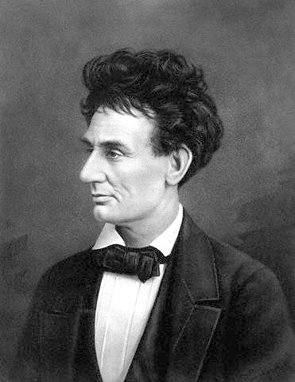
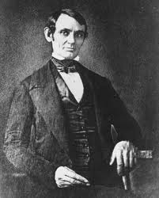
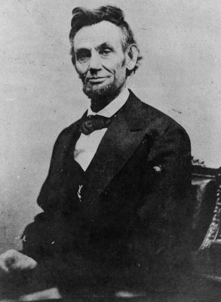
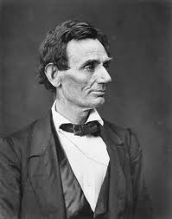
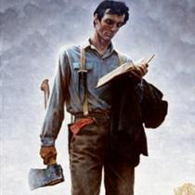
Abraham Lincoln

Slide 21
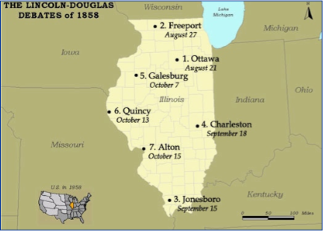
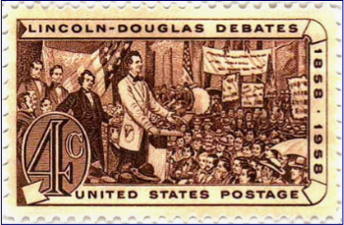
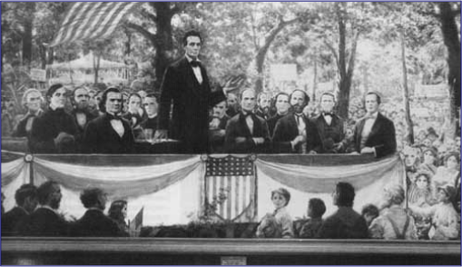
The Lincoln-Douglas (Illinois Senate) Debates, 1858

Slide 22
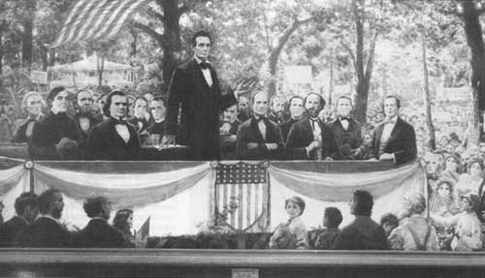
Lincoln Would ask Douglas questions that made him seem wish-washy on the topic of slavery. Douglas was trying to make friends on both the sides of the North and South. Instead, it hurts his reputation.
"A House divided amongst inself cannot stand"
-Abraham Lincoln
Lincoln states that the US could not survive as half-slave and half-free states. "A House divided amongst itself, cannot stand." and.... he was right.
*The Lincoln-Douglas debates drew the attention of the entire nation. Makes Lincoln Famous.
*Lincoln walks away a man of clear insightful thinking and with the reputation of an anti slavery Republican politiician.
Douglas wins the election, but Lincoln wins the debates.

Slide 23
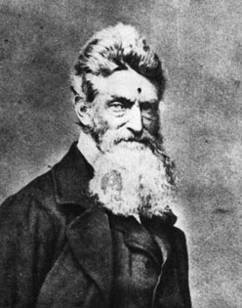
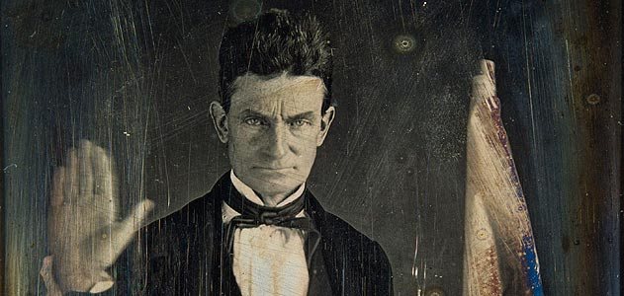
John Brown: Madman, Hero or Martyr?
"I, John Brown am now quite certain that the crimes of this guilty land will never be purged away but with blood"

Slide 24
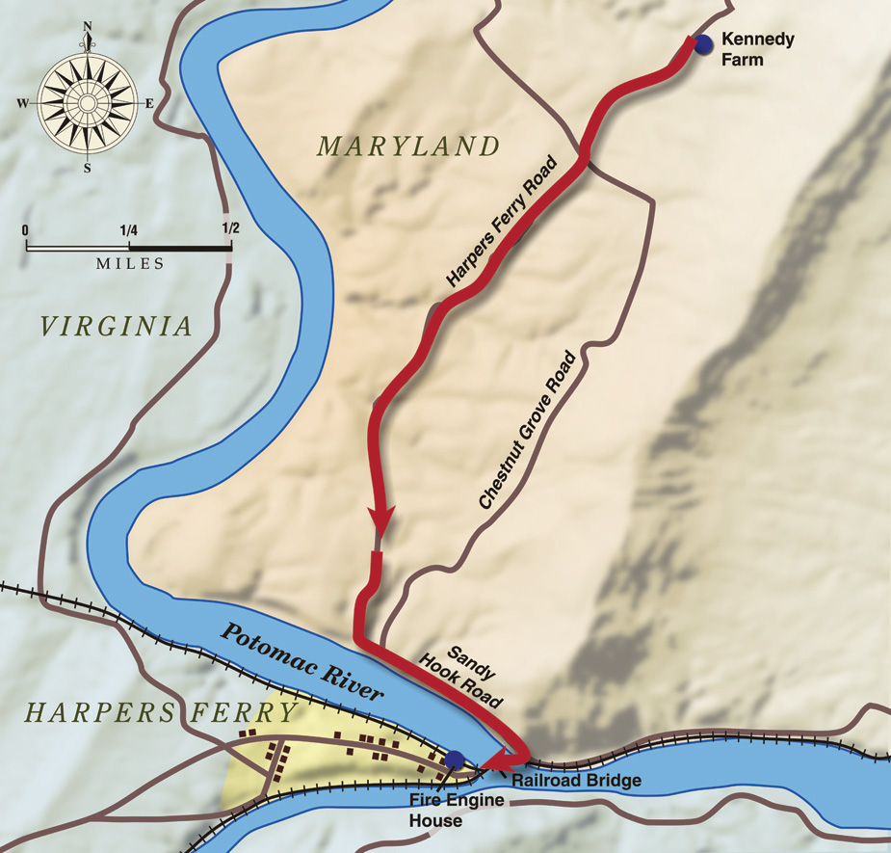
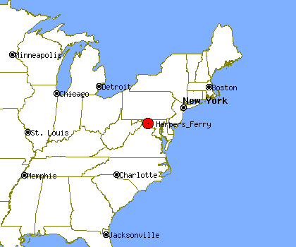
The Plan
October 16th 1859
1.John Brown and 21 of his abolitionist followers would attempt to take over the Arsenal at Harper's Ferry.
2.Take Hostages.
3. Release a Proclamation to all slaves in the area to flock to Harper's Ferry where they would be armed.
4. March South and overthrow the entire institution of Slavery.

Slide 25
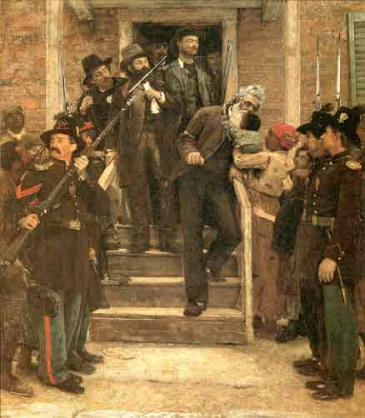
Plead Insanity?.....No Sir!
Brown took full responsibility for his actions, deploring his court-appointed lawyers' attempts to have him declared insane and insisting that he was right to "interfere" with slavery, even violently.
"Now, if it is deemed necessary that I should forfeit my life for the furtherance of the ends of justice, and mingle my blood further with the blood of my children, and with the blood of millions in this slave country whose rights are disregarded by wicked, cruel, and unjust enactments, I say let it be done."
-John Brown
After the jury found him guilty and before the judge sentenced him to hang,

Slide 26
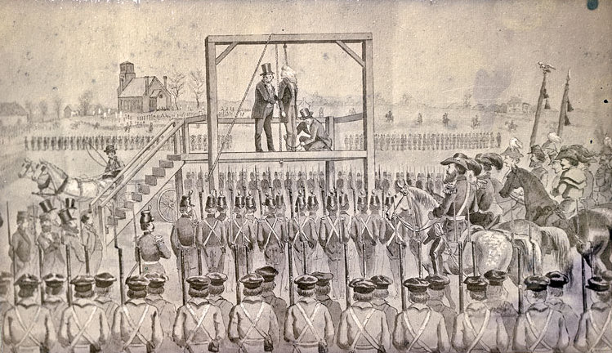

Slide 27
Reactions in the North and the South
Northern Reaction
Some thought John Brown was an insane fanatic.
Others admired his ideals and aims but rejected his use of violence. (Fredrick Douglas)
But many abolitionist saw him as an inspired martyr who brought the day of liberation of slaves that much closer.
Southern reaction
Outraged; saw action as a threat to their slaves (property) as well as their own lives.
"This was the attempt of a fanatic or mad­man"
-Robert E.Lee
"To the South, he was a murderer who wanted to deprive them of their property. The North "has sanctioned and applauded theft, murder, and treason," said De Bow's Review"

Slide 28
Republican Party Platform in 1860
Non-extension of slavery (for the Free-Soilers.)
Protective tariff [for the No. Industrialists].
No abridgment of rights for immigrants
Government aid to build a Pacific RR [for the Northwest].
Internal improvements [for the West] at federal expense.
Free homesteads for the public domain [for farmers].
It had little presence in the South, but in the North it enlisted most former Whigs, Know-Nothings and former Free Soil Democrats to form majorities in nearly every state.
The Republican Party was based on northern white Protestants, businessmen, professionals, factory workers, wealthier farmers, and poor blacks. It was pro-business, supporting banks, the gold standard, railroads, and high tariffs to protect heavy industry and the industrial workers.

Slide 29
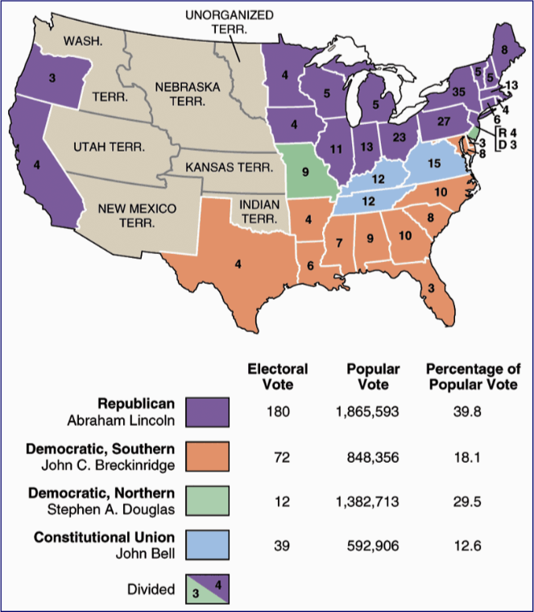
1860
Election
Results

Slide 30
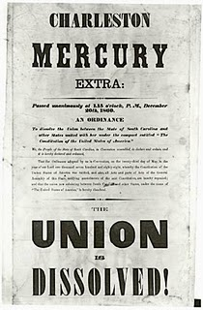
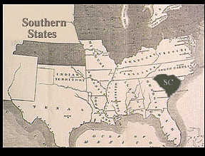
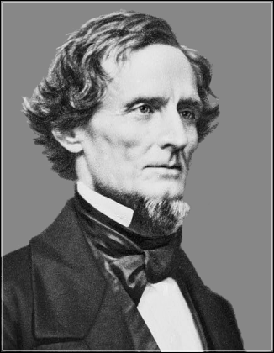
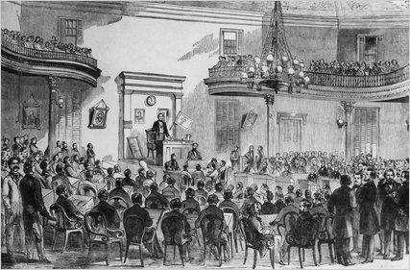
Confederate States of America- A New Nation
December 20th, 1860 South Carolina secedes from the Union.
Mississippi, Alabama, Georgia, Florida, Louisiana, and Texas followed.
"If We submit to the Lincoln Government, the South is Done!""
Jefferson Davis
First President of the
C.S.A

Slide 31
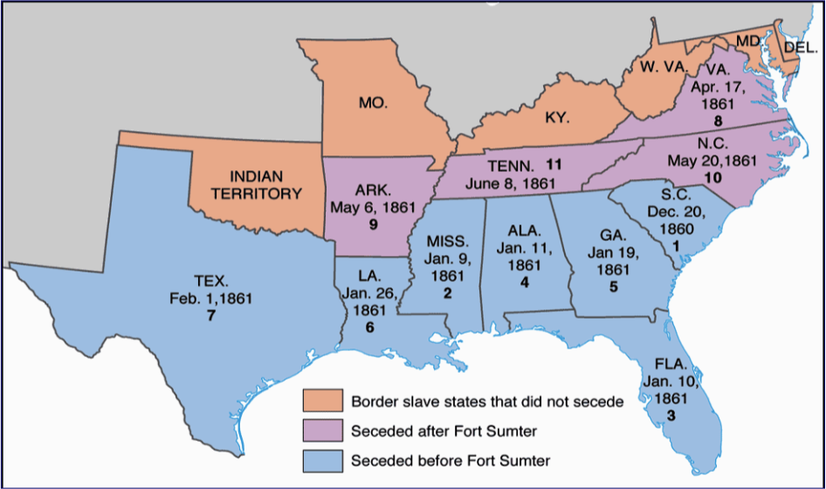
Secession!: SC→ Dec. 20, 1860

Slide 32
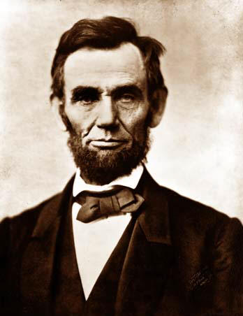
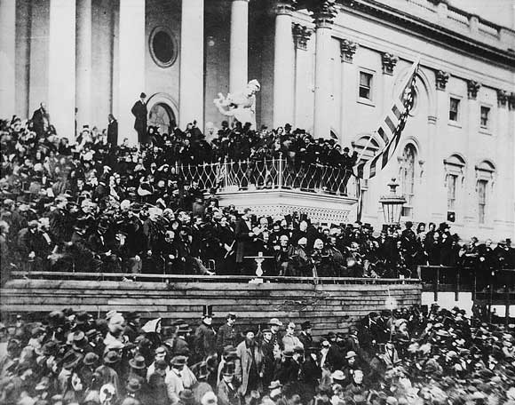
Lincoln's First Inaugural Address

Slide 33
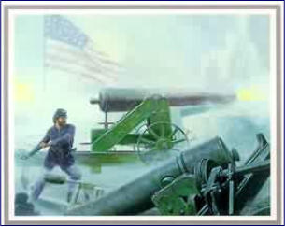
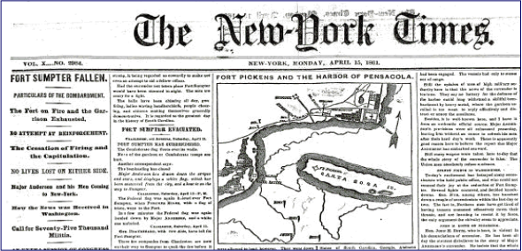
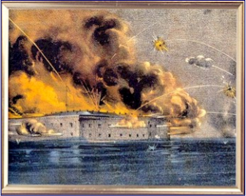
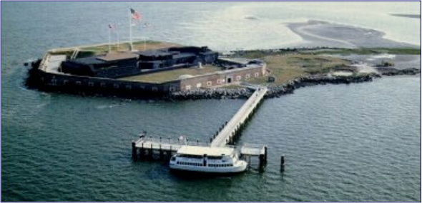
Fort Sumter: April 12, 1861

Slide 34
Causes of the Civil War
1. Slavery-Political, Moral and Economical Question that no one could answer or agree upon.
2. Two regions on separate paths.
3. States' Rights
3. Abolitionism
4. Abraham Lincoln becoming President.

Slide 35
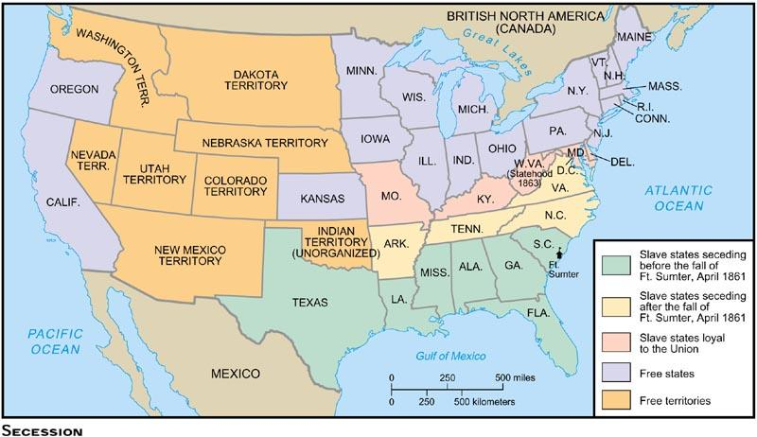
Picking Sides- The Border States
Border States
Missouri- second bleeding Kansas until Lincoln send troops.
Kentucky- Lincoln treats them like an upset teenager, do not force them to rebel.
Maryland-Lincoln declares Martial Law- When the military takes control of an area and replaces civilian authorities, and it suspends certain rights.
Virginia- population becomes sharply divided over the issue of secession from the Union and in 1863 separates from Virginia. West Virginia would be considered one of the Civil War Border States.

Slide 36
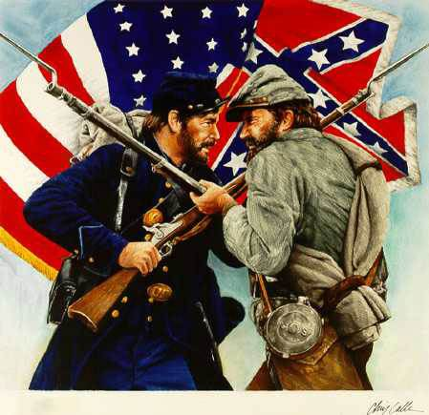
Civil War
A dispute between members of the same country.
Civil=Citizen... War
North vs South
For the future of the Union.

