Slide 1
American Foreign Policy: 1920-1941

Slide 2
Foreign Policy Tensions
Interventionism
Disarmament
Collective security
“Wilsonianism”
Business interests
Isolationism
Nativists
Anti-War movement
Conservative Republicans

Slide 3
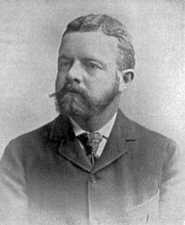
American Isolationism
-Isolationists like Senator Lodge, refused to allow the US to sign the Versailles Treaty.
-July, 1921 → Congress passed a resolution declaring war officially over!
Sen. Henry Cabot Lodge, Sr. [R-MA]

Slide 4
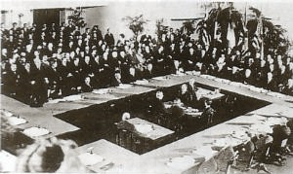
Washington Disarmament Conference (1921-1922)
Goals → naval disarmament and calming the political situation in the Far East.

Slide 5
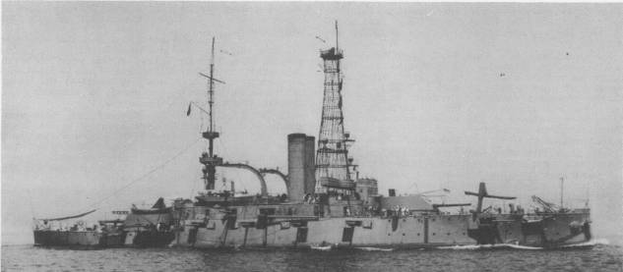
Five-Power Treaty (1922)
-A battleship ratio was achieved through this ratio: US Britain Japan France Italy 5 5 3 1.67 1.67
-Japan got a guarantee that the US and Britain would stop fortifying their Far East territories [including the Philippines].
-Loophole → no restrictions on small warships

Slide 6
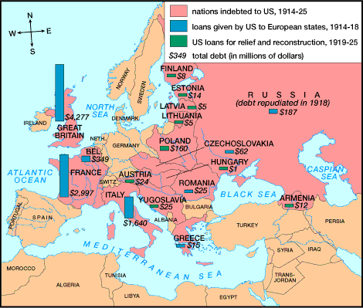
European Debts to the US

Slide 7
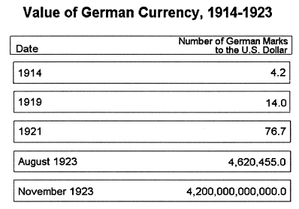
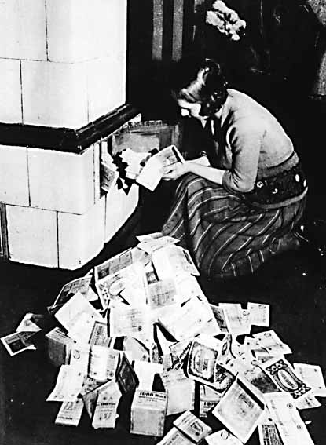
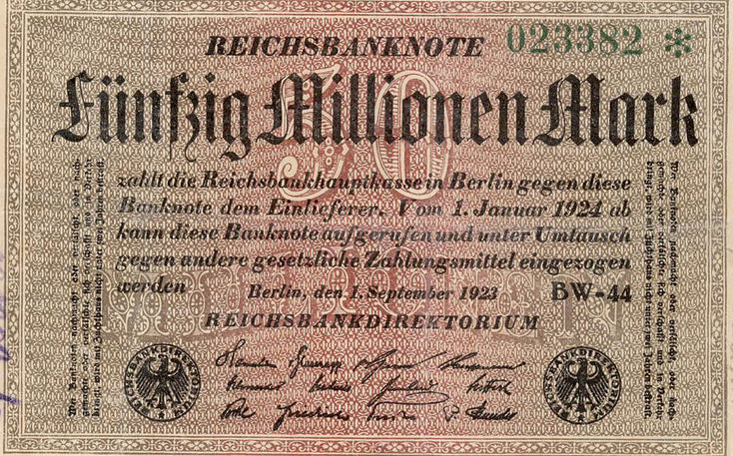
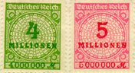
Hyper-Inflation in Germany: 1923

Slide 8
Dawes Plan (1924)

Slide 9
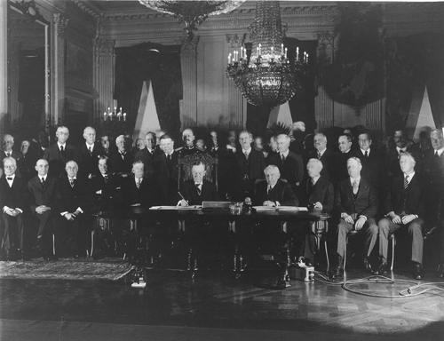
Kellogg-Briand Pact (1928)
-15 nations dedicated to outlawing aggression and war as tools of foreign policy.
-62 nations signed.
-Problems → no means of actual enforcement and gave Americans a false sense of security.

Slide 10
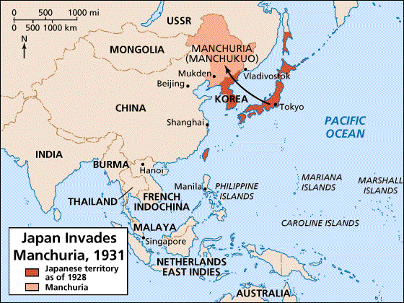
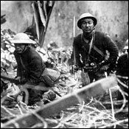
Japanese Attack Manchuria (1931)
-League of Nations condemned the action.
-Japan leaves the League.
-Hoover wanted no part in an American military action in the Far East.

Slide 11
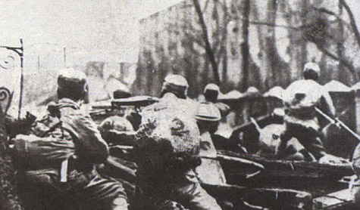
Hoover-Stimpson Doctrine (1932)
-US would not recognize any territorial acquisitions that were achieved by force.
-Japan was infuriated because the US had conquered new territories a few decades earlier.
-Japan bombed Shanghai in 1932 → massive casualties.

Slide 12
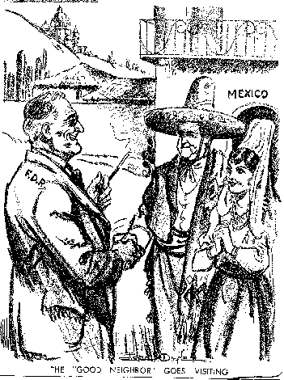
FDR’s “Good Neighbor” Policy
-Important to have all nations in the Western Hemisphere united in lieu of foreign aggressions.
-FDR → The good neighbor respects himself and the rights of others.
-Policy of non-intervention and cooperation.

Slide 13
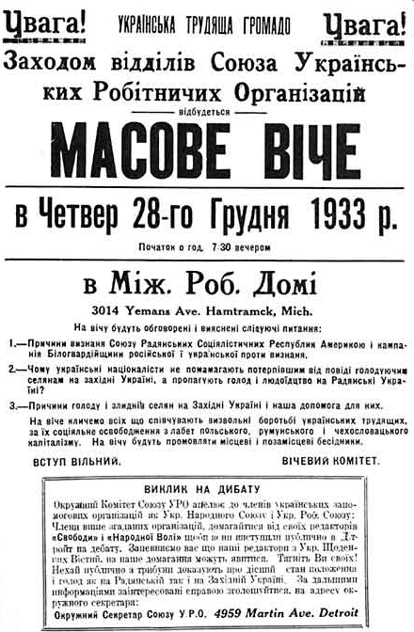
FDR Recognizes the Soviet Union (late 1933)
-FDR felt that recognizing Moscow might bolster the US against Japan.
-Maybe trade with the USSR would help the US economy during the Depression.

Slide 14
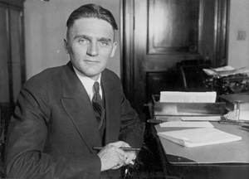
Nye Committee Hearings (1934-1936)
-The Nye Committee I investigated the charge that WW I was needless and the US entered so munitions owners could make big profits [“merchants of death.”]
-The Committee did charge that bankers wanted war to protect their loans & arms manufacturers to make money.
-Claimed that Wilson had provoked Germany by sailing in to warring nations’ waters.
-Resulted in Congress passing several Neutrality Acts.
Senator Gerald P. Nye [R-ND]

Slide 15
Neutrality Acts: 1935, 1936, 1937
-When the President proclaimed the existence of a foreign war, certain restrictions would automatically go into effect:
Prohibited sales of arms to belligerent nations.
Prohibited loans and credits to belligerent nations.
Forbade Americans to travel on vessels of nations at war [in contrast to WW I].
Non-military goods must be purchased on a “cash-and-carry” basis → pay when goods are picked up.
Banned involvement in the Spanish Civil War.
-This limited the options of the President in a crisis.
-America in the 1930s declined to build up its forces!

Slide 16
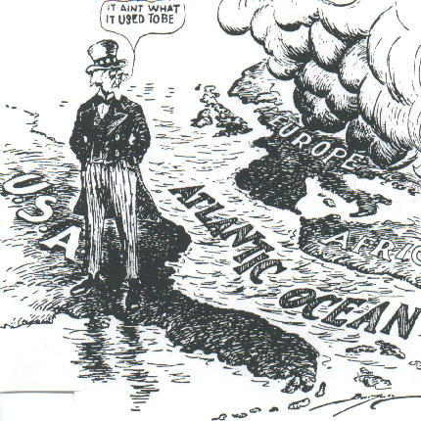
US Neutrality

Slide 17
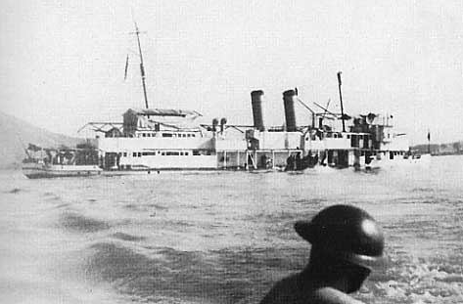
Panay Incident (1937)
-December 12, 1937.
-Japan bombed USS Panay gunboat & three Standard Oil tankers on the Yangtze River.
-The river was an international waterway.
-Japan was testing US resolve!
-Japan apologized, paid US an indemnity, and promised no further attacks.
-Most Americans were satisfied with the apology.
-Results → Japanese interpreted US tone as a license for further aggression against US interests.

Slide 18
Fascist Aggression
-1935: Hitler denounced the Versailles Treaty & the League of Nations [re-arming!] Mussolini attacks Ethiopia.
-1936: German troops sent into the Rhineland. Fascist forces sent to fight with Franco in Spain.
-1938: Austrian Anschluss. Rome-Berlin Tokyo Pact [AXIS] Munich Agreement → APPEASEMENT!
-1939: German troops march into the rest of Czechoslovakia. Hitler-Stalin Non-Aggression Pact.
-September 1, 1939: German troops march into Poland → blitzkrieg → WW II begins!!!

Slide 19
1939 Neutrality Act
-In response to Germany’s invasion of Poland.
-FDR persuades Congress in special session to allow the US to aid European democracies in a limited way:
The US could sell weapons to the European democracies on a “cash-and-carry” basis.
FDR was authorized to proclaim danger zones which US ships and citizens could not enter.
-Results of the 1939 Neutrality Act:
Aggressors could not send ships to buy US munitions.
The US economy improved as European demands for war goods helped bring the country out of the 1937-38 recession.
-America becomes the “Arsenal of Democracy.”

Slide 20
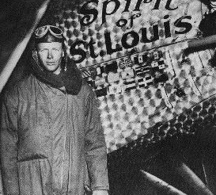
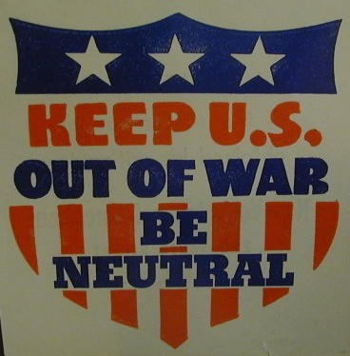
“America First” Committee
Charles Lindbergh

Slide 21
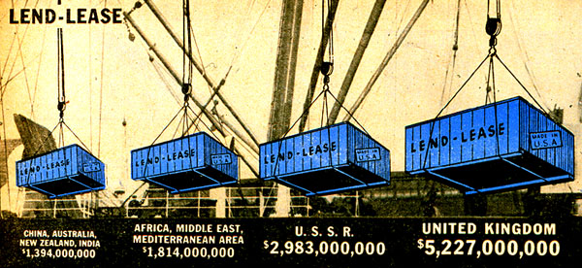
“Lend-Lease” Act (1941)
Great Britain.........................$31 billion Soviet Union...........................$11 billion France......................................$ 3 billion China.......................................$1.5 billion Other European.................$500 million South America...................$400 million The amount totaled: $48,601,365,000

Slide 22
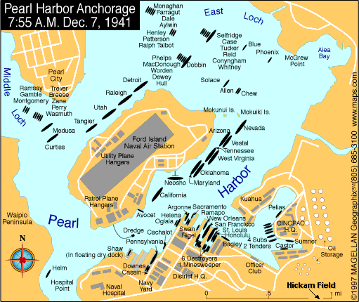
Pearl Harbor

Slide 23
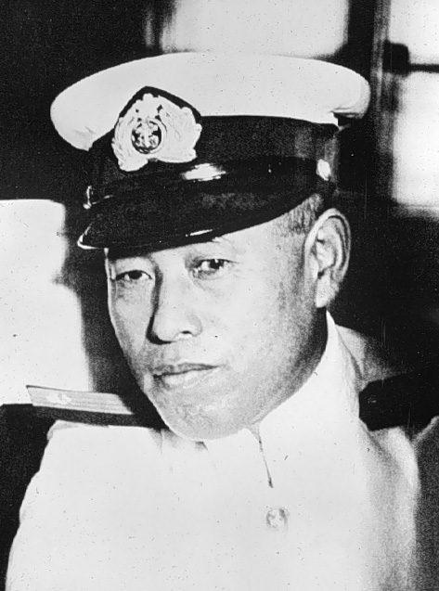
Admiral Isoroku Yamamoto

Slide 24
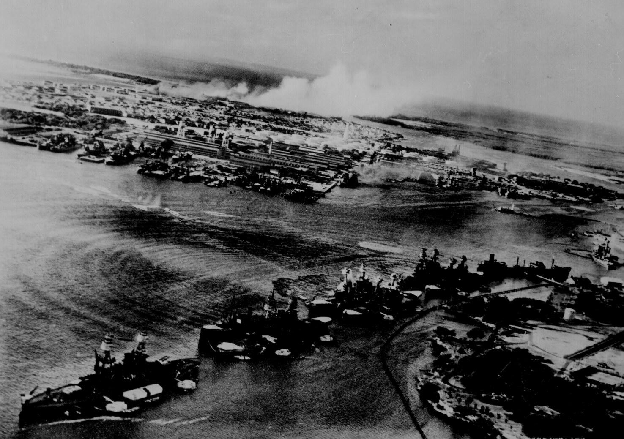
Pearl Harbor from the Cockpit of a Japanese Plane

Slide 25
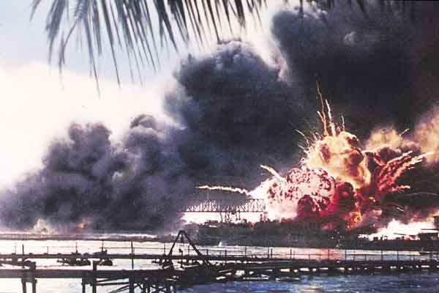
Pearl Harbor – Dec. 7, 1941
A date which will live in infamy!

Slide 26
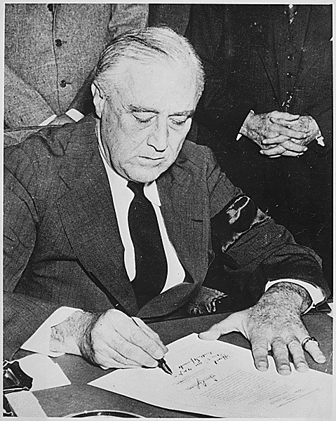
FDR Signs the War Declaration

Slide 27
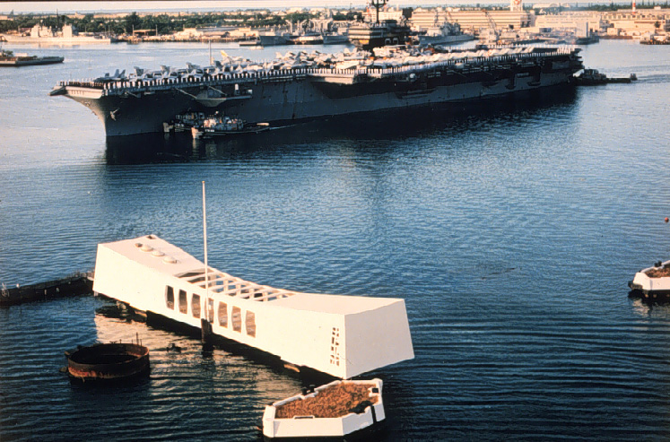
Pearl Harbor Memorial
2,887 Americans Dead!

Slide 28
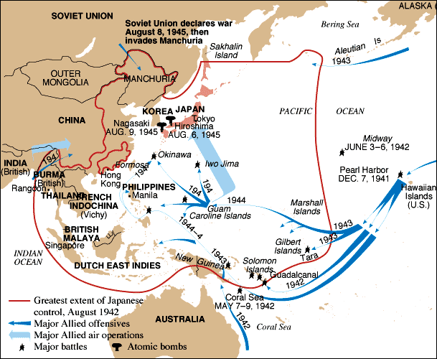
Pacific Theater of Operations

Slide 29
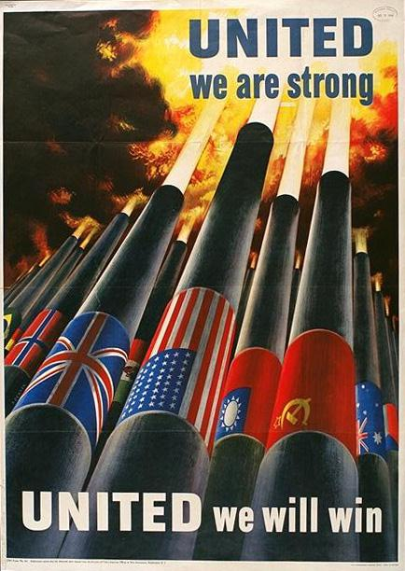
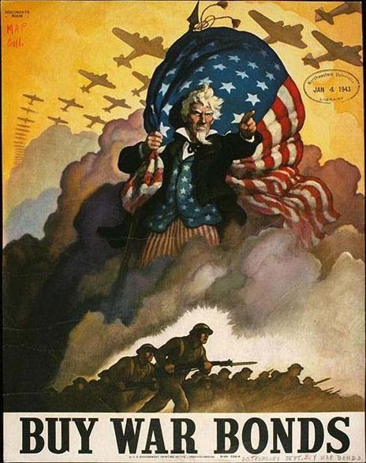
Paying for the War

Slide 30
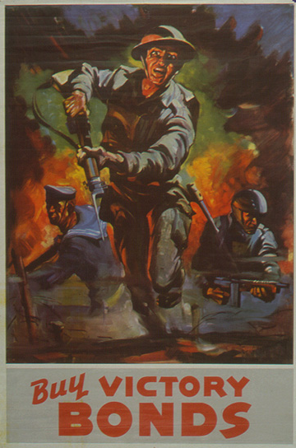
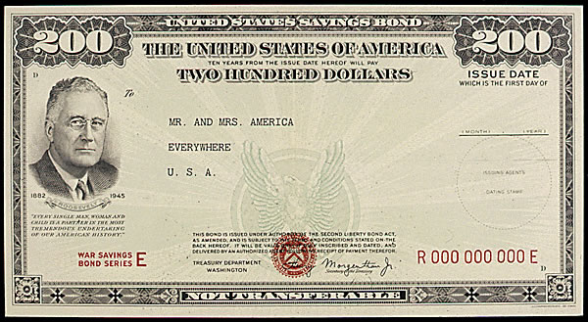
Paying for the War

