Slide 1
Paragraph Response:
Topic: Racism in the North
1. When did most African Americans (A.A.) move from the South to the North?
2. What types of jobs fueled this movement?
3. What racial problems resulted in Northern industrial cities?
4. How might the White populous of these areas enact different de-facto segregation? (In what ways?)

Slide 2
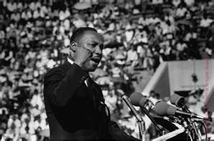
New Issues
Ch. 24.3

Slide 3
Objectives
Describe the division between Dr. Martin Luther King Jr., and the black power movement.
Discuss the direction and progress of the civil rights movement after 1968

Slide 4
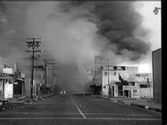
Urban African American Problems
I. Urban A.A. Problems
A. Racism
-Jobs
-Salaries
-Mortgages
B. Rioting in Urban Areas
1. Watts
2. Detroit
C. Kerner Commission
1. Plan
- jobs & public housing

Slide 5
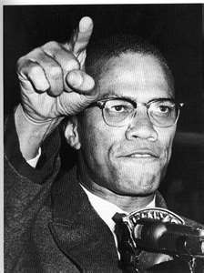
Economic Rights
II. Shift to Economic Rights
A. MLK
1. Chicago Movement
III. Black Power
A. Young African Americans
1. Greater Control
2. Cultural Pride
B. Malcolm X
1. Nation of Islam
a. black nationalism
- advocated self-defense

Slide 6
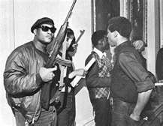
Black Panthers
C. Black Panthers
1. Revolution = equal rights
a. “Ten-Point Program”
- black empowerment
- end to racial oppression
- control of major institutions
*Schools
*Law Enforcement
*Housing
*Medical Facilities

Slide 7
MLK Assassination

